Slide 1
Accountability Tool for tablets
CYSS UNITED

Slide 2
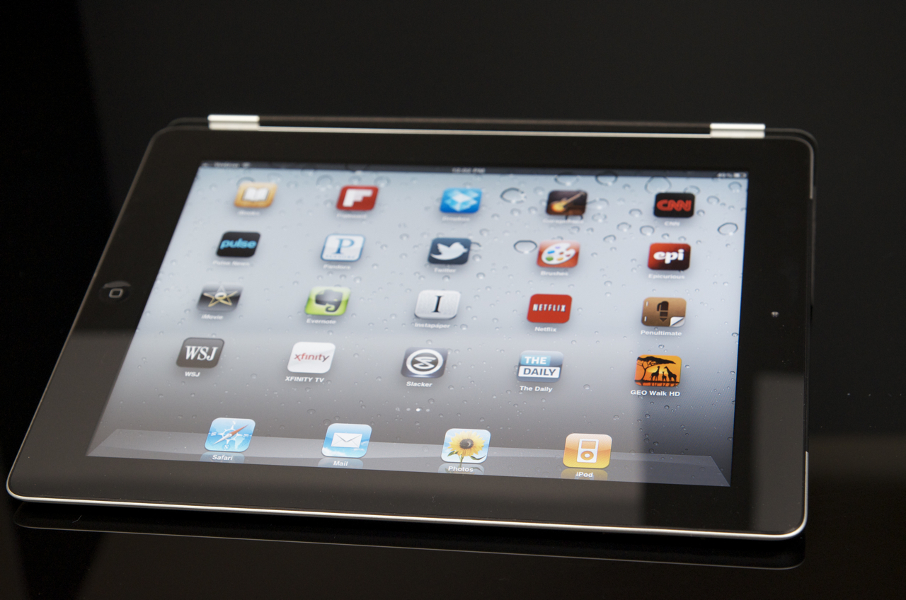
TOMS Tracking Tool (TTT)

Slide 3
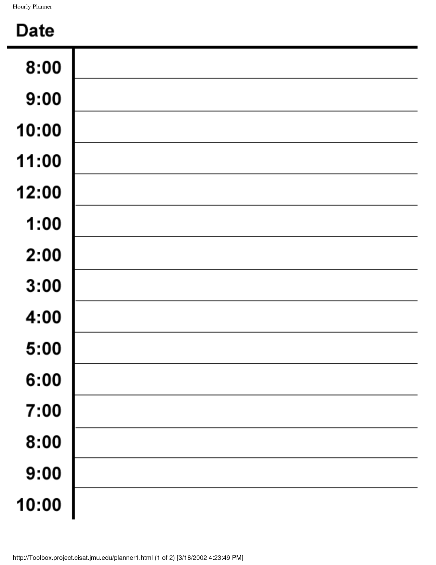
Training
Observing
Mentoring
Coaching
Supporting
Other Duties

Slide 4
Training
Tap on Category
Observing
Mentoring
Coaching
Supporting
Other Duties

Slide 5
OBSERVING
Child Observations
Conducting Assessments
Field Trips
VSS Monitoring
Competencies
Classrooms

Slide 6
OBSERVING
Child Observations
Conducting Assessments
Field Trips
VSS Monitoring
Competencies
Classrooms
Tap on sub
category

Slide 7
Drag selected box to the time on calendar.
Stretch box to indicate time spent for that activity
Tap on any selected box to add details
Ex. Monitored family style dining in Infant room #1
VSS monitoring

Slide 8
VSS monitoring
Link audio or video from classroom observation to view/save and discuss with staff
Coaching and mentoring

Slide 9
Training
61% TOMS
29% Other

Slide 10
Available on your tablet (30 days)
Track Hours/ Duties
Calculates percentages
Daily, Weekly, Monthly views
Can be printed or shared
Easy to use, saves time

