Slide 1
HQ IMCOM G9 Program Metrics
5 March 2018

Slide 2
Garrison Requirement Tools
ASIP: Army Stationing Installation Plan - provides population baseline for installation planning; basis for MILCON, Installation Status Report (ISR) cost and performance measures, RPLANS BASOPS requirements, and is used by Army Staff as the database of record for installation demographics
https://asip.hqda.pentagon.mil/
RPLANS: Real Property Planning & Analysis System - planning tool to efficiency calculate facility space allowances
  https://webrplans.hqda.pentagon.mil/
ISR-S: Installation Status Report – Services - quarterly reporting aligns performance to resources; annualized operational requirements are cost drivers for POM
https://isr.hqda.pentagon.mil/
CLS: Common Levels of Support - annual performance capability targets IAW resource availability
https://army.deps.mil/army/cmds/imcom_HQ/G5/SitePages/CLS.aspx

Slide 3
MWR Management Tools
ACRRO: Army Community Recreation Reports Online - quarterly reporting aligns delivery to baseline standards; annual aggregation of operational requirements
https://cr.xservices.com/ACRRO/
FMWR BUDGET GUIDANCE: provides HQ information, procedures, and instructions for the preparation and execution of the FY’s operating plan
https://army.deps.mil/army/cmds/imcom_G9/G9/Divisions/Pages/NAFFM_Bdgt_Analysis.aspx
FMBS WEB: Financial Management Budget System – database for annual budget and budget revisions submissions
POC: Garrison FM
SMIRF: Standard Management Information Reports for Finance – reports monthly financial statements
Located within MWR Portal (https://cloud.mwr.army.mil/)
IMETS: Installation Management Employee Tracking System – resource tool for manpower and serves as the Personnel Requirement Document (PRD)
POC: Garrison FM
RecTrac: point-of-sale system utilized for continuity and uniform reporting
  POC: Garrison Information Support Officer (GISO)

Slide 4
QDPC Lifecycle
POM
Determines
Critical
Funding
Level
ACRRO 2.0 User
Enhanced Navigation
Data Captured Quarterly
Customized, Real-Time Reports
Simplified Data Input
Facilitates CLS and ISR Reporting
Guidance
For
Coming
FY
Measure /
Report
via MIS
Year of
Execution
Risk Management –
Fund by Priority
CLS
ISR
RecTrac
ACRRO
SMIRF
IMETS
Aggregate
Data Determines
Command
Requirements
Manage
Budgets and
Performance
Cost Drivers for
Future Funding

Slide 5
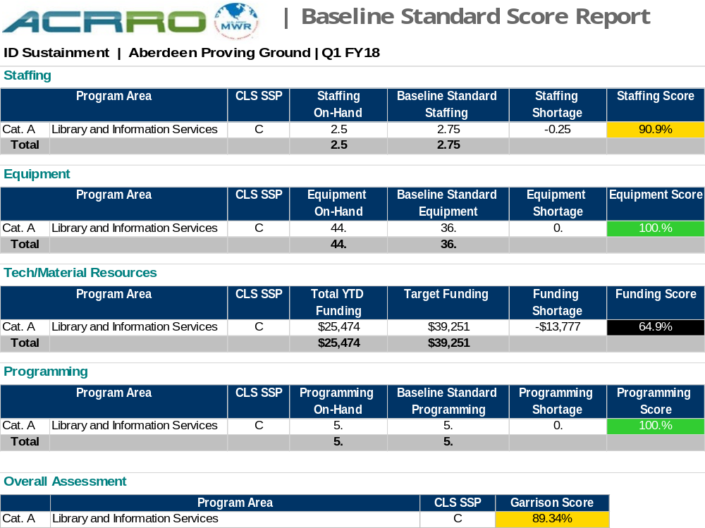
ACRRO
Measures APF allocation to APF authorized

Slide 6
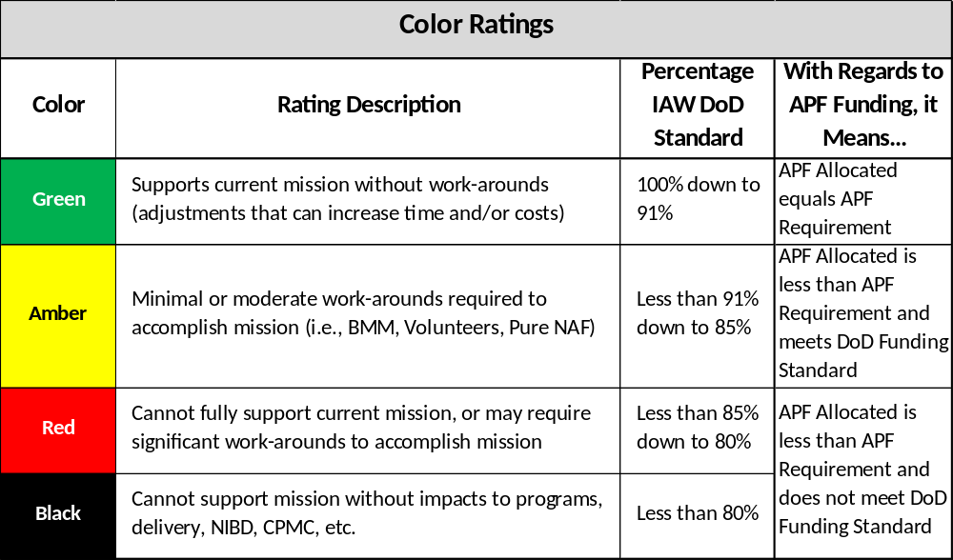
The Basics: Black, Red, Amber, Green
The Army’s readiness rating system is commonly associated with the BRAG scheme (Black, Red, Amber, Green). APF requirements are measured relative to allocated resources. It is critical to report accurate data that provides valuable insight into the “pain points” that need additional support.

