Slide 1

Professional Development Program Empower Hour
Helping you help your employees reach their full potential
5/16/2017

Slide 2
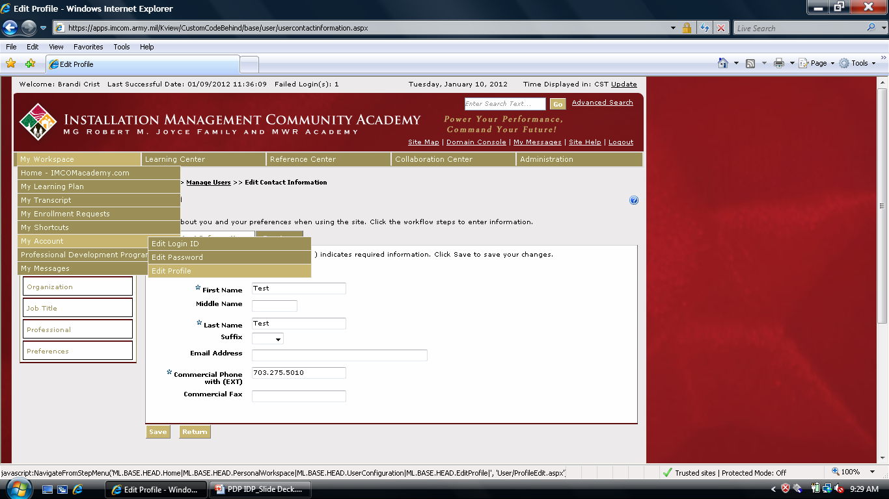
Update Profile

Slide 3
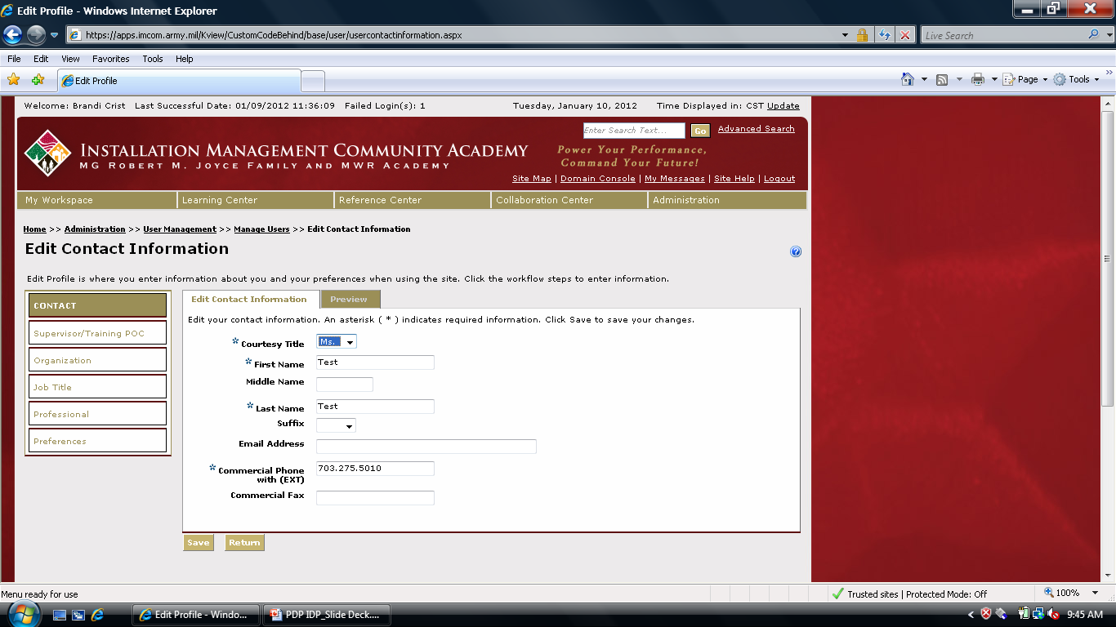
Update Profile

Slide 4
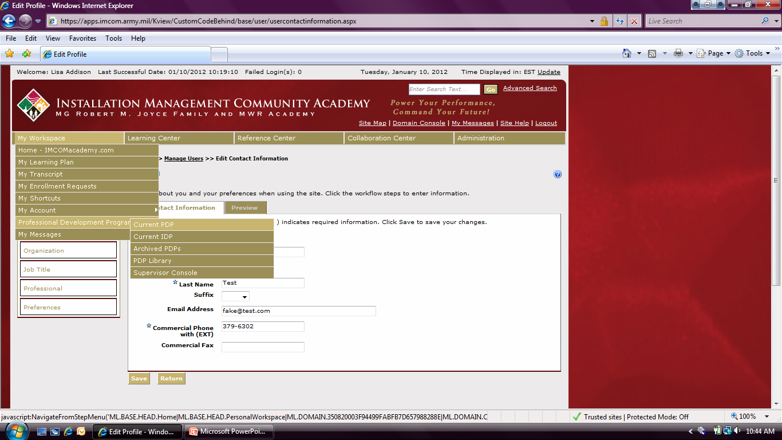
Accessing Your PDP

Slide 5
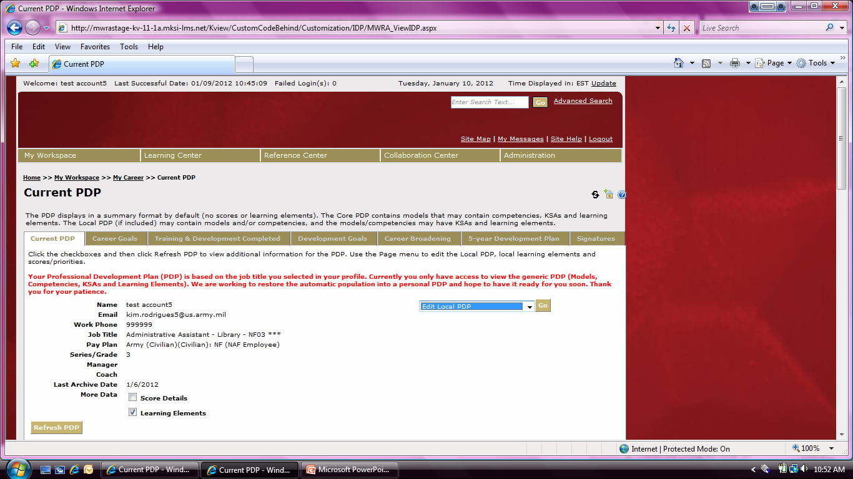
Expand view of PDP

Slide 6
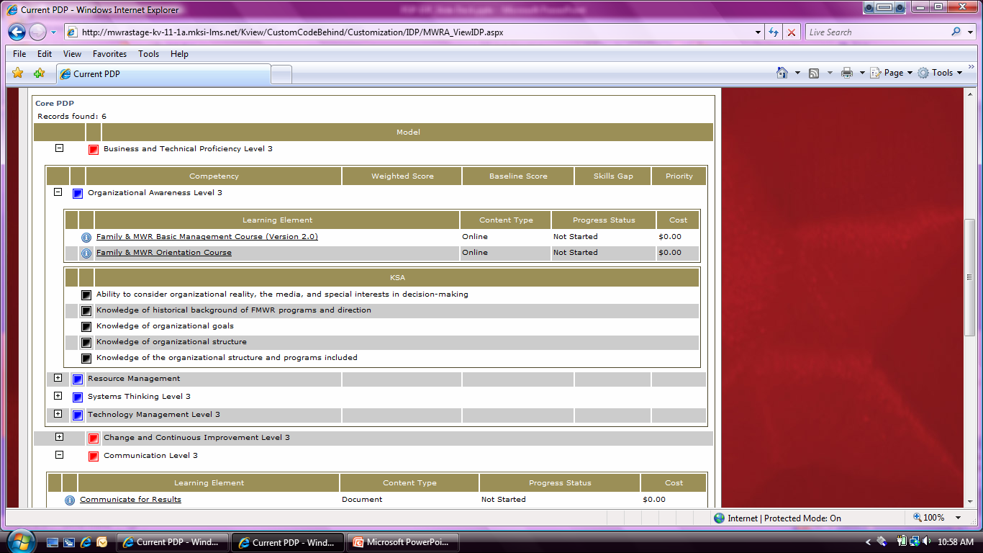
Models and Core Competencies
Red box indicates Model Competencies
Blue box indicates Core Competencies
Black box indicate KSAs
Icon indicates Learning Elements

Slide 7

PDP Elements Explained
Customer Service
Written Communication
Influence and Negotiation
Accountability
Drive for Results
Communication
Oral Communication
Strategic Thinking
Time Management
Leading and Managing Change
Resilience
Technology Management
Leadership
Change & Continuous Improvement
Teambuilding/Teamwork
Conflict Management
Flexibility
Interpersonal Skills
Leading People
Creativity/Innovation
External Awareness
Leveraging Diversity
Enabling and Developing Others
Organizational Awareness
Systems Thinking
Business & Technical Proficiency
Resource Management
Technology Management
Professional Development Program

Slide 8
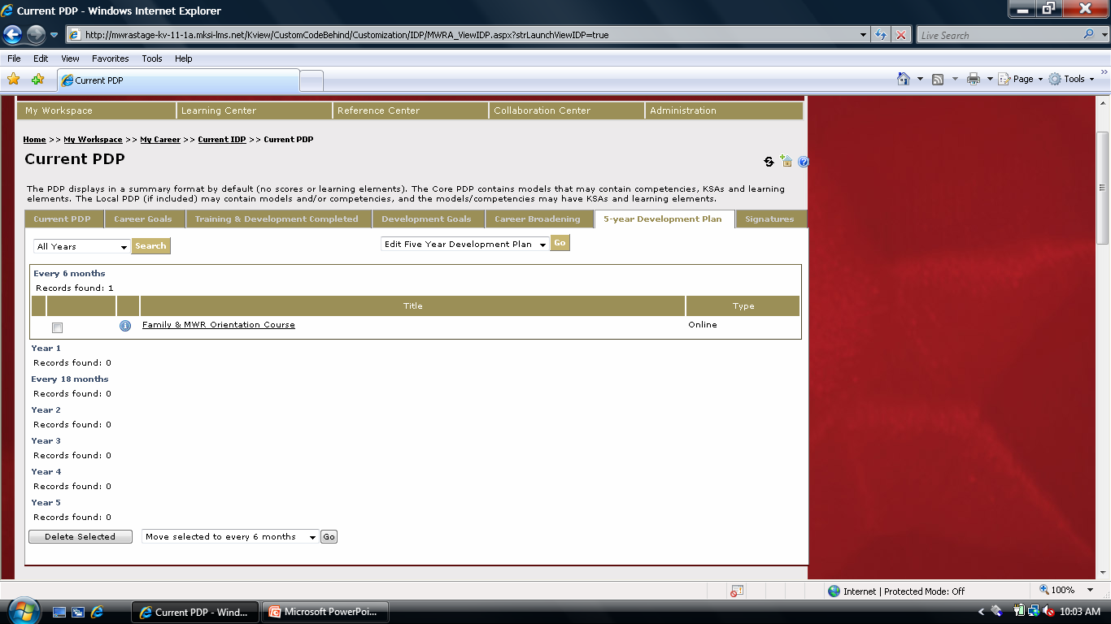
To Complete Tabs, continued
Required Tabs

Slide 9
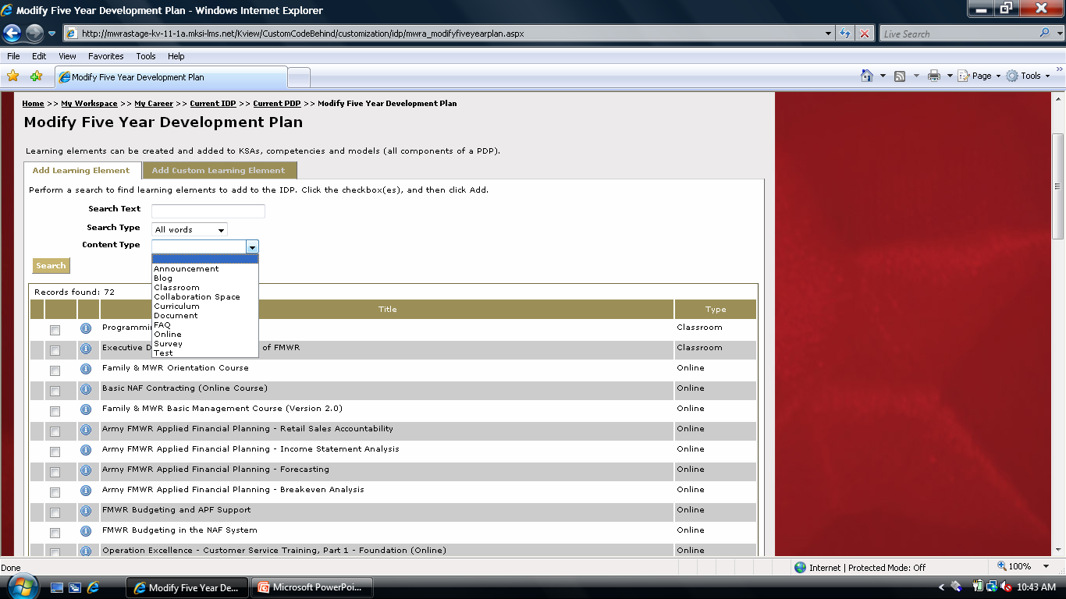
To Complete Tabs, continued

Slide 10
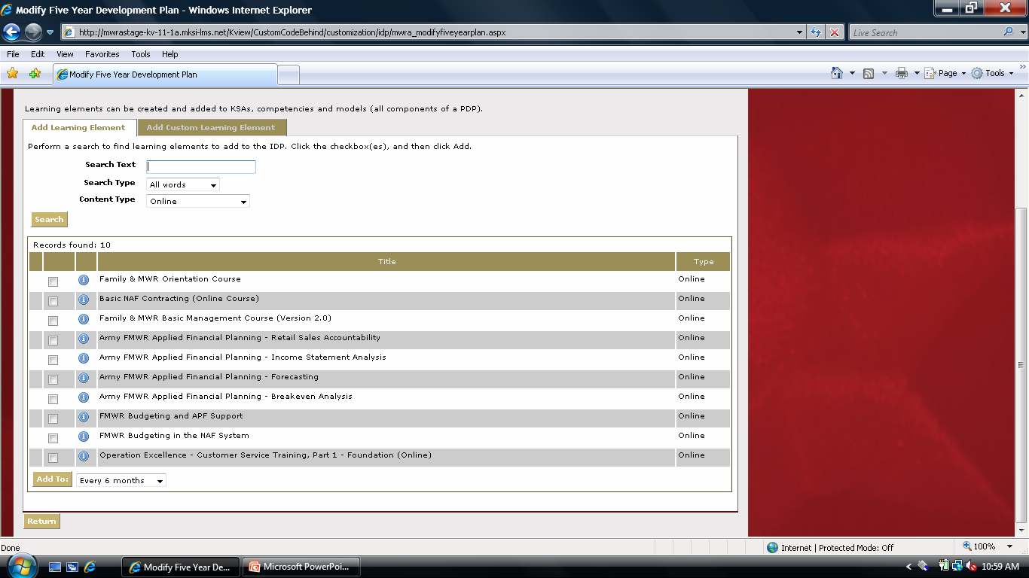
To Complete Tabs, continued
You can only add items to one year at a time, so you may need to repeat this step until you have added all items to your 5 year plan.

Slide 11
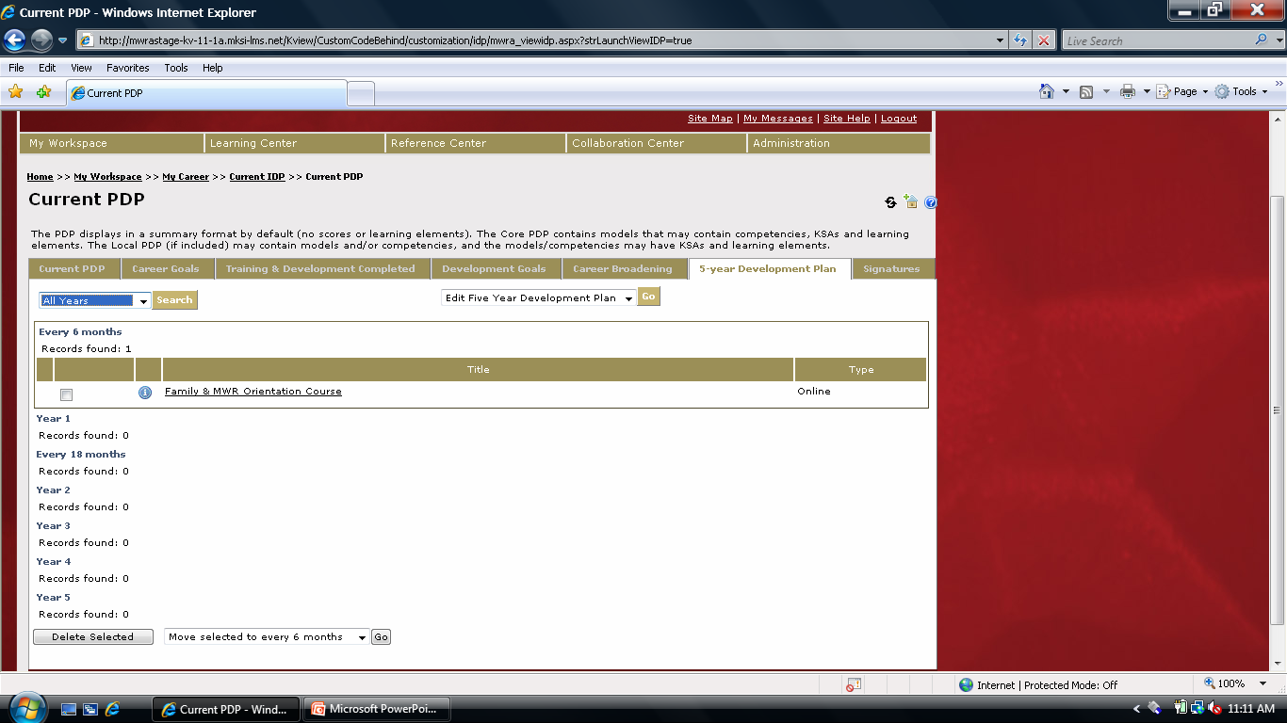
To Complete Tabs, continued

Slide 12
To Complete Tabs, continued

Slide 13
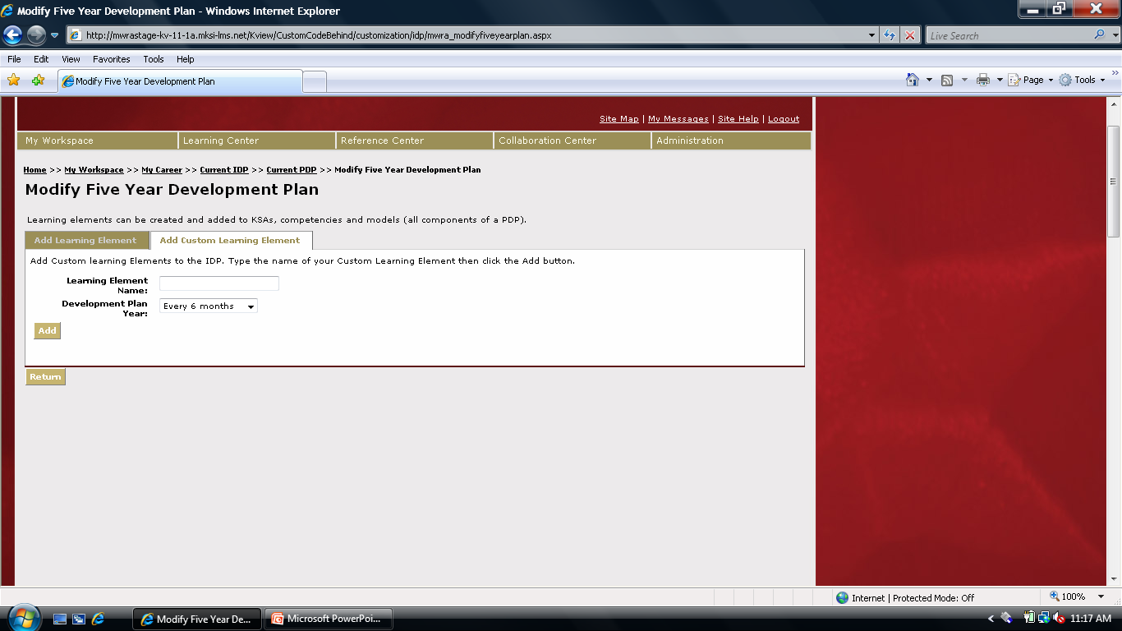
To Complete Tabs, continued

Slide 14
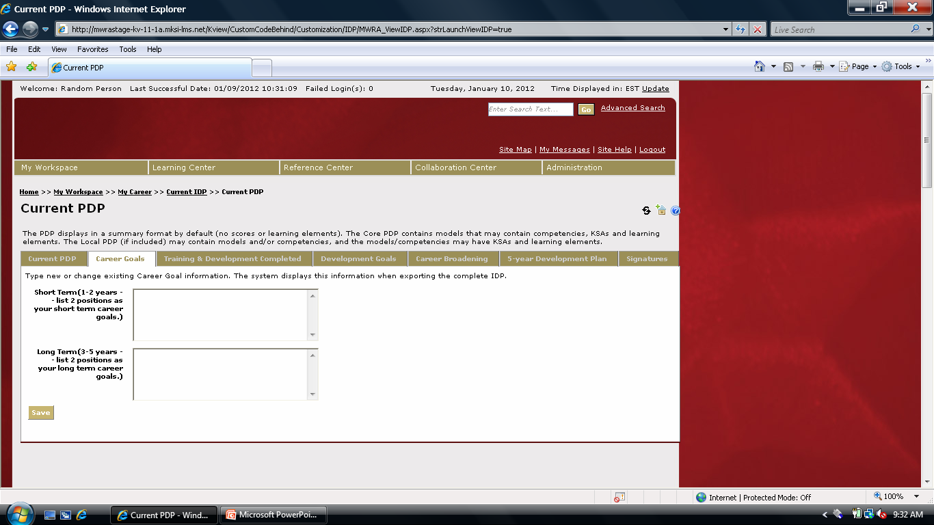
To Complete Tabs
Type Short Term Goals Here
Type Long Term Goals Here

Slide 15
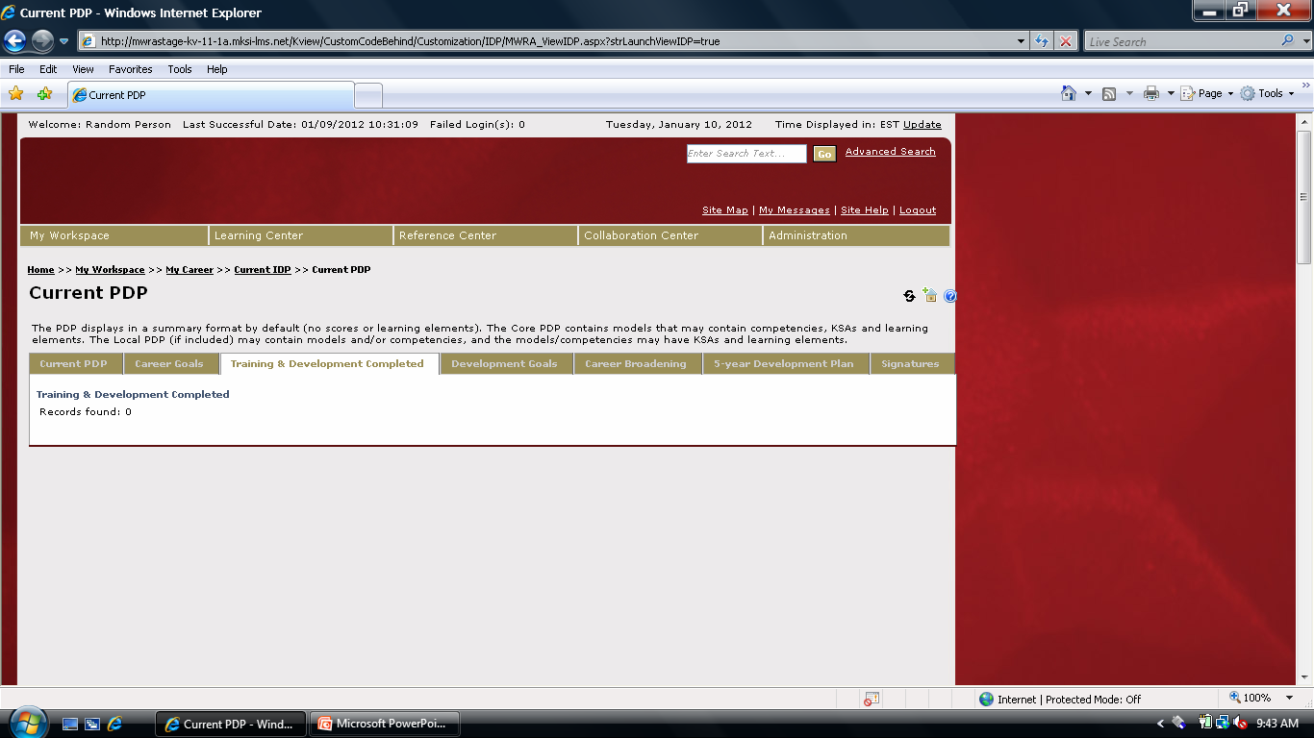
To Complete Tabs, continued

Slide 16
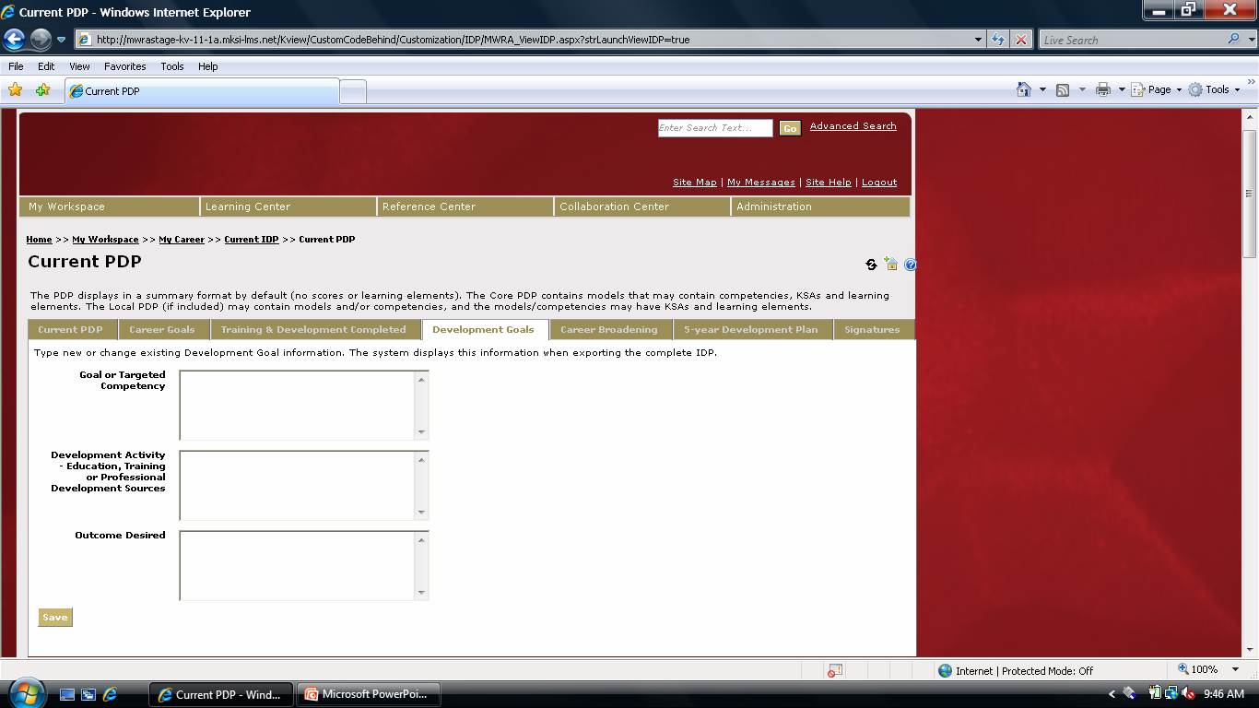
To Complete Tabs, continued
Type Core Competency Here
Type education, training, or resources required here
Type KSA Here

Slide 17
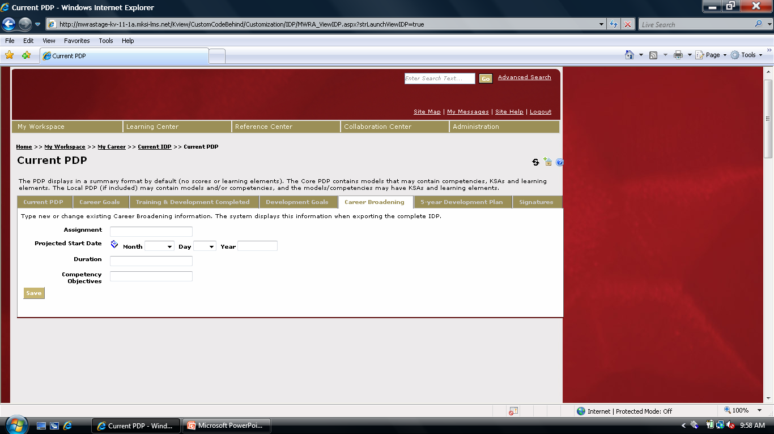
To Complete Tabs, continued

Slide 18
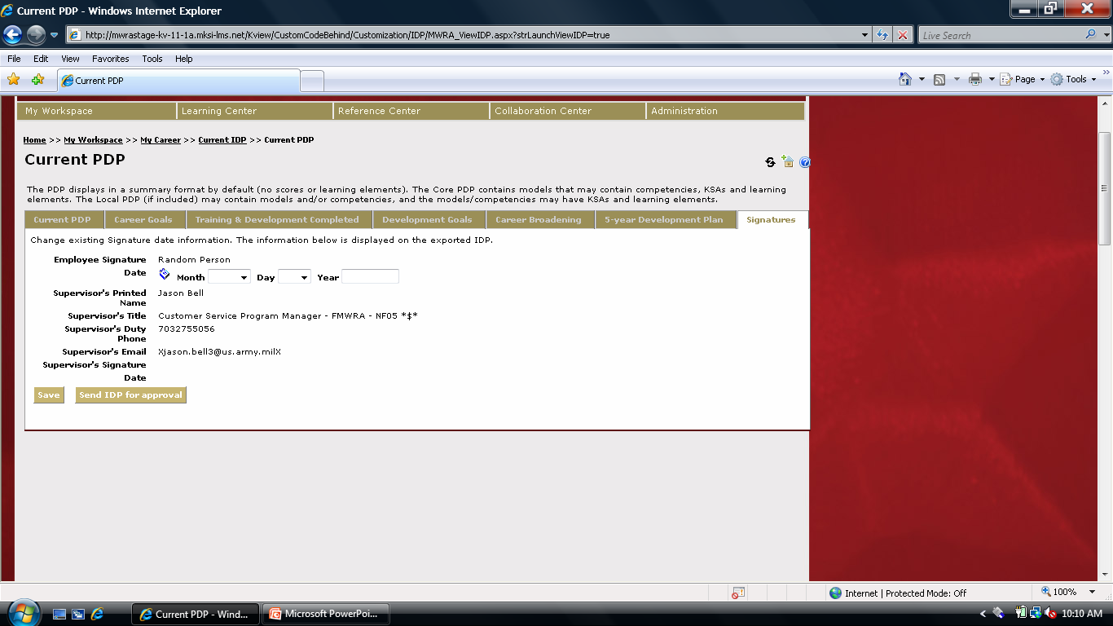
To Complete Tabs, continued
IMPORTANT: You MUST save your IDP!

Slide 19
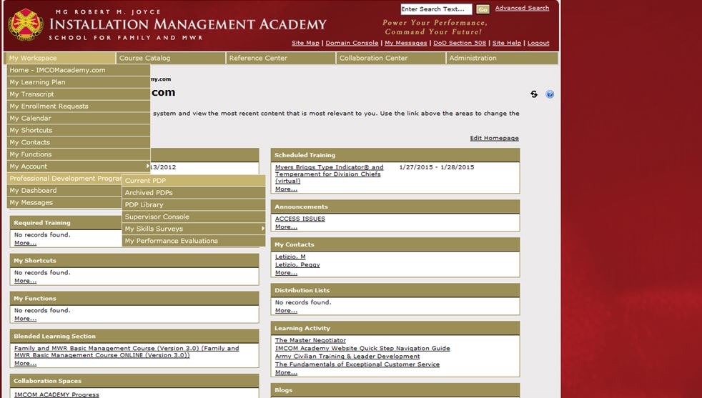
Access to view your IDP

Slide 20
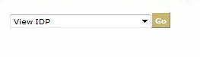
Access to view your IDP

Slide 21
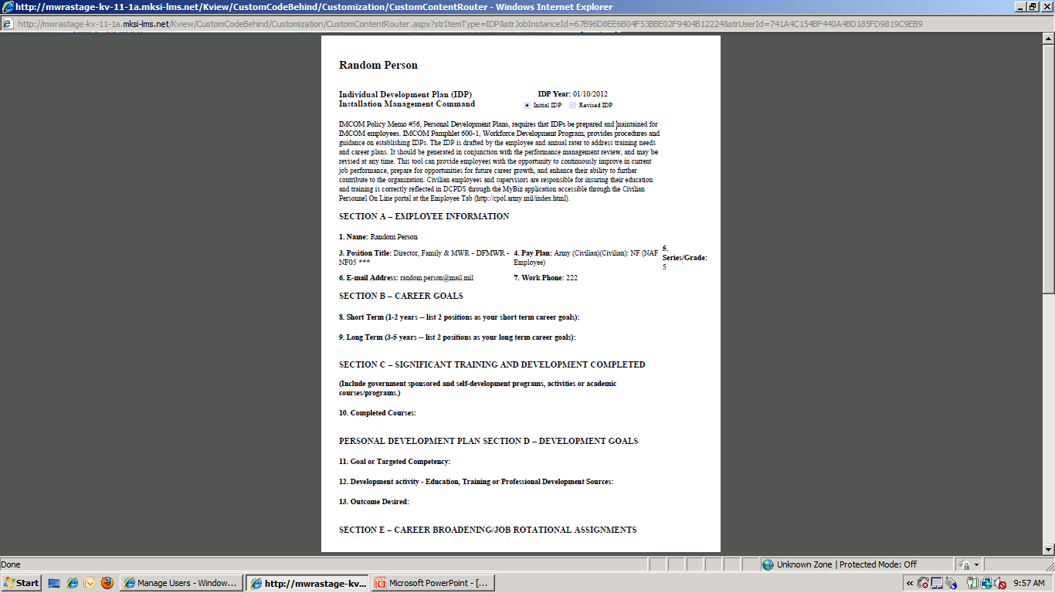
Access to view your IDP, con’t
You can print or save to your desktop.

Slide 22
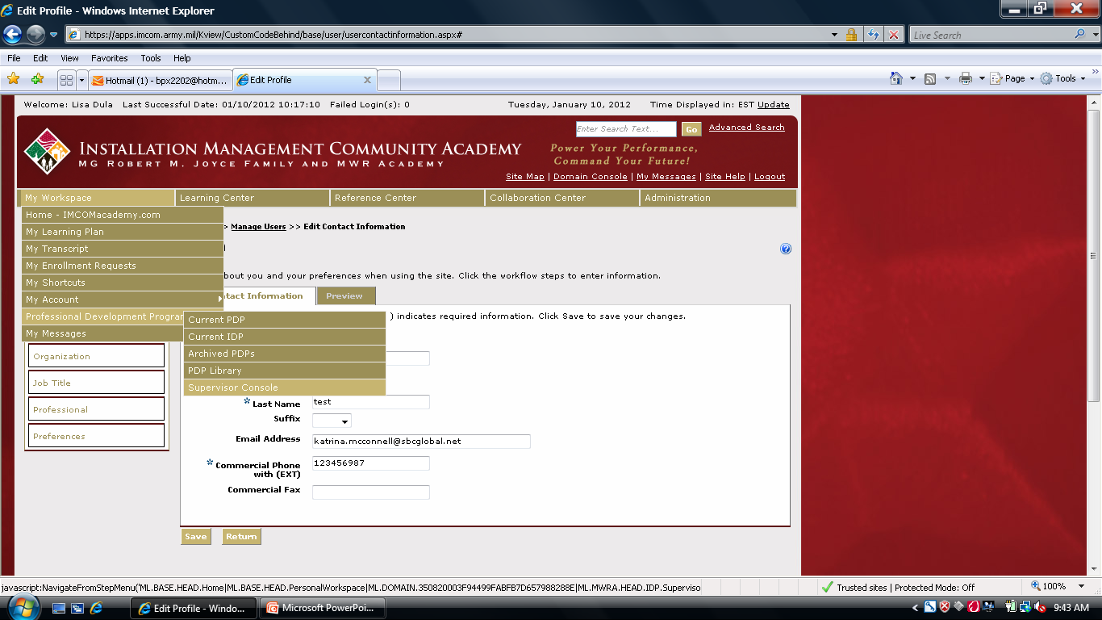
Access to PDP Supervisor Console

Slide 23
Hierarchy for viewing IDP
DFMWR
ACS Chief
BOD Chief
CYSS Chief
CRD Chief
NSM Chief
Golf Course Manager
Bowling Center Manager
Golf Team Members
Bowling Team Members

Slide 24
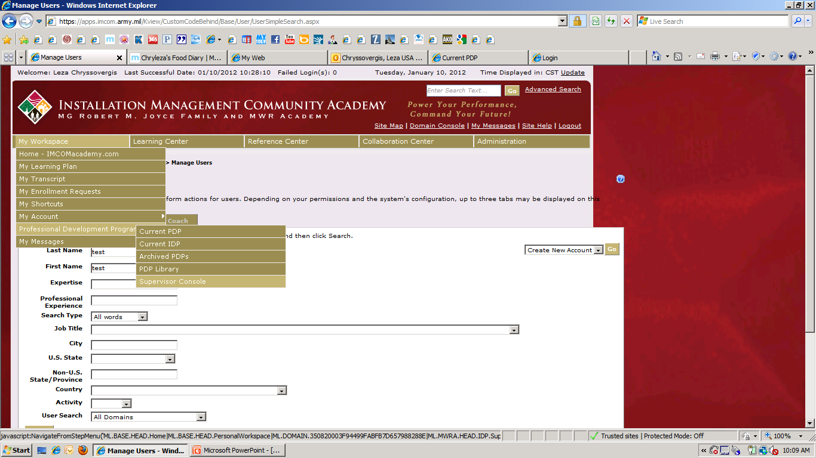
Approving IDP Form as Supervisor

Slide 25
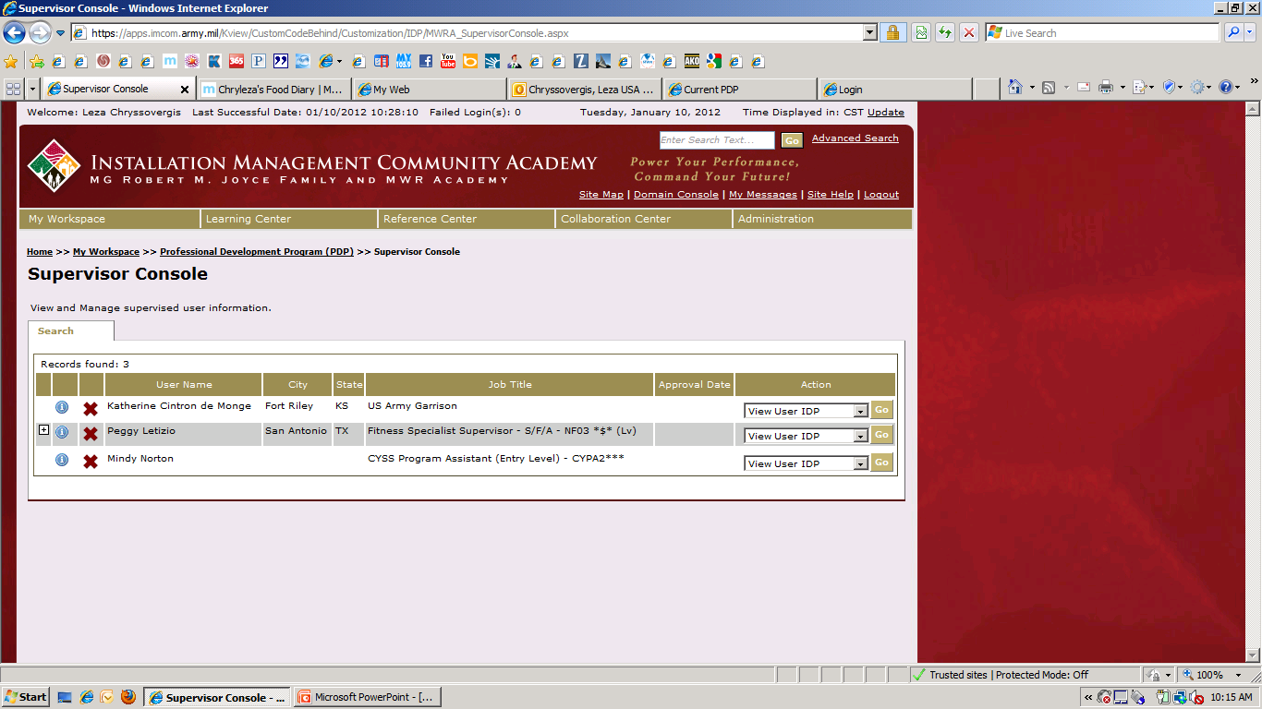
Approving... con’t
Expand to see who your employee supervises
IDP will launch in a new window.

Slide 26
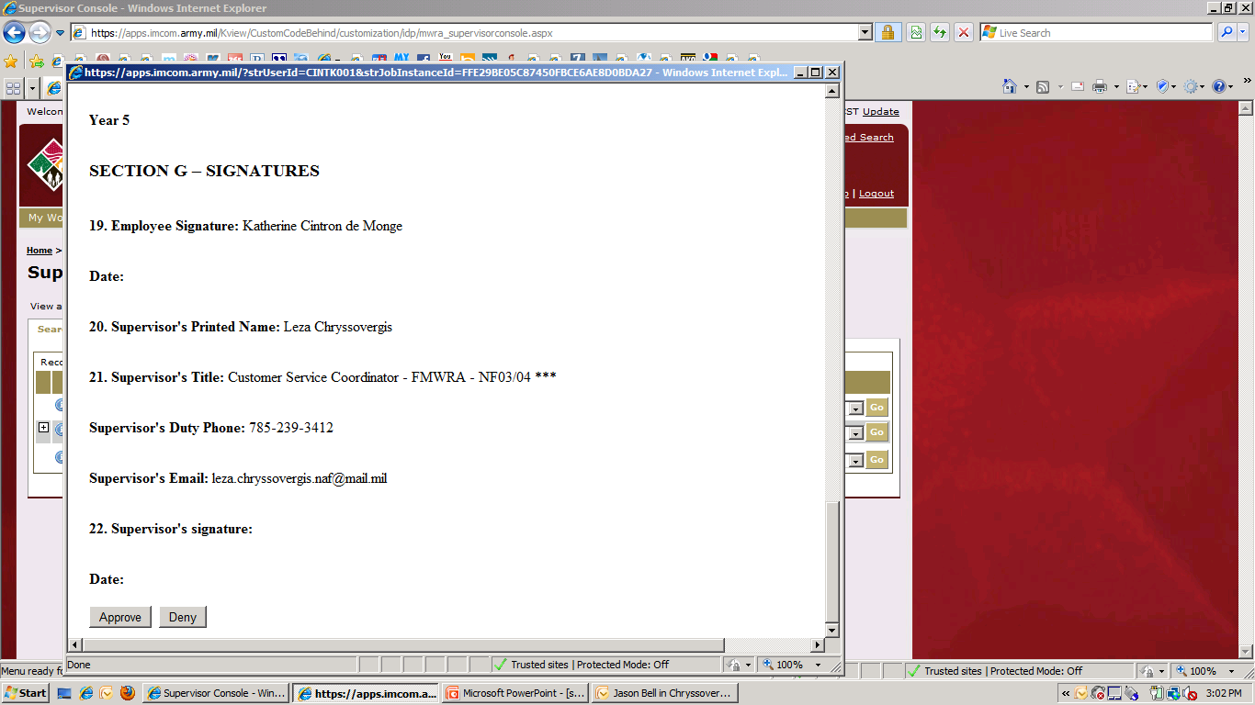
Approving... con’t
If you approve, an email is generated to your employee notifying of approval status and a green check is next to that employee on supervisor console.
If you deny, an email is generated requesting employee contact you to discuss IDP and a red X is next to that employee on supervisor console.

Slide 27
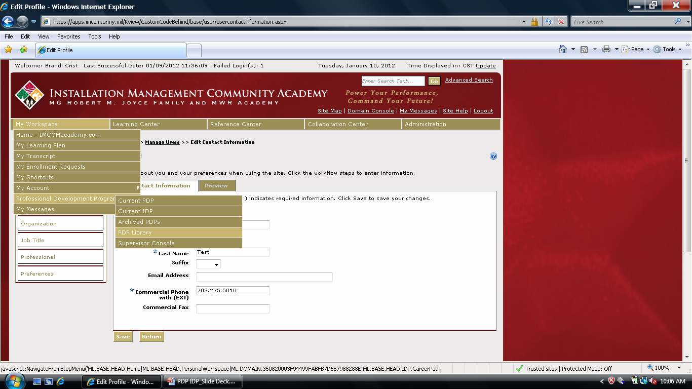
Access PDP Library

Slide 28

Access PDP Library
Leave the “Search Text” field blank and click “Search” to pull up all PDP’s
Type a key word in the “Search Text” field and click “Search” to find a specific PDP

Slide 29
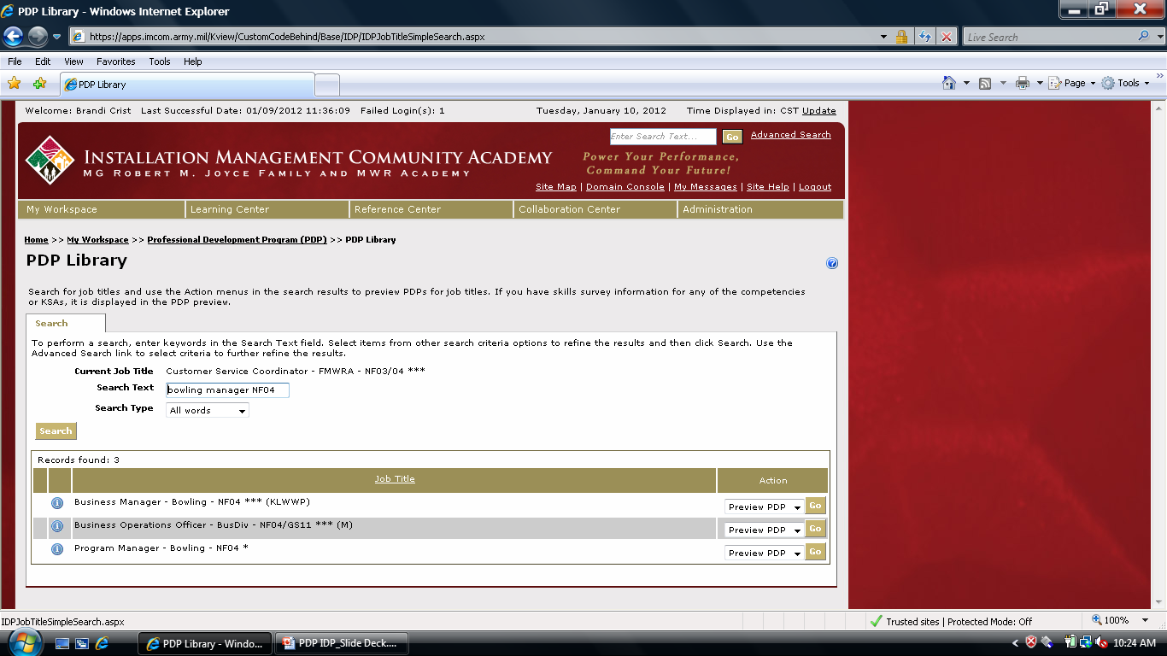
Access PDP Library

Slide 30
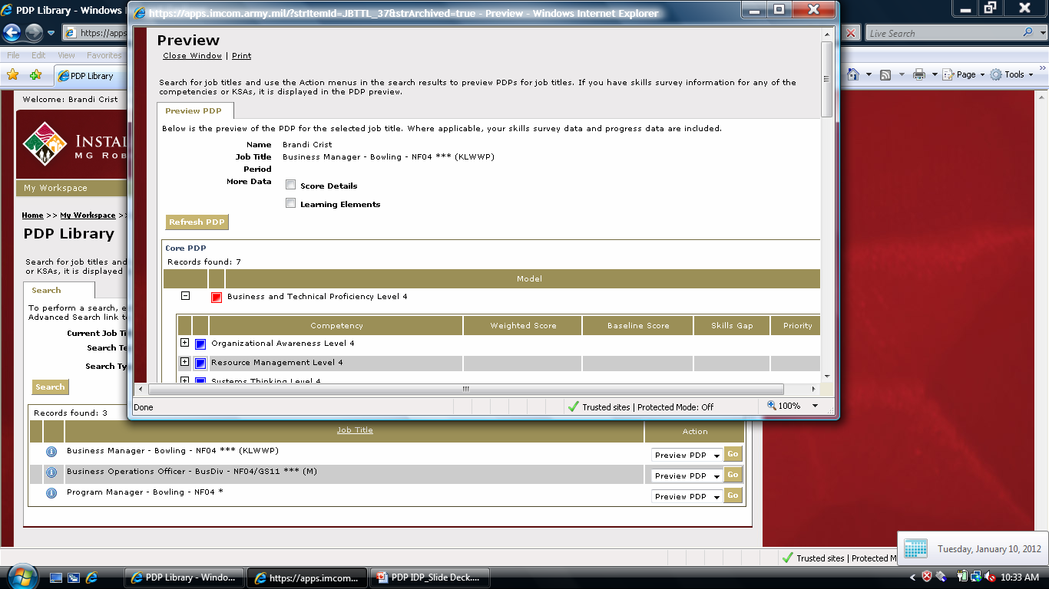
Access PDP Library

Slide 31
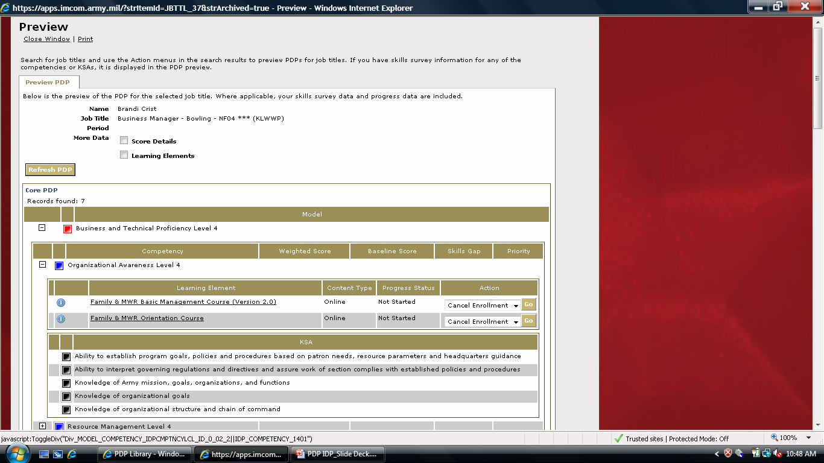
Access PDP Library

Slide 32
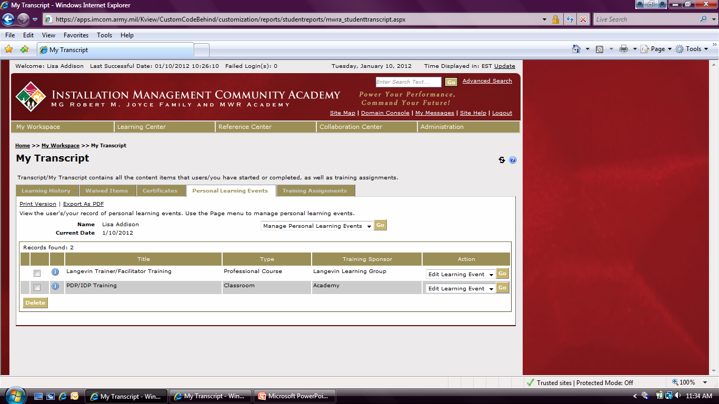
Access to add User Learning Events
My Workspace, My Transcripts

Slide 33
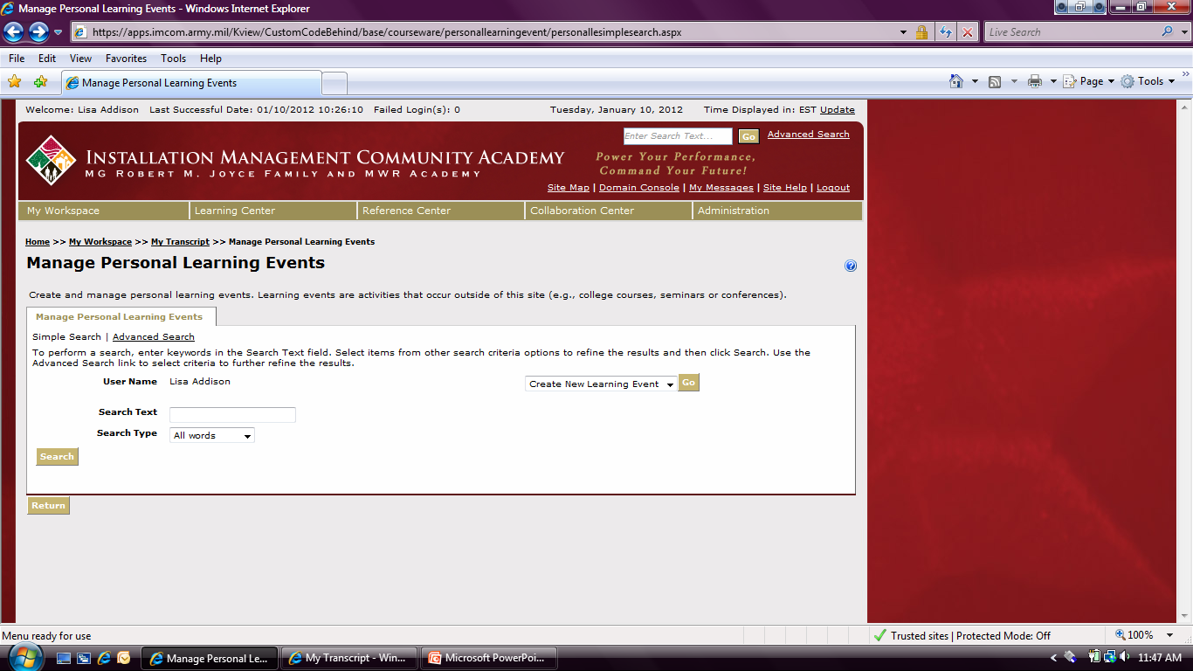
Access to add User Learning Events

Slide 34
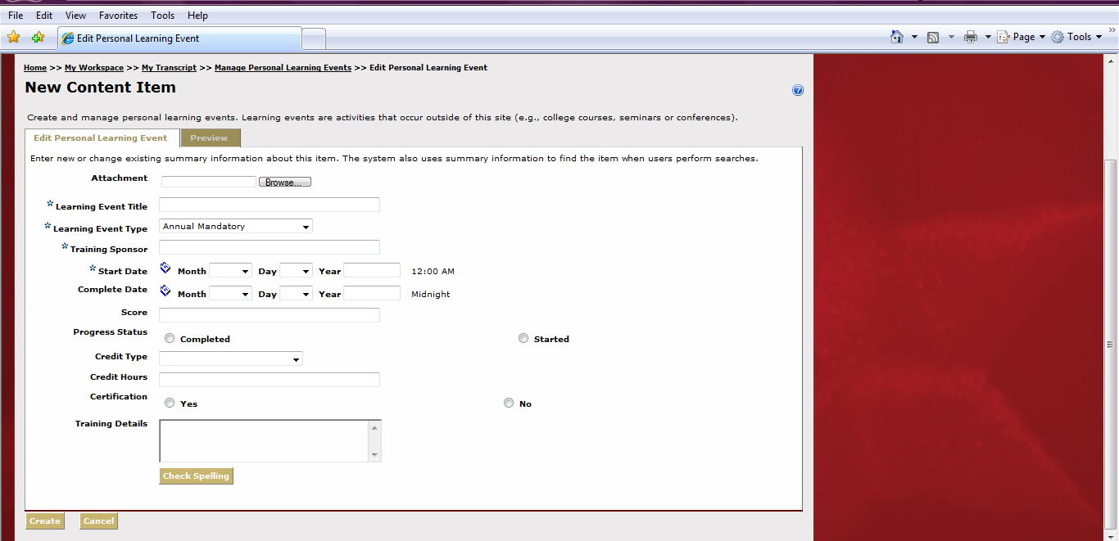
Add Learning Element
Fill in all necessary fields (all fields with * are required) and click Create
You will receive an email confirming your training has been added.
An email will also be sent to your supervisor

