Slide 1

NAF Financial Management for Program Managers
MG Robert M. Joyce School for Family and MWR
IMCOM G 3/5/7 Training Division

Slide 2
Meet your
School for Family and MWR
Training Team!
James Moore
Matt Jobe

Slide 3
Introductions
At Your table:
  Name
  What do you do for Family and MWR?
  How many years have you been with Family and MWR?

Slide 4
Policies and Procedures
Attendance
  Class time is 0800-1700 daily
  You must attend every session to receive credit for the course (AM & PM)
  Failure to meet this requirement will result in an incomplete
  Cannot miss more than 5% of class to earn credit
Lunch/Breaks
  Lunch- 1 hour
  Breaks- 2 per day (AM & PM)
Classroom Expectations
  Be on time for class and returning from breaks
  Actively participate in group discussions and exercises
  Complete all assignments
  Respect your fellow participants
  Place cell phones on silent or vibrate

Slide 5
Syllabus and Information
Participant Guide
    Helpful for taking notes
    Assignment Instructions
Syllabus
    Agenda
    Graded Assignments
    Course Credit
      2.6 CEUs
      3 college semester hours in financial management in the upper-division baccalaureate degree category
Mobile Training Documents (electronic)
    https://www.imcomacademy.com/ima/?page_id=11999
Individual Action Plan

Slide 6

Individual Action Plan
    Actions are clearly stated and based on application of knowledge gained during the course
    Actions are within the control of the individual and include an end date for completion
    Measurements of success are quantitative and measure the success of attaining the action

Slide 7
Expectations

Slide 8
NAF Financial Management
Course Objectives
Given NAF financial management protocols, interpret and relate specific guidance to NAF program operations in accordance with AR215-1, Chapter 16 and annual IMCOM G9 Program Budget Guidance.
Given a NAF Income Statement, analyze its components to distinguish ways the information can be used to make program operating decisions in accordance with AR 215-1 and annual IMCOM G9 Program Budget Guidance.
Given a NAF Variance Report and other historical financial reports, interpret data to identify trends and recommend corrective action if needed in accordance with AR 215-1, Chapter 16.
Given a scenario, consider the role of the manager in proper labor scheduling and budget monitoring to ensure short and long term financial success.

Slide 9
NAF Financial Management
Course Objectives
Given an overview of the budget process, examine IMCOM and garrison strategic guidance and historical data for budget applicability to determine five year program requirements for inclusion in the Manager’s Narrative IAW AR 215-1.
Given a scenario, consider future program requirements to formulate an annual NAF operating budget for one program to meet identified future requirements in accordance with annual IMCOM G9 Program Budget Guidance.
Given the CPMC Process and a CPMC decision matrix, examine the program manager’s role in CPMC management in accordance with legal, Army, IMCOM and/or Garrison imperatives.

Slide 10
Why Make Money?
Group Exercise
Why is it important for your program to breakeven or make a profit?
You will work as a group
Chart your answers
Choose a scribe and spokesperson to brief your results

Slide 11
Why Do We Need to Make Money?
Other Expenses
Other Operating Expenses
REQUIREMENTS
Cost of Goods Sold
Labor
Expenses

Slide 12
Why Do We Need to Make Money?
Sales
Other Income
NIBD +8%
Other Operating Income
NIBD +8%
BREAK EVEN BREAK EVEN
Other Expenses
Other Operating Expenses
REQUIREMENTS
Cost of Goods Sold
Labor
Revenue – Expenses = Net Income (Profit/Loss)

Slide 13
Module 1
Introduction to NAF Financial Management

Slide 14
Module 1 Objectives
Identify and interpret NAF regulations and operating guidance
Explain sources and streams of funding for FMWR programs
Relate the UFM process to your own program funding sources

Slide 15
What do you know?
– Funding Categories
1. Which of the following are the basis for categorization of Family and MWR activities? (Select all that apply)
The relationship of the activity to readiness & retention
The size of the installation
The activity's ability to generate revenue
Availability for corporate sponsorship

Slide 16
What do you know?
– Funding Categories
2. Category C activities are never authorized to use APFs.
True
False

Slide 17
What do you know?
– Funding Categories
3. There are activities with ties to Family and MWR that are NOT in Category A, B, or C.
True
False

Slide 18
FMWR Funding Categories (Review of BMC Module 7)
Category
Mission Sustaining Activities
Critical for retention and readiness of Soldiers
Category
Enhanced Community Support Activities
Category
Business Activities
Little or no ability to generate NAF $
Examples: Libraries, recreation centers, and fitness/sports operations
Examples: CYS, arts and crafts, auto crafts, bowling centers with 16 or less lanes, & outdoor recreation services
Have potential to raise a limited amount of NAF $, but lack the ability to sustain themselves based purely on their business.
Examples: Clubs, golf courses, & bowling centers
Business activities with highest capability of generating revenues
Some exceptions for remote sites & OCONUS installations
MIX APF & NAF
Authorized 100 % APF
NAF FUNDED
Minimum standard is 85% APF
Minimum standard is 65% APF

Slide 19
Knowledge Check
What are Appropriated Funds?
What is the difference between direct APF and indirect APF?
What are Nonappropriated Funds?
Funds set apart for a specific use/purpose by Congress
Direct APF is funding received by FMWR as MWR APF (through the UFM Process) in MDEPs QDPC and QCYS. Indirect APF is generally received through the use of Garrison-wide service ( such as utilities and custodial )
NAFs are funds generated to augment those appropriated by Congress.

Slide 20
Knowledge Check
What are two sources of NAF that are not locally generated from sales or other operating income?
Name at least 3 offices that have responsibility for managing NAF.
Name at least 1 regulation that governs the use of NAF.
ARMP and AAFES Dividend
What is the local contribution from AAFES?
Garrison NAF FM, NFS, ID NAF FM, G9 NAF FM, etc.
AR 215-1 ● DODI 7000.14-R ● AR 11-2 ● DFAS IN 37-1

Slide 21
Group Activity
You are a Program Manager
  What are at least 5 considerations you need to be financially successful?
  Why?
You will work as a group
Chart your answers
Choose a scribe and spokesperson to brief your results

Slide 22
Group Activity
You are analyzing a Cat C Bowling Center that has lost money for 2 straight quarters.
What are at least 5 considerations you need to address to become financially successful? Why?
Each group will be assigned a level
  - Garrison/DFMWR - Program Manager
  - ID - Division Chief
  - Headquarters
Chart your answers
Choose a scribe and spokesperson to brief your results

Slide 23
Regulations and Policies
Legal & fiduciary responsibilities for proper use of APF & NAF
  AR 215-1: Military Morale, Welfare, and Recreation Programs and Nonappropriated Fund Instrumentalities
  IMCOM Reg 215-1-1: Installation Management Command (IMCOM) G9, Family and Morale, Welfare, and Recreation (FMWR) Business Operating Standards (IMCOM BOS)
  DODI 7000.14-R, Volume 1-16: Financial Management Regulation
  AR 11-2: Managers’ Internal Control Program
  DFAS-IN Regulation 37-1, Ch. 32: Accounting Procedures for Army Nonappropriated Fund Instrumentalities
Operating Guidance/Standard Operating Procedures

Slide 24
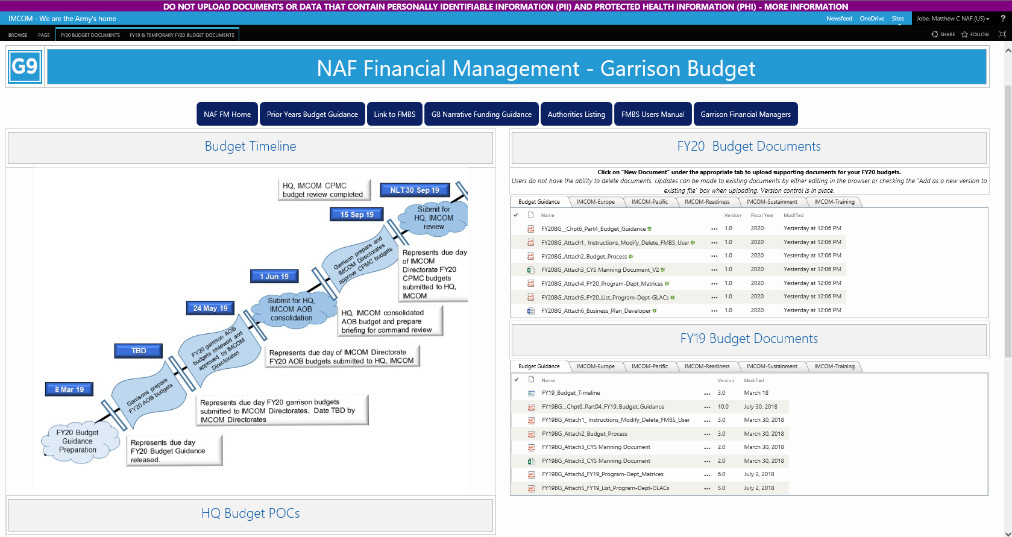

Slide 25

NAF and NAFI
Nonappropriated Funds (NAF)
  Government funds
  Not appropriated by Congress
  Same fiduciary responsibility as for Appropriated Funds (APF)
NAF Instrumentality (NAFI)
  Maintain custody & control of NAFs
  Tax exempt
  Separate FMWR, Lodging, Chaplains, Civilian Welfare, Post Restaurant Funds
  Considered “fenced funds” because one NAFI may not be used to cover the expenses of another NAFI
Notes:
Nonappropriated Funds:
Cash and other assets received from sources other than funds appropriated by congress. They are normally predominantly locally generated.
NAFs are government funds used for the collective benefit of those who utilize the programs MWR offers.
NAFs are separate and apart from funds on the books of the Treasurer of The United States.
Money collected for goods and services offered to authorized patrons (See AR 215-1, Sec 6-2 or Table 6-1, page 19). We have 30 categories of authorized patrons. GC determines who gets service. Generate between $800-$900 M in yearly revenues.
NAF Instrumentalities are:
A DoD Organizational Entity Which:
Performs An Essential Government Function. Assists in recruiting and retention, adds to QOL.
Acts In Its Own Name To Provide MWR Programs.
Maintains Custody Of And Control Over Nonappropriated Funds. (Fund Manager) AR 215-1, Sec 5-6.
NAFI’s Not Incorporated Under The Laws Of Any State.
Enjoy The Legal Status Of An Instrumentality Of The United States. AR 215-1, Sec. 3-1.
Tax Exempt.
MWR not the only NAFI on installation – Sunday collections in military chapels deposited into Chaplains’ Funds, Billeting/Lodging separate from MWR, etc. We don’t share our $ with them, and they don’t share with us. See AR 215-1, Sec. 4-8 page 8 for additional supplemental mission NAFIs.
Supplemental Mission NAF accounts, see AR 215-1, Sec 4-7, page 7.

Slide 26
Fund Manager
Appointed
Monitors FMWR activities
Ensures management controls are in place
Notes:
Will have Fund Manager for IMWRF whose responsibilities are as you see here.
Monitors MWR activities for regulatory compliance, especially regarding internal controls (Cash Control System, Retail Sales Accountability, Physical Security).
They ensure a series of checks and balances/ separation of duties are in place and functioning.
The volume of cash transactions is how NAF is different than APF. Unrecorded cash is easy to steal, this is why NAF puts such a great emphasis on capturing a record of cash as it is received.

Slide 27
Funding
Describe a way your program/activity has received funding/revenue in the last quarter
Sales – Hot dogs, drinks, etc. (G)
Pro-shop (G)
Catering (G)
Sponsorship (G)
Donations (G*)
UFM (F)
Service Income (G)
Recycling Income from Garrison (F)
AAFES Dividend (F)
ARMP (F)
APF under an MOA (G)
  (F) Funded
  (G) Generated

Slide 28


Uniform Funding & Management
What is it? A Process.
UFM
    Procurement of property and services for FMWR
    Management of employees to provide the programs
    Financial reporting and management
UFM is a DOD-wide FMWR initiative
You know the UFM process as “GL”

Slide 29
UFM Cont.
How does it work?
MOA between Government and NAFI serves as basis for transferring APF to NAF
  Outlines FMWR requirements and funding
  Payment schedule
  Purpose for which funds are to be used
Government creates upfront obligation, accrual, expense and disbursement of APF to the NAFI based on MOA payment schedule
Once transfer occurs, NAF management and accounting systems are responsible for tracking and reporting use of dollars

Slide 30
UFM Cont.
Authorized pursuant to 10 U.S.C. 2491
  Regulatory implementation is DoDI 1015.15
Available only for FMWR programs and only for authorized APF expenses
  Table D-1 in AR215-1
  Exclusions: Army Community Services (ACS), Army Lodging, and other Supplemental Mission programs (i.e., museum funds) are not eligible since these are not defined as military FMWR per DoDI 1015.15
UFM does not increase or decrease funding. It is an alternate means of execution.

Slide 31
Funding Levels
How are individual Garrison FMWR APF funding levels determined?

Slide 32
That’s All We Get?!?
How are individual Garrison FMWR APF funding levels determined?
QCYS
Funding by Space
Garrison-level Reporting = “Negotiated Spaces”
QDPC
FMWR Baseline Standards
Garrison-level Reporting = ACRRO
Direct APF Fund Support
FMWR APF via the UFM Process into MDEPS
Divide Available Army-level Funding

Slide 33



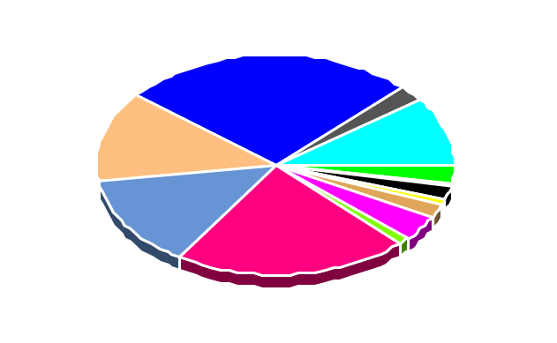
Uniform Funding Management (UFM)
APF
APF
NAF via UFM
**Timely Allocations are key to execute MWR Programs
Appropriated Funds allocated from Army Budget Office
Per annual MOA IMCOM G8 allocates funding to QDPC / QCYS and signs and submits 1034 to DFAS
Processes 1034 and does an Electronic Fund Transfer (EFT) to Army Banking and Investment (ABIF/IMCOM G-9). Funds are now considered NAF
ABIF/IMCOM G-9 deposits into individual garrison bank accounts to fund program expenses
CATEGORY A
CATEGORY B
CATEGORY C
MISSION SUSTAINING
(QDPC)
MISSION SUSTAINING
(QDPC)
BASIC COMMUNITY SUPPORT
(QDPC & QCYS)
BUSINESS ACTIVITIES
Physical Fitness
Libraries
Recreation Centers
Unit Activities
Army Lodging
Bowling / Golf
Army Recreation Machines
Clubs
Armed Forces Recreation
Centers
Auto/Arts & Crafts
Child Development / Youth Svcs
Outdoor Rec. / Entertainment
Information, Tours, Referral
Per DODI 1015.10 Authorized minimum of 65% APF Support. Category B activities should break even
External Revenue
  AAFES Dividends
  Interest Income
  ARMP
Per DODI 1015.10 Authorized minimum of 85% APF Support. Category A activities should break even
Decreases in APF results in:
Increased use of NAF for APF expenses.
Reduced Major/Minor construction
Options to offset APF decreases
Reduce APF authorized services
Price increases to customers
Close programs
Minor
Construction
Major
Construction
Cash Generated From Operations
(After Expenses)
NAF via UFM

Slide 34
Funding FMWR
Point: FMWR support utilizes a blend of funds
APF
NAF
MCA
OMA
Self
Generated
Outside
Sources
BASOPS
Donations
UFM
MWR USA
Utilities
AAFES
SRM
FMWR MDEPS
Commercial
Sponsorship
New Work
ARMP
Trust Fund
KEY:
MCA – Military Construction Army
OMA – Operation and Maintenance Army
BASOPS – Base Operations
SRM – Sustainment Restoration Modernization
MDEP – Management Decision Package
UFM – Uniform Funding Management
MWR USA – MWR Utilization Support and Accountability

Slide 35
Successor-in-interest NAFIs
Army FMWR
IMCOM Directorates
Readiness Sustainment Training Europe Pacific
Garrisons
Ft. Hood Ft. Belvoir Ft. Benning Ansbach USAG Japan
BOTTOM LINE: If you can’t cover your bills, someone else has to!

Slide 36
Questions?

Slide 37
Module 2
Income Statement as a Management Tool

Slide 38






Tell Us Your Story!

Slide 39
Module 2 Objectives
Describe the monthly income statement by categorizing information contained on the statement.
List the seven major elements in an income statement and their value in program operation.
Perform standard income statement calculations and relate their value in program operation.
Establish best uses of the five (5) key financial reports in FMWR
Recognize the role of analysis in financial management and examine reports available for conducting an analysis.

Slide 40

Knowledge and Risk
Knowledge
Risk

Slide 41
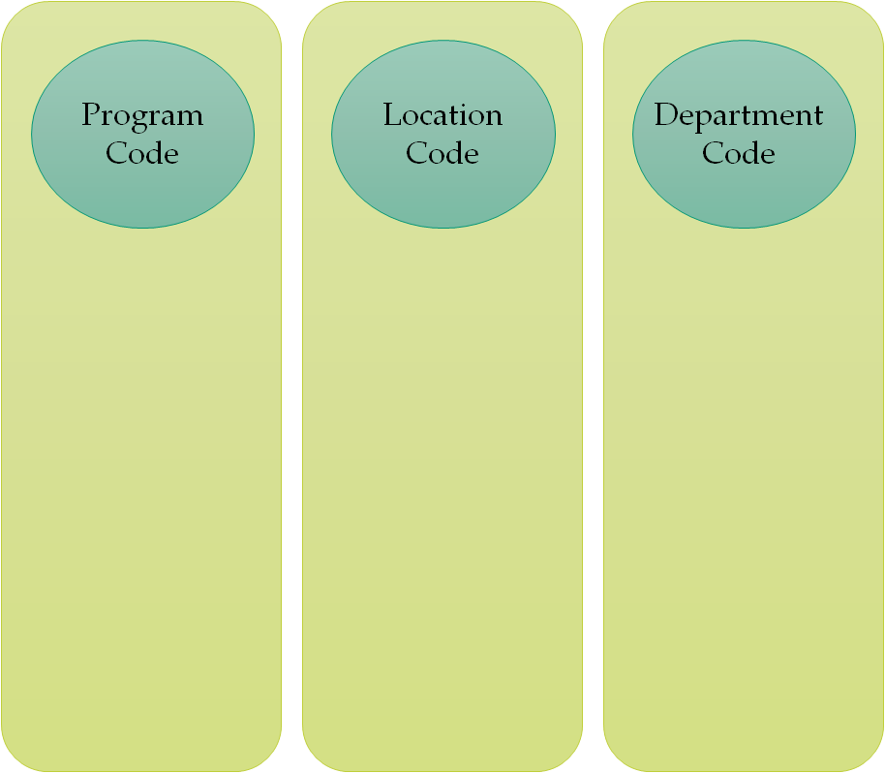
Give Us Your Digits!
Do you know your Program, Location, and Department Codes?

Slide 42
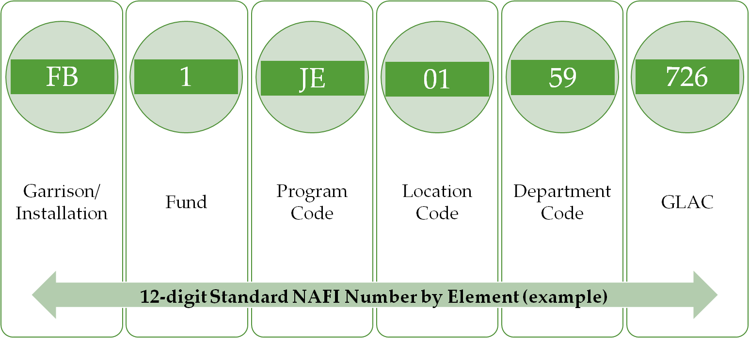
The Standard NAFI Number
Notes:
Will have Fund Manager for IMWRF whose responsibilities are as you see here.
Monitors MWR activities for regulatory compliance, especially regarding internal controls (Cash Control System, Retail Sales Accountability, Physical Security).
They ensure a series of checks and balances/ separation of duties are in place and functioning.
The volume of cash transactions is how NAF is different than APF. Unrecorded cash is easy to steal, this is why NAF puts such a great emphasis on capturing a record of cash as it is received.
In our scenario example for Bowling:
Garrison/Installation: QE (Ft. Greely)
Fund: 1 (Why??)
Program Code: KA (because it is a 16 lane or less center)
Location Code: ??
Department Code: 45 Lane Operations, G1 Admin, C1 Vending, E1 Bingo, 14 snack bar, etc.

Slide 43
Rolling Things Up
IMCOM/G9
IMCOM Directorate
Garrison
Program Code
Location Code
Department Code
GLAC
Notes:
Will have Fund Manager for IMWRF whose responsibilities are as you see here.
Monitors MWR activities for regulatory compliance, especially regarding internal controls (Cash Control System, Retail Sales Accountability, Physical Security).
They ensure a series of checks and balances/ separation of duties are in place and functioning.
The volume of cash transactions is how NAF is different than APF. Unrecorded cash is easy to steal, this is why NAF puts such a great emphasis on capturing a record of cash as it is received.

Slide 44
Income Statement
What is an Income Statement and what is it used for?
Notes:
Nonappropriated Funds:
Cash and other assets received from sources other than funds appropriated by congress. They are normally predominantly locally generated.
NAFs are government funds used for the collective benefit of those who utilize the programs MWR offers.
NAFs are separate and apart from funds on the books of the Treasurer of The United States.
Money collected for goods and services offered to authorized patrons (See AR 215-1, Sec 6-2 or Table 6-1, page 19). We have 30 categories of authorized patrons. GC determines who gets service. Generate between $800-$900 M in yearly revenues.
NAF Instrumentalities are:
A DoD Organizational Entity Which:
Performs An Essential Government Function. Assists in recruiting and retention, adds to QOL.
Acts In Its Own Name To Provide MWR Programs.
Maintains Custody Of And Control Over Nonappropriated Funds. (Fund Manager) AR 215-1, Sec 5-6.
NAFI’s Not Incorporated Under The Laws Of Any State.
Enjoy The Legal Status Of An Instrumentality Of The United States. AR 215-1, Sec. 3-1.
Tax Exempt.
MWR not the only NAFI on installation – Sunday collections in military chapels deposited into Chaplains’ Funds, Billeting/Lodging separate from MWR, etc. We don’t share our $ with them, and they don’t share with us. See AR 215-1, Sec. 4-8 page 8 for additional supplemental mission NAFIs.
Supplemental Mission NAF accounts, see AR 215-1, Sec 4-7, page 7.

Slide 45
Income Statement
Formal documentation of NAF program financial performance
Historical document prepared 15 to 20 days after the close of the monthly accounting period
Compares revenue to expenses
Reflects net income or loss for the period

Slide 46
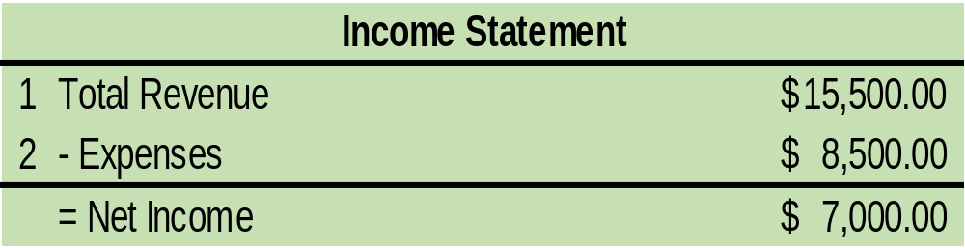
Income Statement
The basic income statement format is:
Revenue - Expense = Net Income (or Loss)
Notes:
Nonappropriated Funds:
Cash and other assets received from sources other than funds appropriated by congress. They are normally predominantly locally generated.
NAFs are government funds used for the collective benefit of those who utilize the programs MWR offers.
NAFs are separate and apart from funds on the books of the Treasurer of The United States.
Money collected for goods and services offered to authorized patrons (See AR 215-1, Sec 6-2 or Table 6-1, page 19). We have 30 categories of authorized patrons. GC determines who gets service. Generate between $800-$900 M in yearly revenues.
NAF Instrumentalities are:
A DoD Organizational Entity Which:
Performs An Essential Government Function. Assists in recruiting and retention, adds to QOL.
Acts In Its Own Name To Provide MWR Programs.
Maintains Custody Of And Control Over Nonappropriated Funds. (Fund Manager) AR 215-1, Sec 5-6.
NAFI’s Not Incorporated Under The Laws Of Any State.
Enjoy The Legal Status Of An Instrumentality Of The United States. AR 215-1, Sec. 3-1.
Tax Exempt.
MWR not the only NAFI on installation – Sunday collections in military chapels deposited into Chaplains’ Funds, Billeting/Lodging separate from MWR, etc. We don’t share our $ with them, and they don’t share with us. See AR 215-1, Sec. 4-8 page 8 for additional supplemental mission NAFIs.
Supplemental Mission NAF accounts, see AR 215-1, Sec 4-7, page 7.

Slide 47
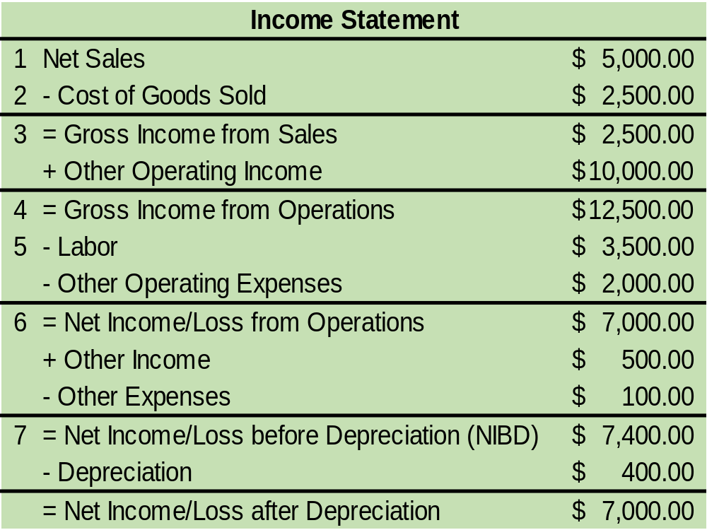

Slide 48

Group Activity Instructions
Given an Income Statement and what you just learned, calculate the following:
  Percentage of Cost of Good Sold
  Gross Income from Sales
  Gross Income from Operations
  Percentage of Labor
  Net Income/Loss from Operations
  Net Income/Loss before Depreciation (NIBD)
  Percentage of Net Income/Loss before Depreciation
  Net Income/Loss after Depreciation (NIAD)
Please work as a group to complete the income statement blanks.
When you are finished, choose a spokesperson to brief your results.

Slide 49
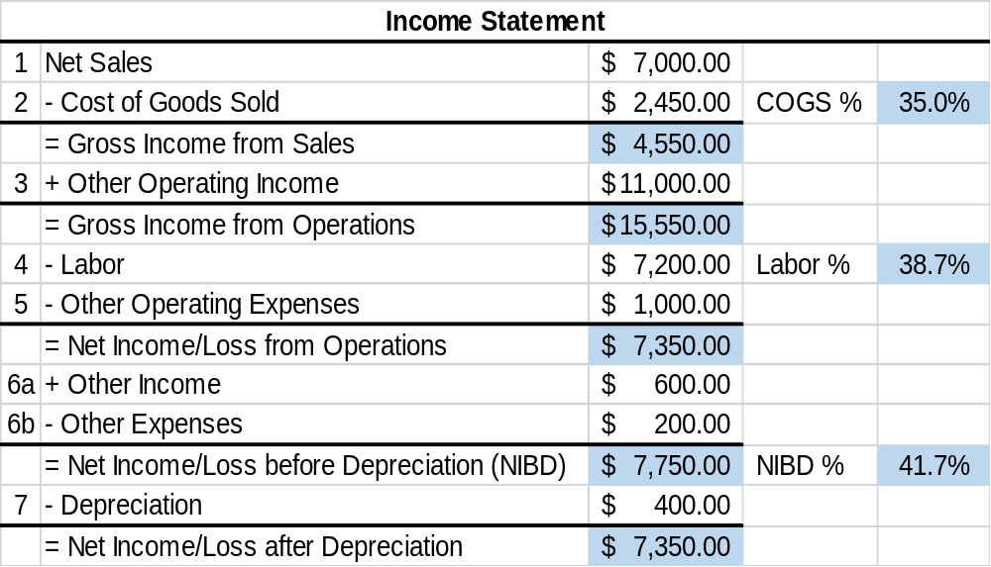
Income Statement

Slide 50
Income Statement
The income statement in summary format simply lists all the revenue and expenses in a specified format.
These figures document the performance for a single month.
While this information documents performance for the period, does it paint the total picture?
 | Aug 2018
Sales | $ 7,000
Cost of Goods Sold | $ 4,900 | 70.0%
Gross Income from Sales | $ 2,100
Other Operating Income | $ 500
Gross Income from Opns | $ 2,600
Labor | $ 1,900 | 25.3%
Other Operating Expense | $ 200 | 2.7%
Net Income Before Dep (NIBD) | $ 500 | 6.7%

Slide 51
Analyzing Financials
 | Aug 2018 |  | Jul 2018 |  | Aug 2017 |  | Budget Aug 2018
Sales | $ 7,000 |  | $ 7,600 |  | $ 6,900 |  | $ 7,300
Cost of Goods Sold | $ 4,900 | 70.0% | $ 5,000 | 65.8% | $ 4,200 | 60.9% | $ 4,900 | 67.1%
Gross Income from Sales | $ 2,100 |  | $ 2,600 |  | $ 2,700 |  | $ 2,400
Other Operating Income | $ 500 |  | $ 500 |  | $ 400 |  | $ 600
Gross Income from Opns | $ 2,600 |  | $ 3,100 |  | $ 3,100 |  | $ 3,000
Labor | $ 1,900 | 25.3% | $ 2,000 | 24.7% | $ 1,840 | 25.2% | $ 1,900 | 24.1%
Other Operating Expense | $ 200 | 2.7% | $ - | 0.0% | $ 120 | 1.6% | $ 150 | 1.9%
Net Income Before Dep (NIBD) | $ 500 | 6.7% | $ 1,100 | 13.6% | $ 1,140 | 15.6% | $ 950 | 12.0%

Slide 52
Analysis
How do you conduct an analysis?

Slide 53

Analysis Defined
Comparative analysis is a method used in the examination of financial statements to identify new trends by the item-by-item comparison of two or more sets of data

Slide 54
Reports
What are some Reports used in your program?

Slide 55

Five Key Financial Reports
This month vs. last month
This month vs. budget
This month vs. same month last year
YTD this year vs. YTD last year
YTD this year vs. YTD budget
Notes:
Trend analysis is simply the comparison of operating data on the income statement with previous period performance (historical data) or with planned performance (budget). Trend analysis can be accomplished for all income statement lines or selected lines
Trend Analysis Defined
Trends are expressed as either positive or negative.
In general, when revenue is "down" or expenses are "up," the financial trend is considered negative.
Conversely, when revenue is "up" or expenses are "down," the financial trend is considered positive.
As a manager of an activity, you should always review and take action to correct negative trends. Successful managers also analyze positive trends to determine causes so that similar strategies can be applied in the future.

Slide 56
This Month vs Last Month
May highlight upward or downward trends
May be useful to analyze percentages (e.g. Labor, COGs)
May be used to start to isolate any problem areas
Notes:
Summarize points on slide

Slide 57
This Month vs Budget
Highlights differences with actual figures
Called the monthly variance report
Variances should be explained by program managers and may need an action plan
Notes:
SAY: Discuss Key points of this trend then transition into white board

Slide 58
Current Month vs Same Month Last Year
Good for seasonal activities
Useful for detecting cost and income changes
Highlights changes over a longer period of time
Notes:
Summarize points on slide

Slide 59
YTD this Year vs YTD Last Year
Good picture between two years
Can help predict the rest of year
Notes:
Summarize points on slide

Slide 60
YTD this Year vs YTD Budget
Reveals if you are on target with your AOB
May need to analyze and explain a variance
  What is the cause of the variance?
Any variance MUST be reviewed, analyzed, and applied accordingly to the next FY Budget
Notes:
Summarize points on slide

Slide 61
Five Key Financial Reports Exercise
Given one of the 5 Key Financial Reports, provide at least one scenario in which you would use the report you are assigned.
After you receive your group assignment, work as a group to complete the exercise:
    Group 1 – This month vs. last month
  Group 2 – This month vs. budget
  Group 3 – This month vs. same month last year
  Group 4 – YTD this year vs. YTD last year
  Group 5 – YTD this year vs. YTD budget

Slide 62
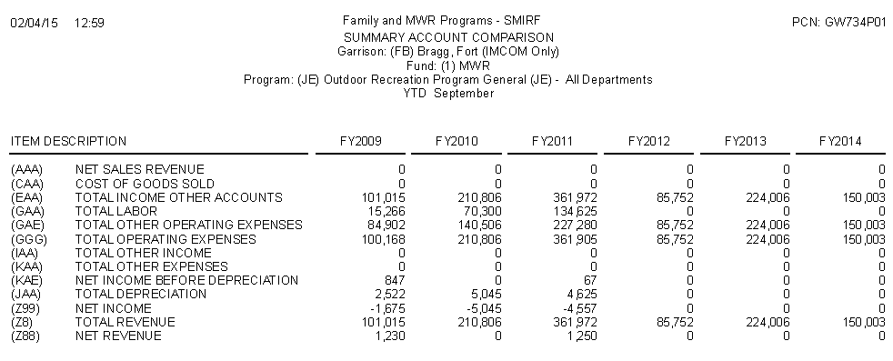
SMIRF Reports
Summary Account Comparison
This report compares the actual financial results of the current year and 5 years prior

Slide 63
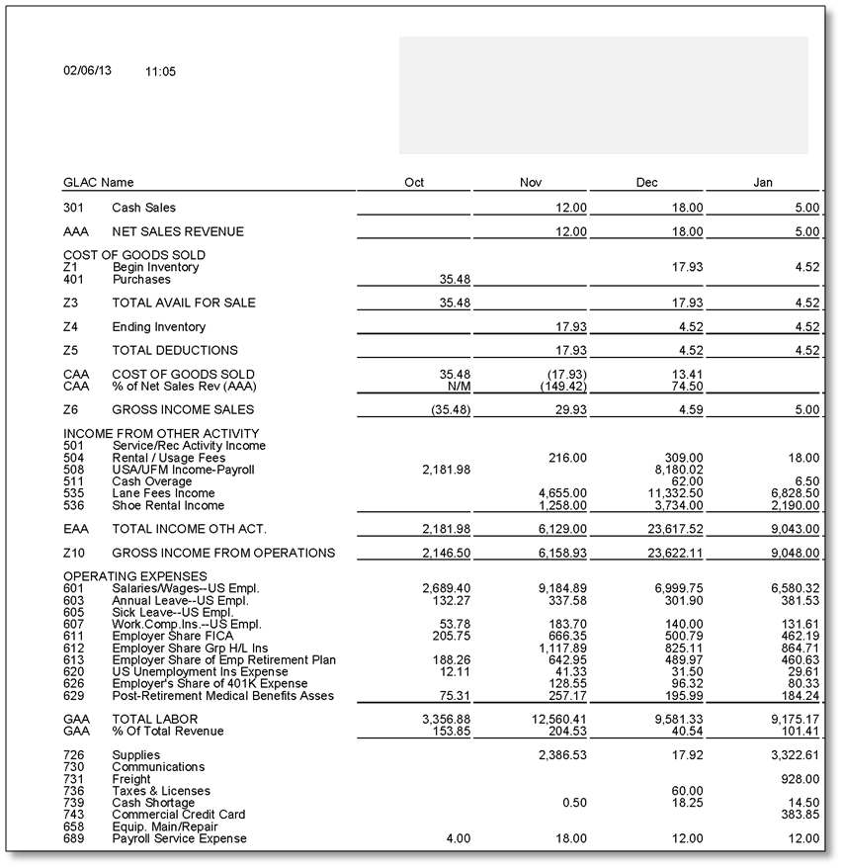

SMIRF Reports
Income by Month
This report provides the fiscal year by month in a side-by-side format.
Includes all GLACs used by the activity

Slide 64
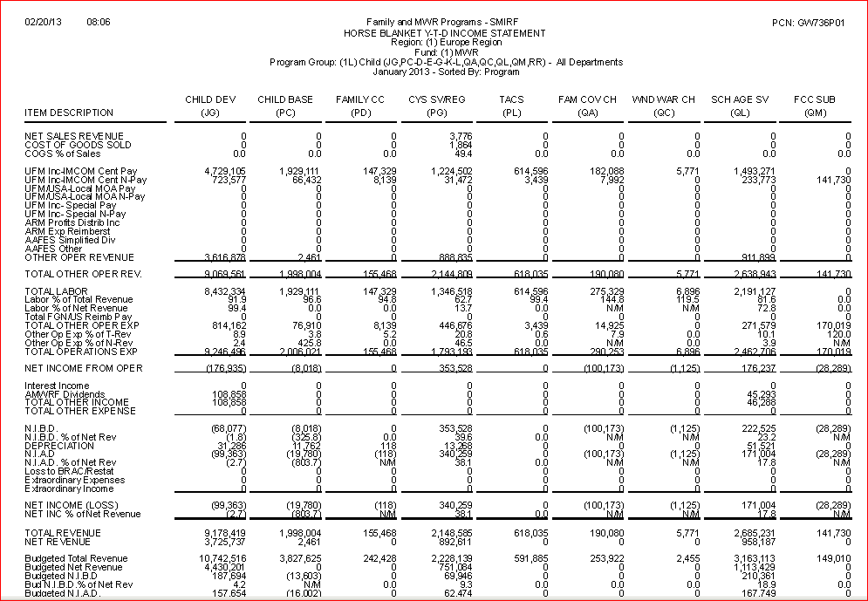
SMIRF Reports
Horse Blanket YTD Income Statement
This report Summarizes the income statement by major element.
Use it when looking for asset/liability information, or cash/debt ratio.
GLACs are summarized by major category.

Slide 65
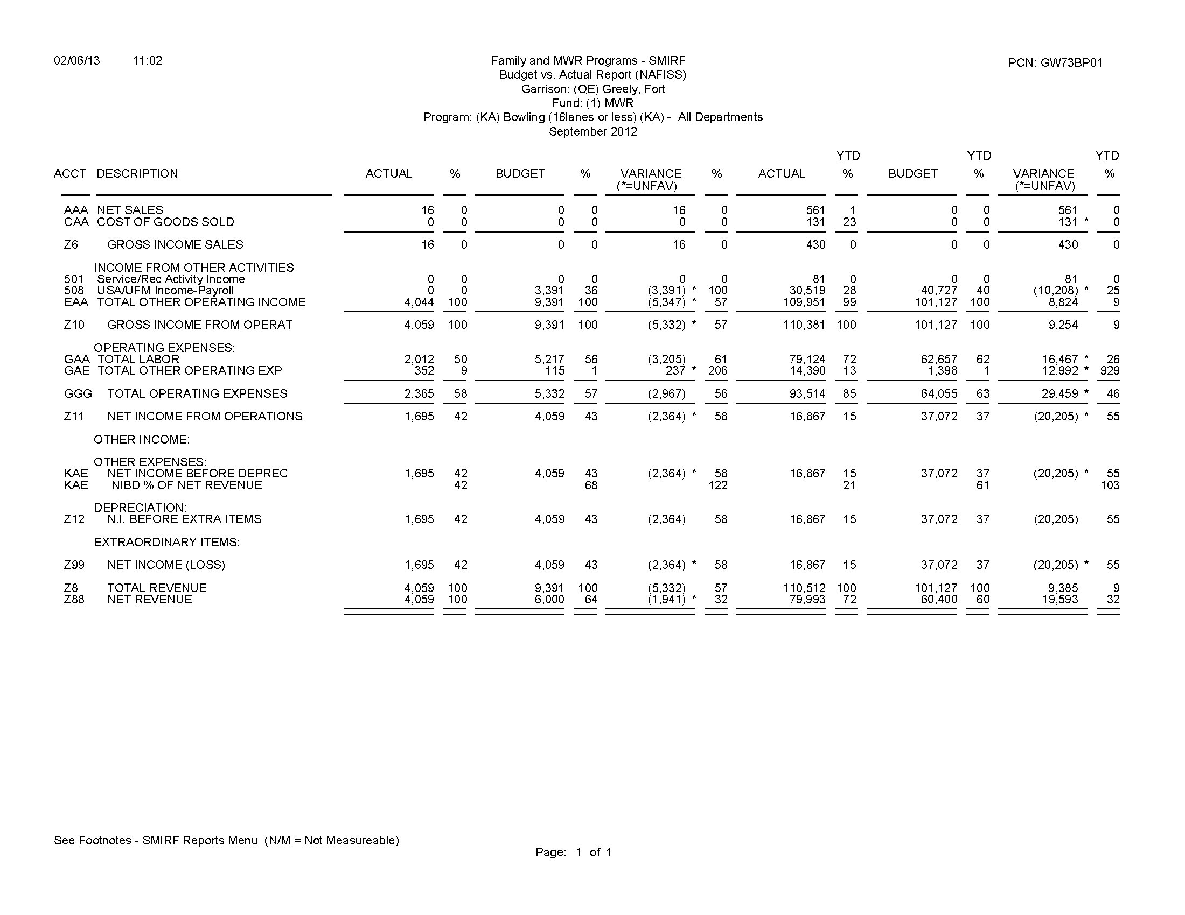
SMIRF Reports
Budget vs. Actual
This report compares the actual financial results with the budget for the month requested and includes the year-to-date results

Slide 66
SMIRF Reports
GLAC Query Summary
This report provides monthly and year-to-date financial data on individual summary GLAC‘s; includes quarterly totals
GLAC Query Actual
This report provides monthly and year-to-date financial data on individual actual GLAC‘s; includes quarterly totals

Slide 67
Questions?

Slide 68
NAF Financial Management for Program Managers
MG Robert M. Joyce School for Family and MWR
IMCOM G 3/5/7 Training Division

Slide 69
Day 1 FM Review

Slide 70
FMWR Funding Categories (Review of BMC Module 7)
Category
Mission Sustaining Activities
Critical for retention and readiness of Soldiers
Category
Enhanced Community Support Activities
Category
Business Activities
Little or no ability to generate NAF $
Examples: Libraries, recreation centers, and fitness/sports operations
Examples: CYS, arts and crafts, auto crafts, bowling centers with 16 or less lanes, & outdoor recreation services
Have potential to raise a limited amount of NAF $, but lack the ability to sustain themselves based purely on their business.
Examples: Clubs, golf courses, & bowling centers
Business activities with highest capability of generating revenues
Some exceptions for remote sites & OCONUS installations
MIX APF & NAF
Authorized 100 % APF
NAF FUNDED
Minimum standard is 85% APF
Minimum standard is 65% APF

Slide 71
Funding
Describe a way your program/activity has received funding/revenue in the last quarter
Sales – Hot dogs, drinks, etc. (G)
Pro-shop (G)
Catering (G)
Sponsorship (G)
Donations (G*)
UFM (F)
Service Income (G)
Recycling Income from Garrison (F)
AAFES Dividend (F)
ARMP (F)
APF under an MOA (G)
  (F) Funded
  (G) Generated

Slide 72
Uniform Funding Management (UFM)
APF
APF
NAF via UFM
**Timely Allocations are key to execute MWR Programs
Appropriated Funds allocated from Army Budget Office
Per annual MOA IMCOM G8 allocates funding to QDPC / QCYS and signs and submits 1034 to DFAS
Processes 1034 and does an Electronic Fund Transfer (EFT) to Army Banking and Investment (ABIF/IMCOM G-9). Funds are now considered NAF
ABIF/IMCOM G-9 deposits into individual garrison bank accounts to fund program expenses
CATEGORY A
CATEGORY B
CATEGORY C
MISSION SUSTAINING
(QDPC)
MISSION SUSTAINING
(QDPC)
BASIC COMMUNITY SUPPORT
(QDPC & QCYS)
BUSINESS ACTIVITIES
Physical Fitness
Libraries
Recreation Centers
Unit Activities
Army Lodging
Bowling / Golf
Army Recreation Machines
Clubs
Armed Forces Recreation
Centers
Auto/Arts & Crafts
Child Development / Youth Svcs
Outdoor Rec. / Entertainment
Information, Tours, Referral
Per DODI 1015.10 Authorized minimum of 65% APF Support. Category B activities should break even
External Revenue
  AAFES Dividends
  Interest Income
  ARMP
Per DODI 1015.10 Authorized minimum of 85% APF Support. Category A activities should break even
Decreases in APF results in:
Increased use of NAF for APF expenses.
Reduced Major/Minor construction
Options to offset APF decreases
Reduce APF authorized services
Price increases to customers
Close programs
Minor
Construction
Major
Construction
Cash Generated From Operations
(After Expenses)
NAF via UFM

Slide 73
Funding FMWR
Point: FMWR support utilizes a blend of funds
APF
NAF
MCA
OMA
Self
Generated
Outside
Sources
BASOPS
Donations
UFM
MWR USA
Utilities
AAFES
SRM
FMWR MDEPS
Commercial
Sponsorship
New Work
ARMP
Trust Fund
KEY:
MCA – Military Construction Army
OMA – Operation and Maintenance Army
BASOPS – Base Operations
SRM – Sustainment Restoration Modernization
MDEP – Management Decision Package
UFM – Uniform Funding Management

Slide 74
The Standard NAFI Number
Notes:
Will have Fund Manager for IMWRF whose responsibilities are as you see here.
Monitors MWR activities for regulatory compliance, especially regarding internal controls (Cash Control System, Retail Sales Accountability, Physical Security).
They ensure a series of checks and balances/ separation of duties are in place and functioning.
The volume of cash transactions is how NAF is different than APF. Unrecorded cash is easy to steal, this is why NAF puts such a great emphasis on capturing a record of cash as it is received.
In our scenario example for Bowling:
Garrison/Installation: QE (Ft. Greely)
Fund: 1 (Why??)
Program Code: KA (because it is a 16 lane or less center)
Location Code: ??
Department Code: 45 Lane Operations, G1 Admin, C1 Vending, E1 Bingo, 14 snack bar, etc.

Slide 75
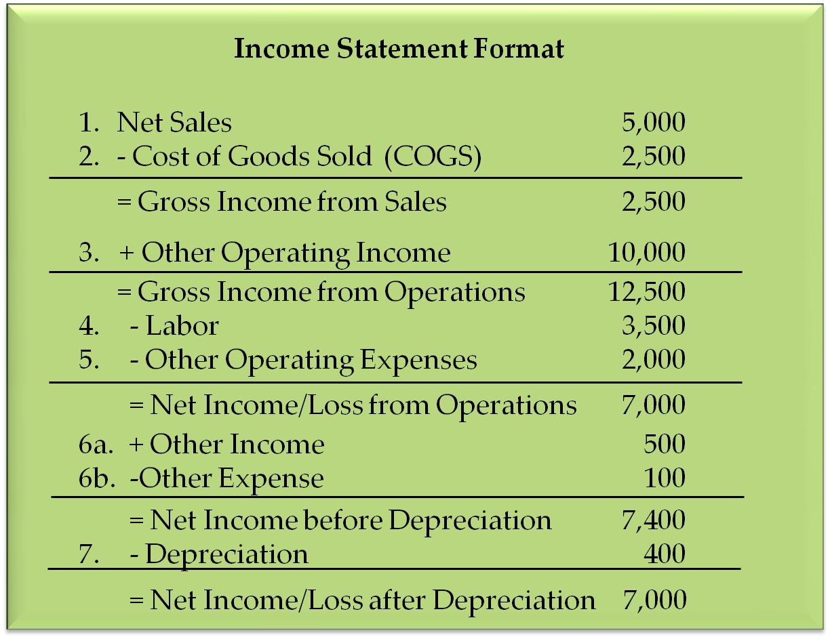

Slide 76
Analyzing Financials
 | Aug 2018 |  | Jul 2018 |  | Aug 2017 |  | Budget Aug 2018
Sales | $ 7,000 |  | $ 7,600 |  | $ 6,900 |  | $ 7,300
Cost of Goods Sold | $ 4,900 | 70.0% | $ 5,000 | 65.8% | $ 4,200 | 60.9% | $ 4,900 | 67.1%
Gross Income from Sales | $ 2,100 |  | $ 2,600 |  | $ 2,700 |  | $ 2,400
Other Operating Income | $ 500 |  | $ 500 |  | $ 400 |  | $ 600
Gross Income from Opns | $ 2,600 |  | $ 3,100 |  | $ 3,100 |  | $ 3,000
Labor | $ 1,900 | 25.3% | $ 2,000 | 24.7% | $ 1,840 | 25.2% | $ 1,900 | 24.1%
Other Operating Expense | $ 200 | 2.7% | $ - | 0.0% | $ 120 | 1.6% | $ 150 | 1.9%
Net Income Before Dep (NIBD) | $ 500 | 6.7% | $ 1,100 | 13.6% | $ 1,140 | 15.6% | $ 950 | 12.0%

Slide 77

Five Key Financial Reports
Variance Report
This month vs last month
This month vs budget
This month vs same month last year
YTD this year vs YTD last year
YTD this year vs budget YTD
Notes:
Recall the five ….
Trend analysis is simply the comparison of operating data on the income statement with previous period performance (historical data) or with planned performance (budget). Trend analysis can be accomplished for all income statement lines or selected lines
Trend Analysis Defined
Trends are expressed as either positive or negative.
In general, when revenue is "down" or expenses are "up," the financial trend is considered negative.
Conversely, when revenue is "up" or expenses are "down," the financial trend is considered positive.
As a manager of an activity, you should always review and take action to correct negative trends. Successful managers also analyze positive trends to determine causes so that similar strategies can be applied in the future.

Slide 78
Module
Analyzing Labor

Slide 79


Staffing Mix Impact on Labor Expense
Category |  |  |  |  |  | Total
Benefits?
Minimum
Maximum
Rate
RFT
RFT
RPT
FLX
FLX
YES
YES
YES
NO
NO
40
40
20
0
0
100
40
40
39
39
39
197
$20/hr
$15/hr
$12/hr
$10/hr
$10/hr
(you must solve for each person: hours x rate = weekly labor rate)
Minimum Labor Cost: ___________ Maximum Labor Cost: ___________
$1,640
$2,648

Slide 80
Objectives
Recognize the new fiscal reality and how labor impacts business
Identify program code and associated labor standard
Identify key inputs and outputs for controlling labor costs
Notes:
This weeks module objectives
Notes:
standard (15% variance from budget Check Budget Guidance. Does it change per region?)
Really don’t have true, across the board, hard-and-fast standards.
Depends on your program, funding, category, and location
There are some general G9 and Industry guidelines, but your specific guidance should come from your own DFMWR and/or C, SSD or FM.
Bullet 2 - (make this a scenario? Bowling Center)
We will need dummie information to do this…
Actual against budget is the variance – if we had asked them to bring their own AOB and income statement we could have made this an exercise for them to do with their own info – probably the most relevant. Can do with dummie info, though. Just need to get from what Bryan sent or request more.
Actual against last year – will need dummie info
Same for actual against YTD
Think we should do labor here in order to keep it relevant to all
4 & 5 would be based on 3

Slide 81
Labor Categories
Appointment Categories (AR 215-3, Ch 2-2.)
  Regular: serves in continuing position on a scheduled basis
    Regular full-time (RFT) workweek is 40 hours
    Regular part-time (RPT) workweek is from 20 to 39 hours
  Flexible: serves in a continuing position on a schedule or as needed
    No upper limit to the number of hours worked
      subject to overtime obligations and work scheduling requirements
    FLX employees may be guaranteed a specific number of hours
  Seasonal
    Not needed for the entire year
      Regular Full Time Seasonal (RFS)
      Regular Part-Time Seasonal (RPS)
    Must last at least 6 months

Slide 82
What are some labor challenges facing FMWR programs?
Mitigate the reduction in UFM funding
Right size the workforce to meet targeted labor standards
Improve NIBD to ensure programs can recapitalize operations
Implement Labor Model based on targeted Labor Standards

Slide 83
Labor Standards (IAW IMCOM Reg 215-1-1)
Program | Code | Standard (Less than or Equal to)
Bowling (Cat B) | KA | 50%
Bowling (Cat C) | LE | 50%
Golf | LQ | 50%
Food, Beverage & Entertainment (FBE) | KM | 42%
Branded Restaurants | KL | 42%
Branded – Java | KL | 35%
Community Club | KG | 42%
Free Standing Snack Bars | LT | 35%
Bingo | KM | 7.5%

Slide 84
Labor Standards (IAW FY20 Guidance)
Fund 1 | STANDARD
MWR Fund | Garrison |  |  |  | IMCOM Directorate
RECREATION | COGS | Labor | OOE | NIBD | NIBD
Category A Recreation (Program Codes HA, HB, HC, HE,HF, HH, HJ, QD) |  |  |  | 0% | 0%
Category B Recreation (specific to IMCOM Pilot) (Program Codes JB, JC, JD, JE, JQ, KB, KC, KD, KJ,WZ) |  |  |  | 0% at the PROGRAM level
Category B Recreation (Program Codes JA, JF) |  |  |  | 0% at the GARRISON level | 0%
Category C Recreation (Program Codes KK, LA, LB, LE, LF, LG, LK, LL, LM, LP, LV, LW) |  |  |  | 5% | 5%
 | Garrison Standard (* +/- 5% variation authorized except COGS)
 | COGS | Labor | OOE | NIBD | APF Funding (% of Total Revenue)
Campgrounds (Program Code JK) |  | 20%* | 10%* | 65%* | 25%
--Snack Bar (Department 14) | 35%
--Convenience Resale _{(Department} ₂₇₎ | 55%
--Gift Shop (Department 37) | 75%
Travel Camps/RV Parks and Campgrounds (Program Code KK) |  | 30%* | 20%* | 45%*
--Snack Bar (Department 14) | 35%
--Convenience Resale _{(Department} ₂₇₎ | 55%
--Gift Shop (Department 37) | 75%
Cabin, Cottages, and Recreational Guesthouses (Program Code LF) |  | 35%* | 25%* | 35%*
--Snack Bar (Department 14) | 35%
--Convenience Resale _{(Department} ₂₇₎ | 55%
--Gift Shop (Department 37) | 75%

Slide 85
Labor = Largest Controllable Expense
Group Exercise
How do you control labor costs?
How frequently do you monitor labor cost?
What can you do to better manage labor cost?

Slide 86
Labor Model
  An efficient allocation of labor hours based on forecasted revenue
    Adjust operation hours based on usage and operational cost
  A financial management tool used to schedule and adjust labor on a weekly, monthly and annual basis
  Defines the specific key performance indicators (KPIs) that an organization uses to track the workforce
    Key to developing annual operating budget
  Utilized to aid in the determination of the right staffing mix

Slide 87
Labor Model
Key Inputs:
  Revenue Forecasting:
    Historical Data such as revenue, cover counts and average check
  Cost of Goods Sold:
    Based on budget, trends and established benchmarks
  Other Operating Expense:
    Based on budget and established benchmarks
  Net Income Before Depreciation (NIBD):
    Based on recapitalization needs and established benchmarks
  Average Hourly Cost of Labor:
    Total Labor Cost divided by Productive Hours (Total hours worked minus Leave Taken- Annual, Holiday, and Sick)

Slide 88
Labor Model
Key Outputs:
  Total Payroll Cost (Labor) for budget time period
  Allowable hours of labor for effective scheduling

Slide 89
Labor Scheduling:
Effective Management Practices
Define minimum manning requirement for facility and develop long term action plan to meet standard/manning requirement
  Through attrition and/or BBAs, adjust the employment status of new hires
Staffing: “right person” in the right position
  Recruiting, Selecting, Hiring and Training
  Correct mix of Full-time, Part-time and Flex

Slide 90
Effective Management Practices
  Scheduling: “right number of personnel” in the right job at the right time
    Effective staffing and scheduling based on forecasted customer count and sales
  Increase Productivity:
    Increase revenue generating events without increased labor
    Cross Train Staff
  Control Cost:
    Operational hours
    Utilized Benchmarks

Slide 91
Group Activity- Labor Scheduling
You are an Arts & Crafts Program Manager
  Staffing Mix (1 Manager & 2 RFT)
  Departments: Retail and Engraving
  Hours of Operation: 1000-1700 (Monday – Friday)
Create a weekly staffing schedule
You will work as a group
Choose a scribe and spokesperson to brief your results

Slide 92
Group Activity- Labor Scheduling
You are an Arts & Crafts Program Manager
  Staffing Mix (1 Manager & ?????????)
  Departments: Retail and Engraving
  Operational Hours: ???????
  Minimum Hours Opened = 35
  Maximum Hours Opened = 55
Create a weekly staffing schedule
Choose a scribe and spokesperson to brief your results

Slide 93
Labor Budgeting
Revenue Forecasting
  Accurate forecasting revenue is CRITICAL
Cost of Goods Sold (COGS)
  Use “Current COGS %”, “YTD COGS %” from your financial statement or COGS % from your Budget
  Must be Realistic, do NOT simply utilize the targeted benchmark if the facility CANNOT meet that percentage mark
Desirable Labor Cost Percentage
  Use the percentage in the IMCOM Reg 215-1-1 labor standard or realistic target

Slide 94
Labor Budgeting
Other Operating Expense
  Use “Current Other Operating Expenses (OOE) %” or “YTD OOE %” from your financial statement or “Budgeted %” from your budget
  Must be an accurate and realistic figure based on your current operational situation or requirement
Net Income Before Depreciation (NIBD)
  Use the percentage in the “Benchmark” from Guidance (Annual Budget Guidance/Local Guidance), or Budgeted NIBD percentage (NIBD %)
  Must be an accurate and realistic figure based on your current operational situation

Slide 95
Labor Budgeting
How to calculate “Average Hourly Labor Cost”
  Represents the dollar amount you spend per hour any employee works in the facility
    Total Payroll Cost = Total Labor per a given month from your financial statement
    Total Productive Hours = Total hours worked minus Leave Taken (Annual, Holiday, and Sick)
  Average Hourly Labor Cost = Total Payroll Cost / Total Productive Hours

Slide 96
Labor Budgeting
Average Hourly Labor Cost Calculation:
  Total Labor Cost for the month: $320,000
  Total Productive Hours for the month: 16,000 hours
___________/ __________ hours = __________ per hour
$320,000
16,000
$20.00

Slide 97
Activity- Labor Budgeting
Monthly Labor Total: $ _________________________
Monthly Total Revenue: $ ________________________
Example: (50% labor standard; $5000 weekly labor)
I need to make $_______ a month in revenue to ONLY cover my labor.
Based on my program labor standard of ______%, I need to make $_________ a month in revenue to meet my labor standard.
20,000
50
40,000

Slide 98
Questions?

Slide 99
Module 3
Analyzing a Variance

Slide 100
Putting It Together
Comparative analysis is a method used in the analysis of financial statements to identify new trends by the item-by-item comparison of two or more sets of data.
Income Statement (Yields your Variance Report)
Other financial and non-financial data
Comparative Analysis, Trends, Action
Module 3 – Analyzing a Variance
Notes:
Remember last week we discussed how you take your income statement and other data to conduct a comparative analysis. We spent last week looking at the income statement. This week we are going to pick up with the income statement, but more specifically the variance report. Then we will move into analysis and action.

Slide 101
Objectives
Analyze a variance report to identify actual financial operations performing outside of established standards
Perform an analysis of the Actual vs. Budget for a given financial trend
Conduct an analysis to determine financial trends
Distinguish cause and effect
Formulate possible causes for identified trends and recommend resulting/corrective action(s)
Notes:
This weeks module objectives
Notes:
standard (15% variance from budget Check Budget Guidance. Does it change per region?)
Really don’t have true, across the board, hard-and-fast standards.
Depends on your program, funding, category, and location
There are some general G9 and Industry guidelines, but your specific guidance should come from your own DFMWR and/or C, SSD or FM.
Bullet 2 - (make this a scenario? Bowling Center)
We will need dummie information to do this…
Actual against budget is the variance – if we had asked them to bring their own AOB and income statement we could have made this an exercise for them to do with their own info – probably the most relevant. Can do with dummie info, though. Just need to get from what Bryan sent or request more.
Actual against last year – will need dummie info
Same for actual against YTD
Think we should do labor here in order to keep it relevant to all
4 & 5 would be based on 3

Slide 102
Five Key Financial Reports
Variance Report
This month vs last month
This month vs budget
This month vs same month last year
YTD this year vs YTD last year
YTD this year vs budget YTD
Notes:
Recall the five ….
Trend analysis is simply the comparison of operating data on the income statement with previous period performance (historical data) or with planned performance (budget). Trend analysis can be accomplished for all income statement lines or selected lines
Trend Analysis Defined
Trends are expressed as either positive or negative.
In general, when revenue is "down" or expenses are "up," the financial trend is considered negative.
Conversely, when revenue is "up" or expenses are "down," the financial trend is considered positive.
As a manager of an activity, you should always review and take action to correct negative trends. Successful managers also analyze positive trends to determine causes so that similar strategies can be applied in the future.

Slide 103
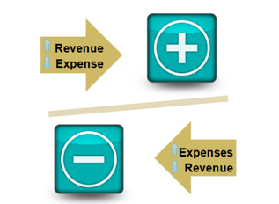
The + or – of Financial Trends
Expressed as either favorable or unfavorable
In general, when revenue is "down" or expenses are "up," the financial trend is considered unfavorable
Conversely, when revenue is "up" or expenses are "down," the financial trend is considered favorable
Which trends should managers analyze? Why?
Notes:
Remember, financial trend analysis is simply the comparison of operating data on the income statement with previous period performance (historical data) or with planned performance (budget).
(Pause)
And, it can be accomplished for all income statement lines or selected lines.
Trends are expressed as either positive or negative.
In general, when revenue is "down" or expenses are "up," the financial trend is considered negative.
Conversely, when revenue is "up" or expenses are "down," the financial trend is considered positive.
As a manager of an activity, you should always review and take action to correct negative trends. Successful managers also analyze positive trends to determine causes so that similar strategies can be applied in the future.

Slide 104
SMIRF Reports
Budget vs Actual (Variance)
Compares actual financial results with budget for month requested
Includes year-to-date results
Notes:
If you have access to OLRV – Online Reports Viewer This provides a more in depth view of variance.
Were you able to access SMIRF? Green check yes red x no
Did you bring a copy of your income statement? Green check yes red x no. (have a generic income statement available in file share)

Slide 105
What is a Variance?
In Financial Management, a variance is the difference between a budgeted, planned, or standard amount and the actual amount incurred
Variances can be computed for both expenses and revenues
Variances can be favorable or unfavorable
Notes:
Whiteboard for them to answer

Slide 106
What is a Variance?
In Financial Management, the variance is the difference between budgeted and actual amounts.
When would 30% over budget on supplies be a good thing?
Example: 726 Supplies Expense
Actual – Budgeted = Variance/Budgeted x 100 = Variance %
$1300 – $1000 = 300 /$1000 x 100 = 0.3 x 100 = 30 %
Notes:
Discuss the positive or negative and budget verse actual is really the sum difference.
For example if you are talking about an expense like supplies (GLAC 726) and you are under budget that is generally a positive variance. What does that mean to you?
For any income like sales, if you are over budget it is generally a positive. So for example you actually made more than what you said you were going to.
Expense over equals a negative variance. The point is that it is the sum difference and you are trying to get to a percentage which is the benchmark that tells you whether further investigation is needed.

Slide 107
How do you “Measure Up”?
What are your numbers compared against?
  Matrix
  Performance Standards
  Key Performance Indicators
  What else?
Notes:
White Board: Have them tell us if they have any performance measure, what they are and where do they come from.

Slide 108
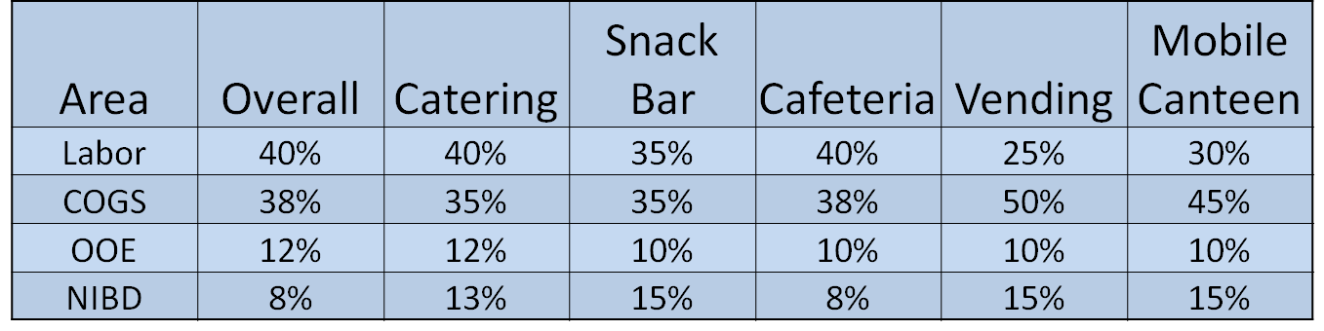
What are you measured against?
Headquarters guidance – Food and Beverage Benchmarks
Where can you find this guidance?
IMCOM Reg 215-1-1, Table 4-22, p. 54
or
G9 Program Budget Guidance
Notes:
The point is to demonstrate that they have various levels of standards, e.g. HQs, etc, but everyone has separate local requirements that may differ. For example your cost of good percentage or your
Page 49 of the operating guidance enclosure 5 provides the standards for Post Restaurant Fund Food and Beverage Benchmarks. Not all programs have benchmarks and your garrison may have different standards, but its important to understand they exist and you need to know which ones you are graded against. Check with Bryan.

Slide 109
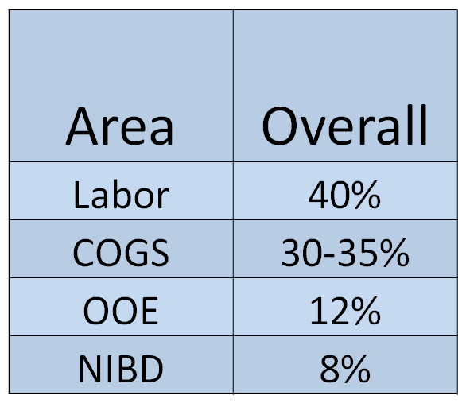

What are you measured against?
Headquarters guidance
Industry standards
              Why do you care?
Notes:
Find picture of Industry standards
Facilitate a discussion with the learners on how they are measured.
Call on learners – Who measures you and what are you measured against?
The point is to demonstrate that they have various levels of standards, e.g. HQs, etc, but everyone has separate local requirements that may differ. For example your cost of good percentage or your
Page 49 of the operating guidance enclosure 5 provides the standards for Post Restaurant Fund Food and Beverage Benchmarks. Not all programs have benchmarks and your garrison may have different standards, but its important to understand they exist and you need to know which ones you are graded against. Check with Bryan.

Slide 110

What are you measured against?
Headquarters guidance
Industry standards
Local standards
Which has priority?
Notes:
Find a pic of a commander and suit
Facilitate a discussion with the learners on how they are measured.
Call on learners – Who measures you and what are you measured against?
The point is to demonstrate that they have various levels of standards, e.g. HQs, etc, but everyone has separate local requirements that may differ. For example your cost of good percentage or your
Page 49 of the operating guidance enclosure 5 provides the standards for Post Restaurant Fund Food and Beverage Benchmarks. Not all programs have benchmarks and your garrison may have different standards, but its important to understand they exist and you need to know which ones you are graded against. Check with Bryan.

Slide 111
Analyzing a Variance
Analyze Data at the Lowest Level Possible
  Things roll-up!
Compare Actual Results to Budget Estimates for Each Income Statement Item
  Start with Summary GLACS
  REMEMBER: Variances may be favorable or unfavorable, significant or insignificant. YOU SHOULD ANALYZE BOTH!
Notes:
Steps to analyzing a variance – look online in the income statement analysis course.
Defining and Identifying Variances
When Reviewing Variance, Analyze Data at the Lowest Level Possible
Recall that departments roll up into locations, which roll up into activity budgets/results. Activity roll-ups are not true indicators of how individual locations or departments are performing.
It is important to start at the lowest operational level when analyzing variance in order to find the cause or solution. Poor results in one department may or may not cause a significant variance at the activity level. It is easier to identify the exact cause of variance when data is analyzed at the lowest level and, thus, easier to correct any problems that may exist.
Compare Actual Results to Budget Estimates for Each Income Statement Item
Starting with the Summary GLACs, managers can look for variances and then break them down into individual GLACs to determine the exact causes.
Defining and Identifying Variances
Points to Consider When Identifying Variances
Variance may be favorable or unfavorable, significant or insignificant. It is the manager's responsibility to analyze the report for both. For example, if actual sales exceeded budgeted sales and expenses were at or below estimated levels, the variance is considered favorable.
There may be fluctuations, above or below budget, during a given month. However, an unfavorable variance that continues for over three months usually indicates an unfavorable trend and requires analysis and justification. Unfavorable trends may indicate the need for budget revisions or program adjustments.
Cost of Goods dollar amounts are irrelevant when used alone. Cost of Goods percentages are analyzed as a percentage point variance. Analysis should include revenue and expenses, and dollar amounts and percentages

Slide 112
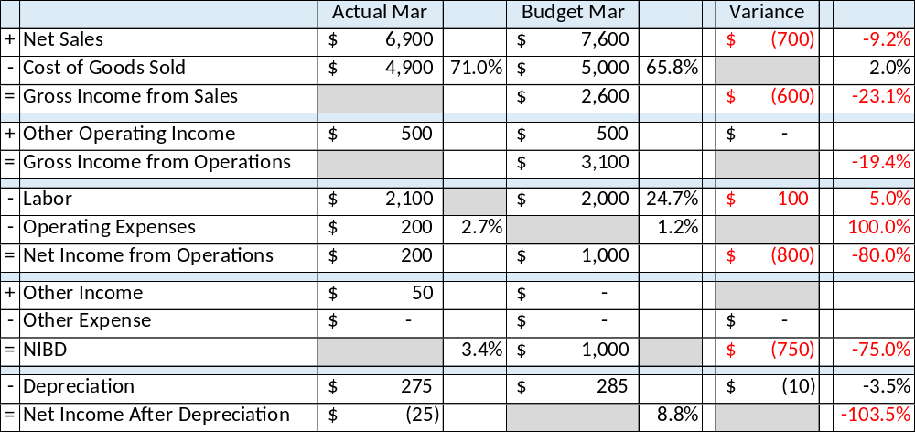
Group Exercise
In your group, calculate the missing data
  Work in table groups
  Show work as necessary
  Choose spokesperson to brief

Slide 113
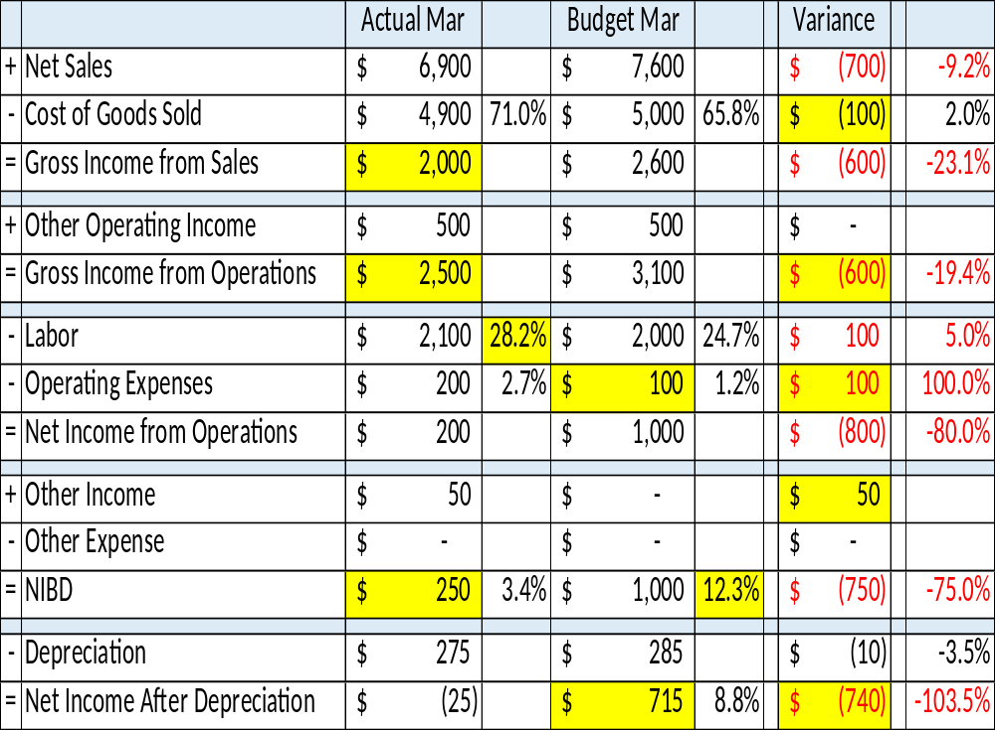
Notes:
This is the answer slide

Slide 114
This Month vs Budget
Highlights differences with actual figures
Called the monthly variance report
Variances should be explained by program managers and may need an action plan
Notes:
SAY: Discuss Key points of this trend then transition into white board

Slide 115
This Month vs. Budget
Data | Variance (unfavorable) | Possible Reasons | Possible Actions
Sales | $1,000
Labor | 2%
Operating Income | $200
COGS% | 10%
Other Operating Expense | $50
NIBD% | 8%
Notes:
White board activity. Based off This Month vs Last Month group practice
Add this slide to each of the breakout group slides.
Scenario: We are a bowling center. Given the data and resulting variance above, what might be some possible reasons and then actions.
In your groups you will discuss possible reasons for variance and any necessary resulting actions. One group member will document on the white board. You will have five minutes to discuss, document and be prepared to brief.
DO: Tell them their group assignments and remind them how to transfer the phone and that they will still be in the main slide deck. We will give you time warning using Chat.
Transition: as an example we have completed the sales.
DO: Go to next slide
DO: Three phone breakouts
Do it in Chat

Slide 116
This Month vs Budget
Data | Variance (unfavorable) | Possible Reasons | Possible Actions
Sales | $1,000 | Largest Unit on Garrison deploys Long-time Employee retires | Decrease hours of operation to reflect current population Host a “Get to know me” event
Notes:
White board activity. Based off This Month vs Last Month group practice
Add this slide to each of the breakout group slides.
Scenario: We are a bowling center. Given the data and resulting variance above, what might be some possible reasons and then actions.
In your groups you will discuss possible reasons for variance and any necessary resulting actions. One group member will document on the white board. You will have five minutes to discuss, document and be prepared to brief.
DO: Tell them their group assignments and remind them how to transfer the phone and that they will still be in the main slide deck. We will give you time warning using Chat.
Transition: as an example we have completed the sales.
DO: Go to next slide
DO: Three phone breakouts
Do it in Chat

Slide 117
Data | Variance (unfavorable) | Possible Reasons | Possible Actions
Labor | 2%
Operating Income | $200
COGS% | 10%
Other Operating Expense | $50
NIBD | 8%
Notes:
White board activity. Based off This Month vs Last Month group practice
Add this slide to each of the breakout group slides.
Scenario: We are a bowling center. Given the data and resulting variance above, what might be some possible reasons and then actions.
In your groups you will discuss possible reasons for variance and any necessary resulting actions. One group member will document on the white board. You will have five minutes to discuss, document and be prepared to brief.
DO: Tell them their group assignments and remind them how to transfer the phone and that they will still be in the main slide deck. We will give you time warning using Chat.
Transition: as an example we have completed the sales.
DO: Go to next slide
DO: Three phone breakouts
Do it in Chat

Slide 118
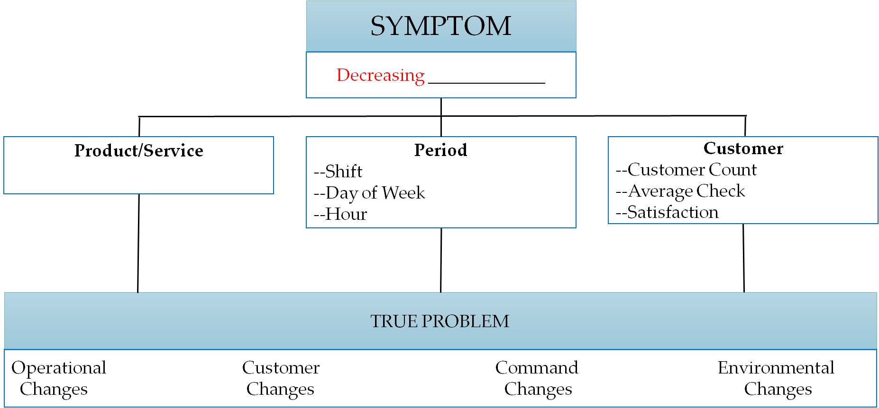
Diagnostic Tools: Root Cause Analysis
Sales
Notes:
The activity we did right before break began our look at cause and effect. This slide is a tool to help diagnose your

Slide 119
TRUE PROBLEM – Declining Spin Class Participation ($2 per class/max 15 participants)
Operational Changes | Customer Changes | Command Changes | Environmental Changes
Notes:
We have decreasing sales.

Slide 120
Wrapping it up
Identify
Investigate
Formulate
Awareness
Identify problems
Dig deeper (investigate) to identify causes
Formulate plan
  Corrective action
  Budget decision
Awareness and Documentation

Slide 121
Questions?

Slide 122
Assignment:
Monthly Variance Report Exercise
Review your Budget vs Actual (BvA) report
  Complete the analysis section as an individual
  Tell us what the variance is saying
    Why the variance occurred
    How you are going to FIX unfavorable variances or DUPLICATE or CONTINUE favorable variances
Brief your variance analysis to your group
  Provide feedback to each individual
  Update analysis accordingly
Turn in your completed report to the instructors

Slide 123
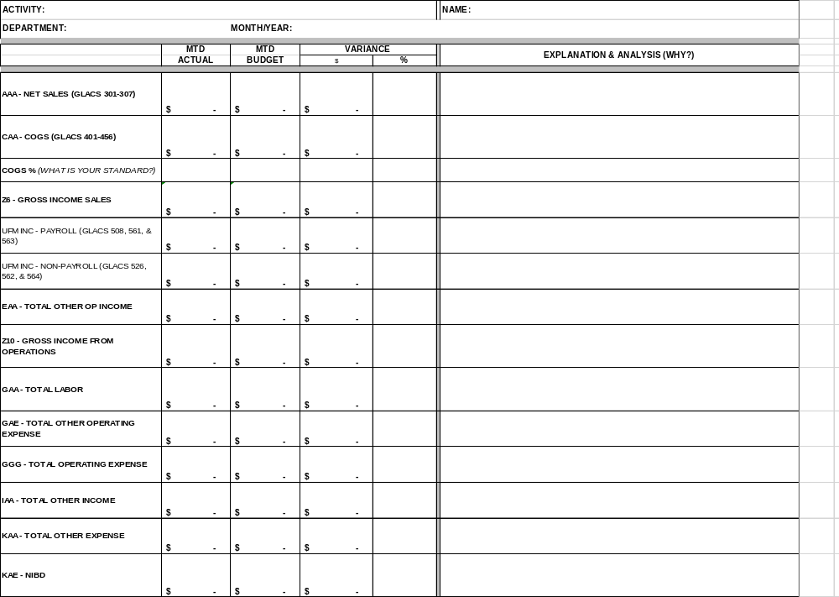

Slide 124
GLAC | Actual | Budget | Variance $ | Variance %
AAA – Net Sales | $ | $ | $ | %
CAA – COGS | $ | $ | $ | %
Z6 – Gross Income Sales | $ | $ | $ | %
UFM INC – Payroll | $ | $ | $ | %
UFM INC – Non-Payroll | $ | $ | $ | %
EAA – Total Other Op Income | $ | $ | $ | %
Z10 – Gross Income from Operations | $ | $ | $ | %
UFM Labor | $ | $ | $ | %
GAA – Total Labor | $ | $ | $ | %
GAE – Total Other Operating Expense | $ | $ | $ | %
GGG – Total Operation Expense | $ | $ | $ | %
IAA – Total Other Income | $ | $ | $ | %
KAA – Total Other Expense | $ | $ | $ | %
KAE – NIBD | $ | $ | $ | %

Slide 125
NAF Financial Management for Program Managers
MG Robert M. Joyce School for Family and MWR
IMCOM G 3/5/7 Training Division

Slide 126
Day 2 FM Review

Slide 127
What are some labor challenges facing FMWR programs?
Mitigate the reduction in UFM funding
Right size the workforce to meet targeted labor standards
Improve NIBD to ensure programs can recapitalize operations
Implement Labor Model based on targeted Labor Standards

Slide 128
Labor Standards (IAW IMCOM Reg 215-1-1)
Program | Code | Standard (Less than or Equal to)
Bowling (Cat B) | KA | 50%
Bowling (Cat C) | LE | 50%
Golf | LQ | 50%
Food, Beverage & Entertainment (FBE) | KM | 42%
Branded Restaurants | KL | 42%
Branded – Java | KL | 35%
Community Club | KG | 42%
Free Standing Snack Bars | LT | 35%
Bingo | KM | 7.5%

Slide 129
Labor Standards (IAW FY20 Guidance)
Fund 1 | STANDARD
MWR Fund | Garrison |  |  |  | IMCOM Directorate
RECREATION | COGS | Labor | OOE | NIBD | NIBD
Category A Recreation (Program Codes HA, HB, HC, HE,HF, HH, HJ, QD) |  |  |  | 0% | 0%
Category B Recreation (specific to IMCOM Pilot) (Program Codes JB, JC, JD, JE, JQ, KB, KC, KD, KJ,WZ) |  |  |  | 0% at the PROGRAM level
Category B Recreation (Program Codes JA, JF) |  |  |  | 0% at the GARRISON level | 0%
Category C Recreation (Program Codes KK, LA, LB, LE, LF, LG, LK, LL, LM, LP, LV, LW) |  |  |  | 5% | 5%
 | Garrison Standard (* +/- 5% variation authorized except COGS)
 | COGS | Labor | OOE | NIBD | APF Funding (% of Total Revenue)
Campgrounds (Program Code JK) |  | 20%* | 10%* | 65%* | 25%
--Snack Bar (Department 14) | 35%
--Convenience Resale _{(Department} ₂₇₎ | 55%
--Gift Shop (Department 37) | 75%
Travel Camps/RV Parks and Campgrounds (Program Code KK) |  | 30%* | 20%* | 45%*
--Snack Bar (Department 14) | 35%
--Convenience Resale _{(Department} ₂₇₎ | 55%
--Gift Shop (Department 37) | 75%
Cabin, Cottages, and Recreational Guesthouses (Program Code LF) |  | 35%* | 25%* | 35%*
--Snack Bar (Department 14) | 35%
--Convenience Resale _{(Department} ₂₇₎ | 55%
--Gift Shop (Department 37) | 75%

Slide 130
Labor Budgeting
Average Hourly Labor Cost Calculation:
  Total Labor Cost for the month: $320,000
  Total Productive Hours for the month: 16,000 hours
___________/ __________ hours = __________ per hour
$320,000
16,000
$20.00

Slide 131
Putting It Together
Comparative analysis is a method used in the analysis of financial statements to identify new trends by the item-by-item comparison of two or more sets of data.
Income Statement (Yields your Variance Report)
Other financial and non-financial data
Comparative Analysis, Trends, Action
Module 3 – Analyzing a Variance
Notes:
Remember last week we discussed how you take your income statement and other data to conduct a comparative analysis. We spent last week looking at the income statement. This week we are going to pick up with the income statement, but more specifically the variance report. Then we will move into analysis and action.

Slide 132
Diagnostic Tools: Root Cause Analysis
Sales
Notes:
The activity we did right before break began our look at cause and effect. This slide is a tool to help diagnose your

Slide 133
Questions?

Slide 134
Module 4
Program Requirements

Slide 135
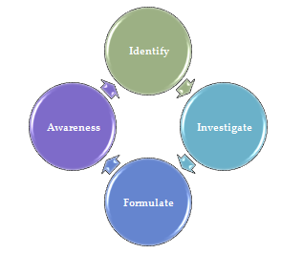
Manager’s Role
Formulate
Plan

Slide 136
Objectives
Identify and apply the NAF Annual Operating Budget (AOB) Process
Identify and discuss strategic guidance; synthesize with NAF AOB Process
Recognize strategic opportunities by applying the SWOT process to program Management.
Describe NAF 5yr Plan Program Requirements and apply to inclusion in the AOB

Slide 137
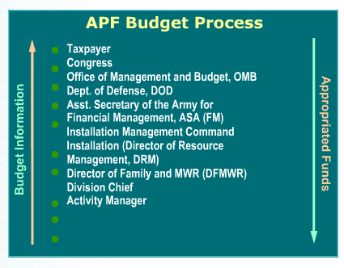
Annual Operating Budgets
Appropriated Fund (APF)
Centralized Process
Six-year plan
  Next fiscal year = budget year
  Five following years = out years
Leads to the President’s annual budget
  Passed by Congress
  Signed by the President
Notes:
Transition:
Let’s jump right in to Annual Operating Budgets. Since this is a NAF Financial Management course, we are going to focus on the NAF Budget Process, but let’s get an overview of the APF process first. Since most of us do work with “some” APF in our overall budgets and we ARE part of the Garrison and IMCOM (i.e. APF worlds) it is beneficial to see the big picture. Additionally, there are similarities and drivers between both processes/funding structures that are important for manager’s to understand.
Talking Points to SLIDE
The Appropriated fund budget process is a centralized process that begins when the activity manager develops a long-range, six-year plan that includes requirements for:
The next fiscal year, called the budget year.
The five following years, called out years.
That request is forwarded through a centralized chain that leads to the President's annual budget. Once the annual budget is passed by Congress and signed by the President, funding streams back through the organization to the activity.
(Talking Points ONLY for script. Keep with above slide. USE ARROW to point out information)
Appropriated Fund Budget Process
The APF budget process begins at the ACTIVITY LEVEL. Each activity manager must identify funding required to operate the Family and MWR activity for the coming year as well as the out years.
The manager forwards this budget information through the DIVISION CHIEF to the DFMWR. At this level, all the budgets from the Directorate are reviewed, trimmed if necessary, approved, and consolidated for submission to the office of the DRM (Directorate of Resource Management).
The DRM manages the APF resources on the installation for the commander. The DRM consolidates and condenses all the installation activity budgets into the Command Budget Estimate (CBE). The CBE is the Installation Commander's estimate of the financial requirements needed to operate the installation during the budget year.
This estimate is submitted to the IMCOM for further Consolidation. IMCOM reviews each CBE and five-year projection for each installation and then makes any necessary changes. A consolidated IMCOM budget is prepared and sent to the next level for approval by the Secretary of the Army.
All the IMCOM budgets are forwarded to the Assistant Secretary of the Army for Financial Management (ASAFM). At this level the IMCOM budgets are consolidated into a total Army budget and this budget is sent on to the DOD.
The DOD receives all the budget submissions from the agencies: Army, Navy, Air Force, and Marine Corps. The budgets are reviewed,
consolidated, and submitted as the DOD budget to the Office of Management and Budget (OMB).
The OMB consolidates all the Federal agencies' budgets. For example, the Department of the Interior, the Department of the Treasury, the
Department of Agriculture, etc., each submit an agency budget. OMB reviews the requirements against the President's fiscal goals, and then
evaluates, trims, and molds them into the President's budget.
The President's budget finally reaches Congress. This document tells Congress the funding required to execute the President's programs for
the next fiscal year. After much consideration and deliberation, Congress puts together what it considers a fiscally sound, acceptable budget. The budget, in the form of a Bill passed by Congress, goes to the President for his Signature.
You see the (US) Taxpayer at the top of this process (point to on slide). The taxpayer is both where the money comes from (appropriations = tax dollars) and last step in the budget information process.

Slide 138
Annual Operating Budgets
Non-Appropriated Funds
Army’s Budget
IMCOM/G9
IMCOM Directorate
Garrison
FMWR Director
Division Chief
Program Manager
Activity Manager
B
O
T
T
O
M
U
P
FM Input
Start Here
Budget Process
Notes:
TRANSITION
The Family and MWR NAF annual operating budget (AOB) process is different from the APF budget process because NAFs are not taxpayer dollars appropriated by Congress. NAF budgets are never included in the President's annual budget.
The process to develop the NAF Annual Operating Budget (AOB) requires a bottom up approach. That means the Activity Manager submits a budget for the activity based on the program requirements and the Annual Budget Guidance issued by Family and MWR IMCOM G9 each year.
The budget is then approved and consolidated by the Program Manager and submitted to the Division Chief. The Division Chief then reviews, edits, and consolidates the Division submissions and forwards to the DFMWR for review, edit and consolidation in the DFMWR Budget.
The installation DFMWR budget is then submitted for review and approval to the Garrison Commander. It is not added to his or her budget at the Garrison level because remember – the Commander’s budget is the APF budget.
After approval at the Installation level, the total Installation Family and MWR AOB is forwarded for review and approval to the Region – except for DRU’s which go directly to G9 from the Garrison or Installation level. Once approved by the Region, the submission is included in the Region's AOB which is then submitted to IMCOM G9 for approval.
In this way, the activity budget becomes part of the total Army Family and MWR AOB which is part of the Army’s Budget, but not submitted above the G9 level for approval as it is not part of the appropriations process.
The top-level of this process isn’t as important for you to remember as the fact that the NAF AOB Process is a bottom-up process that starts with the Activity Manager. Understand that if you, the activity manager, are not involved in this budget process, someone else is making these determinations for You!

Slide 139
Manager’s Role
Managers implement financial planning practices according to the annual budget guidance through:
Formulating the Annual Budget.
Tracking and monitoring budget execution throughout the year.
Analyzing and explaining budget variances.
Implementing actions to correct positive/negative variances.
Notes:
Given what we just talked about, let’s do a quick Whiteboard Activity as a review of the Manager’s Role with regard to Financial Management in FMWR.
This will be a Group Whiteboard activity, but we will not be transferring on the phones this time – we’ll use Chat.
(HOST), please remind them how to chat with specific participants only and give them their group assignments.
Blah, blah, blah…

Slide 140
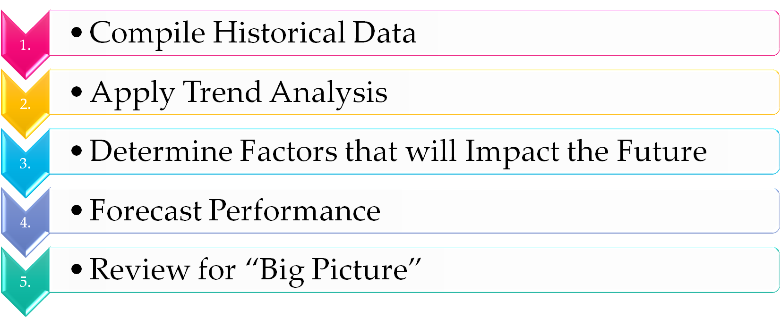
NAF AOB Process
Notes:
Five Steps to Preparing An AOB
Compile Historical Data
Calendars: Activity, FMWR, Garrison, Local Economy, etc.
Financial:
Apply Trend Analysis
Determine Factors that will impact Future
Forecast Performance
Review the “BIG PICTURE”

Slide 141
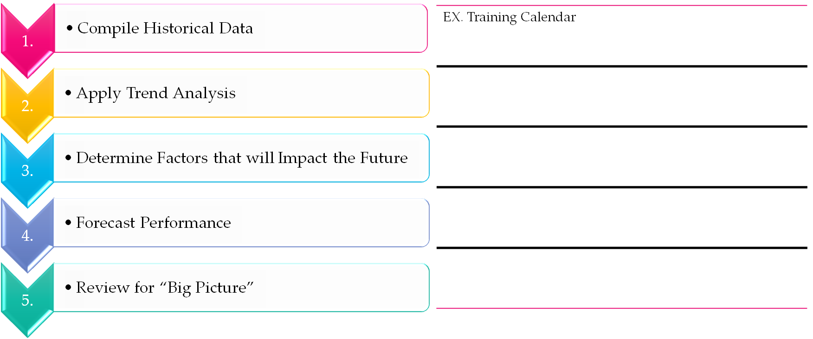
NAF AOB Process: Group Exercise
Brainstorm examples of things we would look at for the 5 steps
Notes:
Five Steps to Preparing An AOB
1. Compile Historical Data
Calendars: Activity, FMWR, Garrison, Local Economy, etc.
Financial: Monthly Income Statements, DARs, Deposits, Variance Reports, etc.
Non-Financial: AARs, Marketing Plan, Participation #s, Customer Feedback, Command Changes, Competition, Lifestyle Trends, Regulation and regulation change
2. Apply Trend Analysis
5 Key Financial Trends
? How has my program performed over the last 3-5 yrs?
? Did I execute my program to budget last year?
? What months were better than others?
? What programs, activities, initiatives did better than others?
? Was participation up or down?
3. Determine Factors that will impact Future
Fluctuations in Income (UFM, funding targets, APF support)
Budget reductions and revisions
Funding cuts/efficiencies
Government/Politics – drawdown or up?
Policy changes
Command changes
Strategic Plans/Guidance
Operating guidance
World and US economies
Laws
Currency changes (OCONUS)
Weather
Environment/sustainability
Forecast Performance
By event or program
Participation
? Should I be making a profit?
? Should I be applying break-even analysis?
Review the “BIG PICTURE”
?Does my data make sense?
? Do my numbers and dollars appear reasonable?
? Am I providing my customers with the services they want?
? Am I providing my customers with the level of service(s) they want and deserve?
? Are my assumptions based on data and are they reasonable?
? Can I live up to my projections?

Slide 142

5 Steps to Preparing a NAF AOB
Compile Historical Data
  Calendars
    Activity, FMWR, Garrison, Local Economy, etc.
  Financial
    Monthly Income Statements, DARs, Deposits, Variance Reports, etc.
  Non-Financial
    AARs, Marketing Plan, Participation #s, Customer Feedback, Command Changes, Competition, Lifestyle Trends, Regulation and regulation change
Notes:
Five Steps to Preparing An AOB
1. Compile Historical Data
Calendars: Activity, FMWR, Garrison, Local Economy, etc.
Financial: Monthly Income Statements, DARs, Deposits, Variance Reports, etc.
Non-Financial: AARs, Marketing Plan, Participation #s, Customer Feedback, Command Changes, Competition, Lifestyle Trends, Regulation and regulation change
2. Apply Trend Analysis
5 Key Financial Trends
? How has my program performed over the last 3-5 yrs?
? Did I execute my program to budget last year?
? What months were better than others?
? What programs, activities, initiatives did better than others?
? Was participation up or down?
3. Determine Factors that will impact Future
Fluctuations in Income (UFM, funding targets, APF support)
Budget reductions and revisions
Funding cuts/efficiencies
Government/Politics – drawdown or up?
Policy changes
Command changes
Strategic Plans/Guidance
Operating guidance
World and US economies
Laws
Currency changes (OCONUS)
Weather
Environment/sustainability
Forecast Performance
By event or program
Participation
? Should I be making a profit?
? Should I be applying break-even analysis?
Review the “BIG PICTURE”
?Does my data make sense?
? Do my numbers and dollars appear reasonable?
? Am I providing my customers with the services they want?
? Am I providing my customers with the level of service(s) they want and deserve?
? Are my assumptions based on data and are they reasonable?
? Can I live up to my projections?

Slide 143
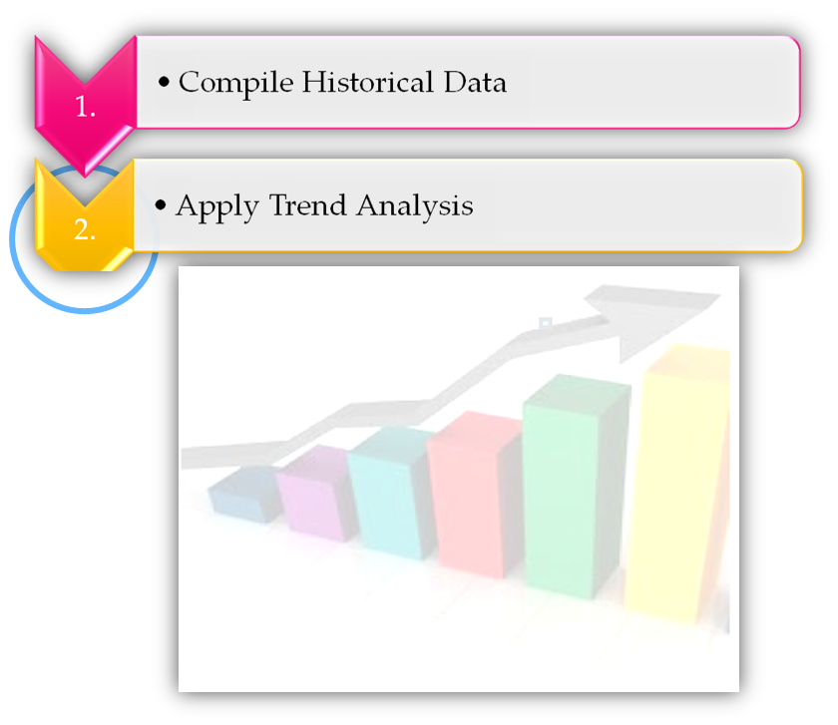
5 Steps to Preparing a NAF AOB
Apply Trend Analysis
  5 Key Financial Reports
  How has my program performed over the last 3-5 yrs?
  Did I execute my program to budget last year?
  What months were better than others?
  What programs, activities, initiatives did better than others?
  Was participation up or down?
Notes:
Five Steps to Preparing An AOB
1. Compile Historical Data
Calendars: Activity, FMWR, Garrison, Local Economy, etc.
Financial: Monthly Income Statements, DARs, Deposits, Variance Reports, etc.
Non-Financial: AARs, Marketing Plan, Participation #s, Customer Feedback, Command Changes, Competition, Lifestyle Trends, Regulation and regulation change
2. Apply Trend Analysis
5 Key Financial Trends
? How has my program performed over the last 3-5 yrs?
? Did I execute my program to budget last year?
? What months were better than others?
? What programs, activities, initiatives did better than others?
? Was participation up or down?
3. Determine Factors that will impact Future
Fluctuations in Income (UFM, funding targets, APF support)
Budget reductions and revisions
Funding cuts/efficiencies
Government/Politics – drawdown or up?
Policy changes
Command changes
Strategic Plans/Guidance
Operating guidance
World and US economies
Laws
Currency changes (OCONUS)
Weather
Environment/sustainability
Forecast Performance
By event or program
Participation
? Should I be making a profit?
? Should I be applying break-even analysis?
Review the “BIG PICTURE”
?Does my data make sense?
? Do my numbers and dollars appear reasonable?
? Am I providing my customers with the services they want?
? Am I providing my customers with the level of service(s) they want and deserve?
? Are my assumptions based on data and are they reasonable?
? Can I live up to my projections?

Slide 144
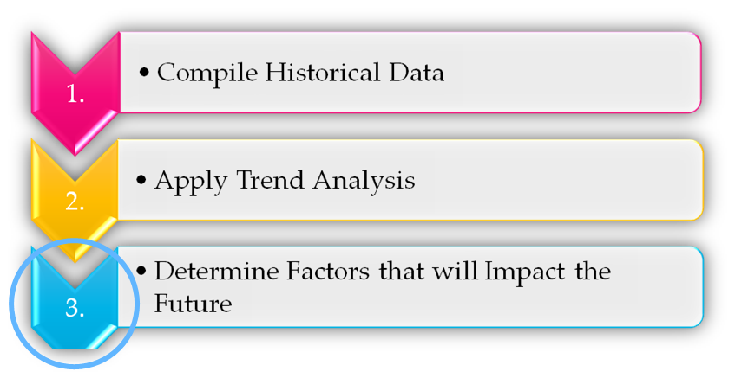
5 Steps to Preparing a NAF AOB
Determine Factors that will impact Future
  Fluctuations in Income
  Budget reductions and revisions
  Funding cuts/efficiencies
  Govt/Politics – drawdown or up?
  Policy changes
  Command changes
  Strategic Plans/Guidance
  Operating guidance
  World and US economies
  Laws
  Currency changes (OCONUS)
  Weather
  Environment/sustainability
Notes:
Five Steps to Preparing An AOB
1. Compile Historical Data
Calendars: Activity, FMWR, Garrison, Local Economy, etc.
Financial: Monthly Income Statements, DARs, Deposits, Variance Reports, etc.
Non-Financial: AARs, Marketing Plan, Participation #s, Customer Feedback, Command Changes, Competition, Lifestyle Trends, Regulation and regulation change
2. Apply Trend Analysis
5 Key Financial Trends
? How has my program performed over the last 3-5 yrs?
? Did I execute my program to budget last year?
? What months were better than others?
? What programs, activities, initiatives did better than others?
? Was participation up or down?
3. Determine Factors that will impact Future
Fluctuations in Income (UFM, funding targets, APF support)
Budget reductions and revisions
Funding cuts/efficiencies
Government/Politics – drawdown or up?
Policy changes
Command changes
Strategic Plans/Guidance
Operating guidance
World and US economies
Laws
Currency changes (OCONUS)
Weather
Environment/sustainability
Forecast Performance
By event or program
Participation
? Should I be making a profit?
? Should I be applying break-even analysis?
Review the “BIG PICTURE”
?Does my data make sense?
? Do my numbers and dollars appear reasonable?
? Am I providing my customers with the services they want?
? Am I providing my customers with the level of service(s) they want and deserve?
? Are my assumptions based on data and are they reasonable?
? Can I live up to my projections?

Slide 145
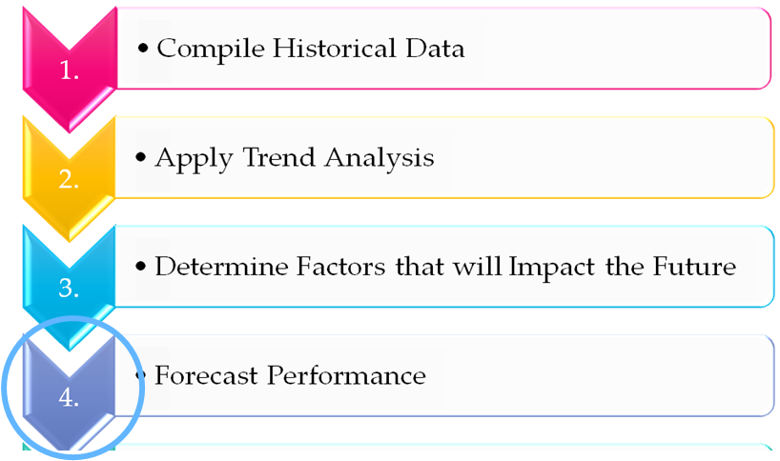
5 Steps to Preparing a NAF AOB
Forecast Performance
  By event or program
  Participation
  Should I be making a profit?
  Should I be applying break-even analysis?
Notes:
Five Steps to Preparing An AOB
1. Compile Historical Data
Calendars: Activity, FMWR, Garrison, Local Economy, etc.
Financial: Monthly Income Statements, DARs, Deposits, Variance Reports, etc.
Non-Financial: AARs, Marketing Plan, Participation #s, Customer Feedback, Command Changes, Competition, Lifestyle Trends, Regulation and regulation change
2. Apply Trend Analysis
5 Key Financial Trends
? How has my program performed over the last 3-5 yrs?
? Did I execute my program to budget last year?
? What months were better than others?
? What programs, activities, initiatives did better than others?
? Was participation up or down?
3. Determine Factors that will impact Future
Fluctuations in Income (UFM, funding targets, APF support)
Budget reductions and revisions
Funding cuts/efficiencies
Government/Politics – drawdown or up?
Policy changes
Command changes
Strategic Plans/Guidance
Operating guidance
World and US economies
Laws
Currency changes (OCONUS)
Weather
Environment/sustainability
Forecast Performance
By event or program
Participation
? Should I be making a profit?
? Should I be applying break-even analysis?
Review the “BIG PICTURE”
?Does my data make sense?
? Do my numbers and dollars appear reasonable?
? Am I providing my customers with the services they want?
? Am I providing my customers with the level of service(s) they want and deserve?
? Are my assumptions based on data and are they reasonable?
? Can I live up to my projections?

Slide 146
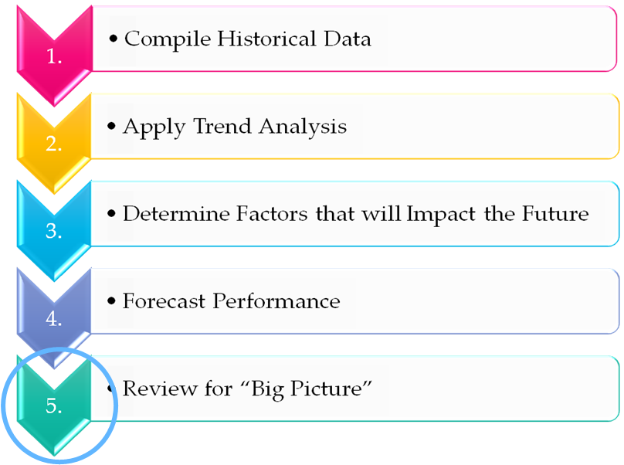
5 Steps to Preparing a NAF AOB
Review the “BIG PICTURE”
  Does my data make sense?
  Do my numbers and dollars appear reasonable?
  Am I providing my customers with the services they want?
  Am I providing my customers with the level of service(s) they want and deserve?
  Are my assumptions based on data and are they reasonable?
  Can I live up to my projections?
Notes:
Five Steps to Preparing An AOB
1. Compile Historical Data
Calendars: Activity, FMWR, Garrison, Local Economy, etc.
Financial: Monthly Income Statements, DARs, Deposits, Variance Reports, etc.
Non-Financial: AARs, Marketing Plan, Participation #s, Customer Feedback, Command Changes, Competition, Lifestyle Trends, Regulation and regulation change
2. Apply Trend Analysis
5 Key Financial Trends
? How has my program performed over the last 3-5 yrs?
? Did I execute my program to budget last year?
? What months were better than others?
? What programs, activities, initiatives did better than others?
? Was participation up or down?
3. Determine Factors that will impact Future
Fluctuations in Income (UFM, funding targets, APF support)
Budget reductions and revisions
Funding cuts/efficiencies
Government/Politics – drawdown or up?
Policy changes
Command changes
Strategic Plans/Guidance
Operating guidance
World and US economies
Laws
Currency changes (OCONUS)
Weather
Environment/sustainability
Forecast Performance
By event or program
Participation
? Should I be making a profit?
? Should I be applying break-even analysis?
Review the “BIG PICTURE”
?Does my data make sense?
? Do my numbers and dollars appear reasonable?
? Am I providing my customers with the services they want?
? Am I providing my customers with the level of service(s) they want and deserve?
? Are my assumptions based on data and are they reasonable?
? Can I live up to my projections?

Slide 147
Formulating Strategy
Vision & Mission
  SWOT
Long-Term Objectives
Alternative Strategies
Strategy Selection

Slide 148
Formulating Strategy
Why is it important to incorporate your own strategies into higher level strategies?
What components could a program manager utilize to formulate a strategy?

Slide 149

Mission Statements
The Army’s mission is to fight and win our Nation’s wars by providing prompt, sustained land dominance across the full range of military operations and spectrum of conflict in support of combatant commanders.
IMCOM integrates and delivers base support to enable readiness for a globally-responsive Army.
We Are the Army's Home

Slide 150
FMWR (G9) Mission
G9 integrates and delivers Family and Morale, Welfare and Recreation programs and services enabling readiness and resilience for a globally-responsive Army.

Slide 151
Carlisle Barracks Family and MWR
MISSION:
Provide sustainable programs and services in support of readiness and resilience.
VISION:
Family and MWR - The Customer’s "First Choice."

Slide 152
Formulating Strategy
Vision & Mission
  SWOT
Long-Term Objectives
Alternative Strategies
Strategy Selection

Slide 153
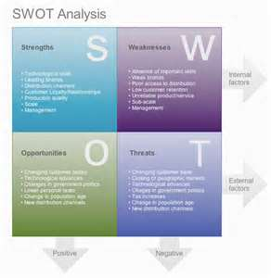
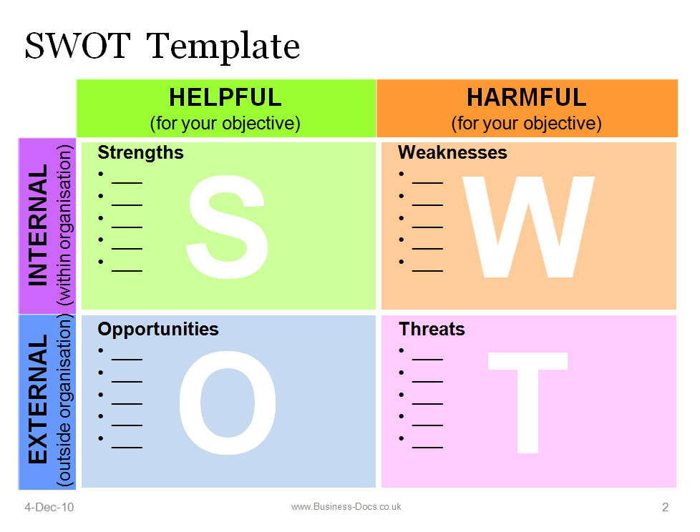
SWOT

Slide 154
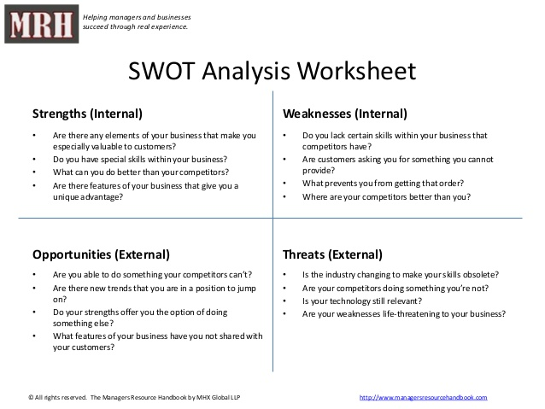

Slide 155
Strengths & Weaknesses
Opportunities & Threats
Group Exercise
In your table groups, identify as many Strengths or Weaknesses, Opportunities and Threats that directly impact the AOB for a program within the Family & MWR organization.
Golf - Auto Skills
Java Café - ODR Equipment Checkout
Bowling - ITR
2. Chart your responses on the Chart Paper.
3. Select a spokesperson to brief the large group.

Slide 156
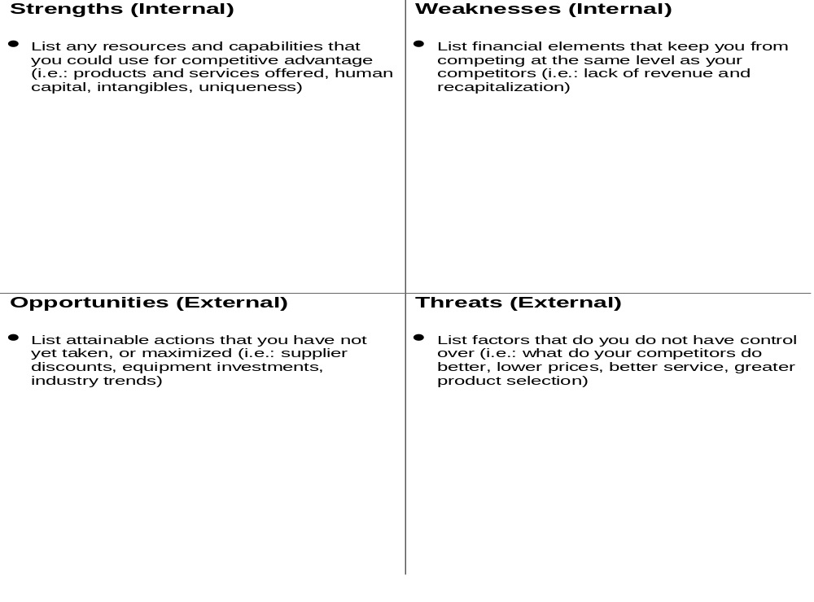

Slide 157
SWOT Wrap Up
Know the mission and vision
Pay attention to the world around you and what your competition is doing
Keep a running SWOT on your desktop
Recognize your Strengths
Seek out Opportunities
Remember that you are the lead strategist

Slide 158
NAF AOB Process
Notes:
Five Steps to Preparing An AOB
Compile Historical Data
Calendars: Activity, FMWR, Garrison, Local Economy, etc.
Financial:
Apply Trend Analysis
Determine Factors that will impact Future
Forecast Performance
Review the “BIG PICTURE”

Slide 159
5yr Plan
The Army requires that each installation develop or revise its 5-year plan annually. As a part of this process, activity managers are required to do the same for their activities.
Benefits of the 5-year plan:
  - Balanced Family and MWR installation program
  - Integration of Family and MWR activities
  - Prioritizes programs according to significance to readiness and retention
  - Meets the needs and desires of the community
Notes:
The 5-Year Plan
The Army requires that each installation develop or revise its 5-year plan annually. As a part of this process, activity managers are required
to do the same for their activities.
Benefits of the 5-year plan include:
1. Provides a balanced Family and MWR installation program.
2. Ensures integration of Family and MWR activities.
3. Prioritizes programs according to the significance of their contribution to readiness and retention.
4. Meets the needs and desires of the community.
How many of you developed or revised your 5-year plan with the FY13 Budget Submission? If you’re not a program/activity manager, you can answer “yes” if you contributed to the process. Green check for yes, red x for no.
The 5-year plan includes both APF and NAF revenues and expenses. It must be prepared in accordance with the
guidance in AR 215-1, as well as current fiscal year (FY) budget guidance.
Chapter 15
Morale, welfare, and recreation Planning and Programming
Section I
Installation Morale, Welfare, and Recreation 5–Year Plan
15–1. Overview
The basis for garrison MWR planning is the MWR 5-year plan. Updated annually, it is the management tool for
justifying program elements and using resources. The 5-year plan documents—
a. Changes needed, as determined by market research, projected funding capability, and assessment of program
alternatives.
b. Priorities established in the assessment process and actions needed to meet requirements.
c. Confirmation that the DOD required revalidation of NAFIs and MWR operations complies with chapter 3.
15–2. Guidelines
At a minimum, plans will integrate results of—
a. Comprehensive review. This includes an annual comprehensive review and consideration of all planning documents
related to MWR operations.
b. Annual MWR needs assessment. If used, attitude and opinion surveys will be conducted in accordance with AR
600–46 and will include—
(1) Patron demographics: distribution of eligible population by grade, sex, age, marital status, and Family members
of active duty military population with percentage residing on post; retired and RC service members and full-time
DOD civilian employees residing in the local community; and other eligible patrons.
(2) Unique considerations: availability of similar private and public sector services; population life-style traits
(interests, use of spare time, opinions); environmental, force protection, and geographical factors that may impact
decisions.
(3) American lifestyle trends: regional, national, and industry data, program-specific forecasts, general market
p r o j e c t i o n s f o r p u r c h a s i n g , l e i s u r e t i m e p a t t e r n s b y a g e g r o u p , a n d p r e d i c t e d c h a n g e s i n A m e r i c a n F a m i l y
demographics.
(4) Alternatives: identification of potential program or facility realignments, to include elimination, expansion,
replacement, consolidation, or integration, and potential nontraditional methods for delivering services. In addition to
reviewing availability of private and public sector services, contractor services will be investigated, considered, and
used when appropriate.
c. Priorities: community conditions and projections and the needs of services will be the evaluative basis for
determining priorities (not the availability of resources). Program elements will be prioritized in a continuum, ranging
from those that are given top priority to those that add variety to the overall program. A program’s impact on military
readiness requirements and the physical and emotional needs of Soldiers will distinguish it for higher priority
placement. Because priorities are garrison unique, garrisons may not have every authorized MWR program.
d. Financial management strategies: APF and NAF resourcing and local pricing necessary to satisfy current commitments
and out-year priorities established in the planning process are delineated by fiscal year, funding source, and
application of funds. Use of APF and NAF will be justified. Funding will be integrated into the POM requirement.

Slide 160
5yr Plan Program Requirements
Includes both APF and NAF revenues and expenses
Must be prepared in accordance with guidance from:
  AR 215-1
    Section 15-1 and 15-2
  Current fiscal year (FY) budget guidance
      https://army.deps.mil/army/cmds/imcom_G9/G9/Divisions/Pages/NAFFM_Bdgt_Analysis.aspx
Notes:
Next slide
The 5-year plan includes both APF and NAF revenues and expenses.
It must be prepared in accordance with the guidance in AR 215-1 (sections 15-1 and 15-2), as well as current fiscal year (FY) budget guidance. (Army MWR website)
Chapter 15
Morale, welfare, and recreation Planning and Programming
Section I
Installation Morale, Welfare, and Recreation 5–Year Plan
15–1. Overview
The basis for garrison MWR planning is the MWR 5-year plan. Updated annually, it is the management tool for
justifying program elements and using resources. The 5-year plan documents—
a. Changes needed, as determined by market research, projected funding capability, and assessment of program
alternatives.
b. Priorities established in the assessment process and actions needed to meet requirements.
c. Confirmation that the DOD required revalidation of NAFIs and MWR operations complies with chapter 3.
15–2. Guidelines
At a minimum, plans will integrate results of—
a. Comprehensive review. This includes an annual comprehensive review and consideration of all planning documents
related to MWR operations.
b. Annual MWR needs assessment. If used, attitude and opinion surveys will be conducted in accordance with AR
600–46 and will include—
(1) Patron demographics: distribution of eligible population by grade, sex, age, marital status, and Family members
of active duty military population with percentage residing on post; retired and RC service members and full-time
DOD civilian employees residing in the local community; and other eligible patrons.
(2) Unique considerations: availability of similar private and public sector services; population life-style traits
(interests, use of spare time, opinions); environmental, force protection, and geographical factors that may impact
decisions.
(3) American lifestyle trends: regional, national, and industry data, program-specific forecasts, general market
p r o j e c t i o n s f o r p u r c h a s i n g , l e i s u r e t i m e p a t t e r n s b y a g e g r o u p , a n d p r e d i c t e d c h a n g e s i n A m e r i c a n F a m i l y
demographics.
(4) Alternatives: identification of potential program or facility realignments, to include elimination, expansion,
replacement, consolidation, or integration, and potential nontraditional methods for delivering services. In addition to
reviewing availability of private and public sector services, contractor services will be investigated, considered, and
used when appropriate.
c. Priorities: community conditions and projections and the needs of services will be the evaluative basis for
determining priorities (not the availability of resources). Program elements will be prioritized in a continuum, ranging
from those that are given top priority to those that add variety to the overall program. A program’s impact on military
readiness requirements and the physical and emotional needs of Soldiers will distinguish it for higher priority
placement. Because priorities are garrison unique, garrisons may not have every authorized MWR program.
d. Financial management strategies: APF and NAF resourcing and local pricing necessary to satisfy current commitments
and out-year priorities established in the planning process are delineated by fiscal year, funding source, and
application of funds. Use of APF and NAF will be justified. Funding will be integrated into the POM requirement.

Slide 161
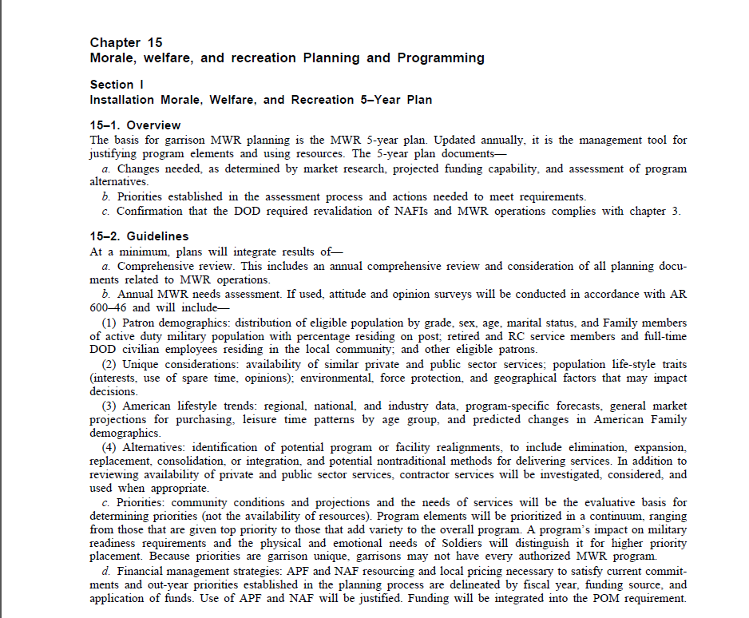
5yr Plan Program Requirements
AR 215-1 Guidelines:
At a minimum, plans will integrate the results of -
  Comprehensive review(s)
  Needs assessment(s)
  Priorities
  Financial management strategies
Notes:
According to AR 215-1, the 5-year plan is a management tool for justifying program elements and using resources.
The 5-year plan documents—
a. Changes needed (as determined by market research), projected funding capability, and assessment of program
alternatives.
b. Priorities are established in the assessment process and the actions needed to meet requirements.
c. Lastly, it confirms the DOD required revalidation of NAFIs and MWR operations.
15–2. Guidelines
At a minimum, plans will integrate results of—
a. Comprehensive review(s). This includes an annual review and consideration of all planning documents related to MWR operations.
b. An annual MWR needs assessment(s)that includes—
(1) Patron demographics with a distribution of eligible population by grade, sex, age, marital status, and Family members of active duty military population with percentage residing on post; retired and RC service members and full-time DOD civilian employees residing in the local community; and other eligible patrons.
(2) Unique considerations: availability of similar private and public sector services; population life-style traits (interests, use of spare time, opinions); environmental, force protection, and geographical factors that may impact decisions.
(3) American lifestyle trends: regional, national, and industry data, program-specific forecasts, general market projections for purchasing, leisure time patterns by age group, and predicted changes in the American Family demographic.
(4) Alternatives: identification of potential program or facility realignments, to include elimination, expansion, replacement, consolidation, or integration, and potential nontraditional methods for delivering services. In addition to reviewing availability of private and public sector services, contractor services will be investigated, considered, and used when appropriate.
c. Priorities: community conditions and projections and the needs of services will be the evaluative basis for determining priorities (not the availability of resources). Program elements will be prioritized in a continuum, ranging from those that are given top priority to those that add variety to the overall program. A program’s impact on military readiness requirements and the physical and emotional needs of Soldiers will distinguish it for higher priority placement. Because priorities are garrison unique, garrisons may not have every authorized MWR program.
d. Financial management strategies: APF and NAF resourcing and local pricing necessary to satisfy current commitments and out-year priorities established in the planning process are delineated by fiscal year, funding source, and application of funds. Use of APF and NAF will be justified. Funding will be integrated into the POM requirement.
SAY: Sounds a lot like the AOB process…

Slide 162
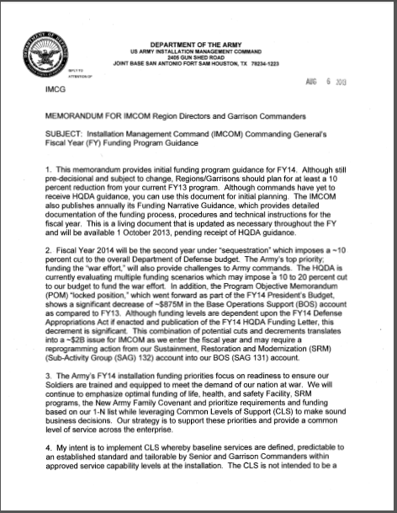
5yr Plan Program Requirements
Current FY Budget Guidance:
You will need to consider both specific initiative guidance as well as any updates to what is required for submission in the 5-year plan
Notes:
Remember to consider any current fiscal year (FY) budget guidance. (Army MWR website)
SAY: Did anyone find anything worth noting in the FY13 Budget Guidance related to changes in the 5 yr Program Requirements?
Raise your hand if you did and would like to share. Green check if you’re ready to move on.

Slide 163
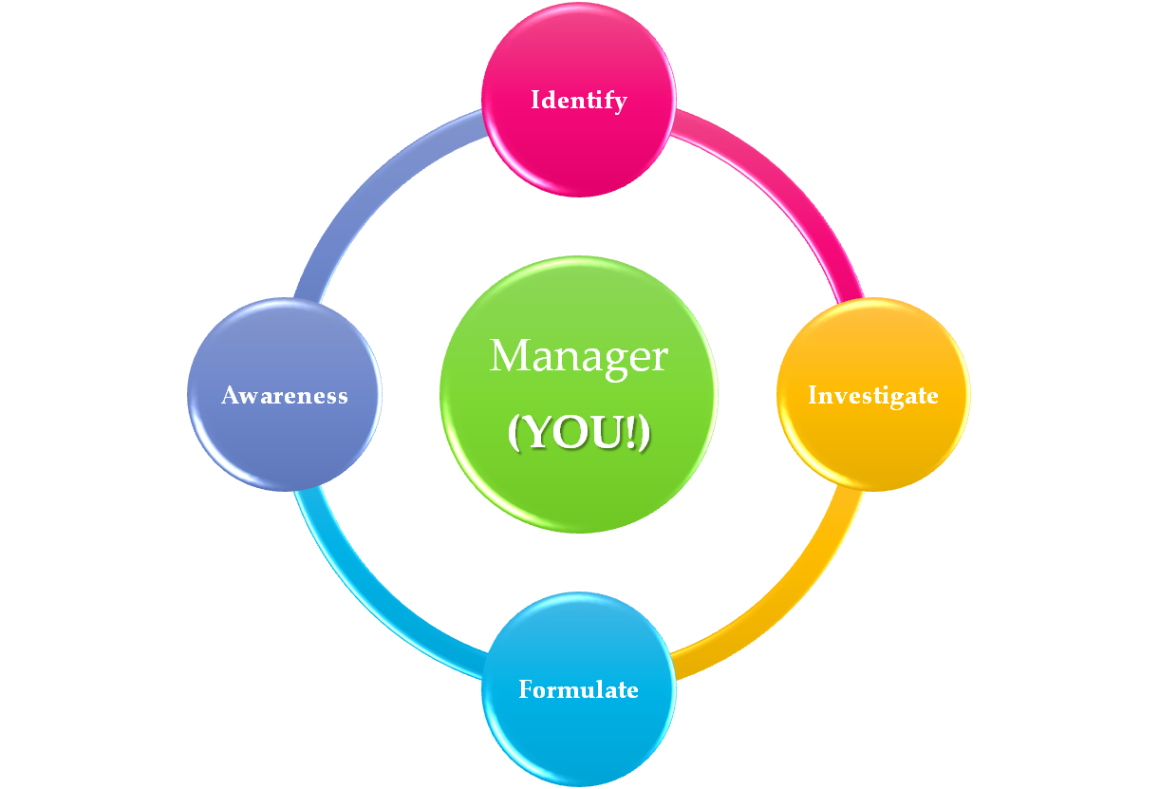
Wrapping it up
You are at the heart of this process and that of managing our facilities and programs
If you are not involved in this process… someone else is making all the decisions for you
Notes:
Let’s go ahead and wrap Session 4 up!
In this process that we’ve been talking about for a few weeks now – Identify, Investigate, Formulate, and Awareness -------(pause)-----the Manager sits at the heart of it.
Today’s module dealt mostly with Formulate and Awareness.
Does everyone see how one thing moves into the other with regard to the process and how the manager is in the middle of all of it?
Smiley face for yes – red x for no.
Remember, if you are not involved in this process – someone else is making all the decisions for you!

Slide 164
Questions?

Slide 165
Module 5
Annual Operating Budget (AOB)

Slide 166
Objectives
Given a scenario, apply the 5-Steps of the NAF Annual Operating Budget Process. Learners will:
  Compile Historical Data
  Apply a Trend Analysis
  Determine factors that will impact the future
  Forecast Performance and determine requirements
  Review Big Picture
  Define components of the Manager’s Narrative in the NAF AOB and relate to budget and planning process

Slide 167
NAF AOB Process ~ 5 Steps
Notes:
Five Steps to Preparing An AOB
Compile Historical Data
Apply Trend Analysis
Determine Factors that will impact Future
Forecast Performance
Review the “BIG PICTURE”

Slide 168
5 Steps to Preparing a NAF AOB
1. Compile Historical Data
  Calendars
  Financial
  Non-Financial
2. Apply Trend Analysis
  5 Key Financial Trends
  How has my program performed over the last 3-5 yrs?
3. Determine Factors that will impact the Future
  Budget reductions and revisions
  Policy, Command changes
4. Forecast Performance
  Should I be making a profit?
  Should I be applying break-even analysis?
5. Review the “Big Picture”
  Does my data make sense?
  Can I live up to my projections
Notes:
Five Steps to Preparing An AOB
1. Compile Historical Data
Calendars: Activity, FMWR, Garrison, Local Economy, etc.
Financial: Monthly Income Statements, DARs, Deposits, Variance Reports, etc.
Non-Financial: AARs, Marketing Plan, Participation #s, Customer Feedback, Command Changes, Competition, Lifestyle Trends, regulation and regulation change
2. Apply Trend Analysis
5 Key Financial Trends
How has my program performed over the last 3-5 yrs?
Did I execute my program to budget last year?
What months were better than others?
What programs, activities, initiatives did better than others?
Was participation up or down?
3. Determine Factors that will impact Future
Fluctuations in Income (UFM, funding targets, APF support)
Budget reductions and revisions
Funding cuts/efficiencies
Government/Politics – drawdown or up?
Policy changes
Command changes
Strategic Plans/Guidance
Operating guidance
World and US economies
Laws
Currency changes (OCONUS)
Weather
Environment/sustainability
Forecast Performance
By event or program
Participation
Should I be making a profit?
Should I be applying break-even analysis?
Review the “BIG PICTURE”
Does my data make sense?
Do my numbers and dollars appear reasonable?
Am I providing my customers with the services they want?
Am I providing my customers with the level of service(s) they want and deserve?
Are my assumptions based on data and are they reasonable?
Can I live up to my projections?

Slide 169

Scenario
You are the Program Manager for an Outdoor Recreation Program (ODR) at Ft. Perfect, USA. The Director of FMWR has informed you that the lake will be open next summer and to reopen the snack bar in anticipation that the swim season and lake recreational activities will bring in hungry patrons.
Given the scenario (in the participant guide) complete the NAF AOB process in order to prepare to open the West Beach Snack Bar next summer.

Slide 170
Group Instructions
Brainstorm what you need to do as a Manager given the scenario and the 5 Steps to preparing your NAF AOB.
You will have 10 minutes to complete each step.
  We will do 1 step at a time.
Chart your responses on your Chart Paper.
Select a spokesperson to brief the main group.

Slide 171
5 Steps to Preparing a NAF AOB
Compile Historical Data
  Calendars
    Activity, FMWR, Garrison, Local Economy, etc.
  Financial
    Monthly Income Statements, DARs, Deposits, Variance Reports, etc.
  Non-Financial
    AARs, Marketing Plan, Participation #s, Customer Feedback, Command Changes, Competition, Lifestyle Trends, Regulation and regulation change
Notes:
Five Steps to Preparing An AOB
1. Compile Historical Data
Calendars: Activity, FMWR, Garrison, Local Economy, etc.
Financial: Monthly Income Statements, DARs, Deposits, Variance Reports, etc.
Non-Financial: AARs, Marketing Plan, Participation #s, Customer Feedback, Command Changes, Competition, Lifestyle Trends, Regulation and regulation change
2. Apply Trend Analysis
5 Key Financial Trends
? How has my program performed over the last 3-5 yrs?
? Did I execute my program to budget last year?
? What months were better than others?
? What programs, activities, initiatives did better than others?
? Was participation up or down?
3. Determine Factors that will impact Future
Fluctuations in Income (UFM, funding targets, APF support)
Budget reductions and revisions
Funding cuts/efficiencies
Government/Politics – drawdown or up?
Policy changes
Command changes
Strategic Plans/Guidance
Operating guidance
World and US economies
Laws
Currency changes (OCONUS)
Weather
Environment/sustainability
Forecast Performance
By event or program
Participation
? Should I be making a profit?
? Should I be applying break-even analysis?
Review the “BIG PICTURE”
?Does my data make sense?
? Do my numbers and dollars appear reasonable?
? Am I providing my customers with the services they want?
? Am I providing my customers with the level of service(s) they want and deserve?
? Are my assumptions based on data and are they reasonable?
? Can I live up to my projections?

Slide 172
5 Steps to Preparing a NAF AOB
Apply Trend Analysis
  5 Key Financial Trends
  How has my program performed over the last 3-5 yrs?
  Did I execute my program to budget last year?
  What months were better than others?
  What programs, activities, initiatives did better than others?
  Was participation up or down?
Notes:
Five Steps to Preparing An AOB
1. Compile Historical Data
Calendars: Activity, FMWR, Garrison, Local Economy, etc.
Financial: Monthly Income Statements, DARs, Deposits, Variance Reports, etc.
Non-Financial: AARs, Marketing Plan, Participation #s, Customer Feedback, Command Changes, Competition, Lifestyle Trends, Regulation and regulation change
2. Apply Trend Analysis
5 Key Financial Trends
? How has my program performed over the last 3-5 yrs?
? Did I execute my program to budget last year?
? What months were better than others?
? What programs, activities, initiatives did better than others?
? Was participation up or down?
3. Determine Factors that will impact Future
Fluctuations in Income (UFM, funding targets, APF support)
Budget reductions and revisions
Funding cuts/efficiencies
Government/Politics – drawdown or up?
Policy changes
Command changes
Strategic Plans/Guidance
Operating guidance
World and US economies
Laws
Currency changes (OCONUS)
Weather
Environment/sustainability
Forecast Performance
By event or program
Participation
? Should I be making a profit?
? Should I be applying break-even analysis?
Review the “BIG PICTURE”
?Does my data make sense?
? Do my numbers and dollars appear reasonable?
? Am I providing my customers with the services they want?
? Am I providing my customers with the level of service(s) they want and deserve?
? Are my assumptions based on data and are they reasonable?
? Can I live up to my projections?

Slide 173
5 Steps to Preparing a NAF AOB
Determine Factors that will impact Future
  Fluctuations in Income
  Budget reductions and revisions
  Funding cuts/efficiencies
  Gov’t/Politics – drawdown or up?
  Policy changes
  Command changes
  Strategic Plans/Guidance
  Operating guidance
  World and US economies
  Laws
  Currency changes (OCONUS)
  Weather
  Environment/sustainability
Notes:
Five Steps to Preparing An AOB
1. Compile Historical Data
Calendars: Activity, FMWR, Garrison, Local Economy, etc.
Financial: Monthly Income Statements, DARs, Deposits, Variance Reports, etc.
Non-Financial: AARs, Marketing Plan, Participation #s, Customer Feedback, Command Changes, Competition, Lifestyle Trends, Regulation and regulation change
2. Apply Trend Analysis
5 Key Financial Trends
? How has my program performed over the last 3-5 yrs?
? Did I execute my program to budget last year?
? What months were better than others?
? What programs, activities, initiatives did better than others?
? Was participation up or down?
3. Determine Factors that will impact Future
Fluctuations in Income (UFM, funding targets, APF support)
Budget reductions and revisions
Funding cuts/efficiencies
Government/Politics – drawdown or up?
Policy changes
Command changes
Strategic Plans/Guidance
Operating guidance
World and US economies
Laws
Currency changes (OCONUS)
Weather
Environment/sustainability
Forecast Performance
By event or program
Participation
? Should I be making a profit?
? Should I be applying break-even analysis?
Review the “BIG PICTURE”
?Does my data make sense?
? Do my numbers and dollars appear reasonable?
? Am I providing my customers with the services they want?
? Am I providing my customers with the level of service(s) they want and deserve?
? Are my assumptions based on data and are they reasonable?
? Can I live up to my projections?

Slide 174
5 Steps to Preparing a NAF AOB
Forecast Performance
  By event or program
  Participation
  Should I be making a profit?
  Should I be applying break-even analysis?
Notes:
Five Steps to Preparing An AOB
1. Compile Historical Data
Calendars: Activity, FMWR, Garrison, Local Economy, etc.
Financial: Monthly Income Statements, DARs, Deposits, Variance Reports, etc.
Non-Financial: AARs, Marketing Plan, Participation #s, Customer Feedback, Command Changes, Competition, Lifestyle Trends, Regulation and regulation change
2. Apply Trend Analysis
5 Key Financial Trends
? How has my program performed over the last 3-5 yrs?
? Did I execute my program to budget last year?
? What months were better than others?
? What programs, activities, initiatives did better than others?
? Was participation up or down?
3. Determine Factors that will impact Future
Fluctuations in Income (UFM, funding targets, APF support)
Budget reductions and revisions
Funding cuts/efficiencies
Government/Politics – drawdown or up?
Policy changes
Command changes
Strategic Plans/Guidance
Operating guidance
World and US economies
Laws
Currency changes (OCONUS)
Weather
Environment/sustainability
Forecast Performance
By event or program
Participation
? Should I be making a profit?
? Should I be applying break-even analysis?
Review the “BIG PICTURE”
?Does my data make sense?
? Do my numbers and dollars appear reasonable?
? Am I providing my customers with the services they want?
? Am I providing my customers with the level of service(s) they want and deserve?
? Are my assumptions based on data and are they reasonable?
? Can I live up to my projections?

Slide 175
5 Steps to Preparing a NAF AOB
Review the “BIG PICTURE”
  Does my data make sense?
  Do my numbers and dollars appear reasonable?
  Am I providing my customers with the services they want?
  Am I providing my customers with the level of service(s) they want and deserve?
  Are my assumptions based on data and are they reasonable?
  Can I live up to my projections?
Notes:
Five Steps to Preparing An AOB
1. Compile Historical Data
Calendars: Activity, FMWR, Garrison, Local Economy, etc.
Financial: Monthly Income Statements, DARs, Deposits, Variance Reports, etc.
Non-Financial: AARs, Marketing Plan, Participation #s, Customer Feedback, Command Changes, Competition, Lifestyle Trends, Regulation and regulation change
2. Apply Trend Analysis
5 Key Financial Trends
? How has my program performed over the last 3-5 yrs?
? Did I execute my program to budget last year?
? What months were better than others?
? What programs, activities, initiatives did better than others?
? Was participation up or down?
3. Determine Factors that will impact Future
Fluctuations in Income (UFM, funding targets, APF support)
Budget reductions and revisions
Funding cuts/efficiencies
Government/Politics – drawdown or up?
Policy changes
Command changes
Strategic Plans/Guidance
Operating guidance
World and US economies
Laws
Currency changes (OCONUS)
Weather
Environment/sustainability
Forecast Performance
By event or program
Participation
? Should I be making a profit?
? Should I be applying break-even analysis?
Review the “BIG PICTURE”
?Does my data make sense?
? Do my numbers and dollars appear reasonable?
? Am I providing my customers with the services they want?
? Am I providing my customers with the level of service(s) they want and deserve?
? Are my assumptions based on data and are they reasonable?
? Can I live up to my projections?

Slide 176
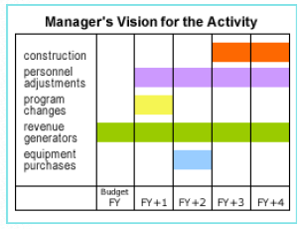
Manager’s Narrative
Describes
  Current program
  Out-years
Includes
  Needed construction, personnel adjustments, program changes, revenue generators, equipment, etc.
  Planned changes or improvements
  HOW and WHY there is a variance between actual and budget
Incorporates manager’s decisions & ideas into long-range plan
Covers the budget year & the next four years
Notes:
The Manager's Narrative, which is rolled into the Garrison Commander’s Narrative for the entire garrison, is one of two components of the
appropriated fund (APF)/nonappropriated fund (NAF) 5-year plan, which documents the planning process.
Does anyone know what the other component is? Raise your hand if you do.
DO: Facilitate response. Answer is CPMC budget
The Manager's Narrative incorporates the activity manager's decisions and ideas into a long-range plan that facilitates the annual operating budget process. It covers the budget year and the next four years (FY+1 to FY+4).
In developing the narrative, first describes the current program and then the program over the next five years. Develop a time line, working backwards chronologically, positioning needed construction, personnel adjustments, program changes, revenue generators, and equipment purchases that will result in a finished product.
The narrative description of planned changes or improvements should reflect the activity manager's vision for the activity. It should include anything necessary to fulfill a new program's requirements or to adjust the activity's resources in preparation for a population or demographic change.

Slide 177
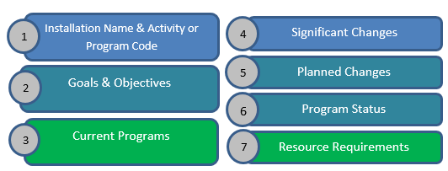
Manager’s Narrative
Notes:
SAY: Let’s talk about what goes in the Manager’s Narrative.
The format required for the Manager's Narrative is specified in each fiscal year's Financial Management
Operating Guidance.
The components of the Manager's Narrative include:
Installation name and the activity or program code (e.g., "KG Community Clubs," or "JB Arts and Crafts")
Goals and objectives
Description of current programs
Description of significant changes
Description of planned changes
Report on status of programs to designated standards.
Resource requirements

Slide 178
Manager’s Narrative
Installation Name & Activity or Program Code
Goals & Objectives
Current Programs
    Serves as the baseline for developing the costs and direction.
Significant Changes
    Description of what has changed since last year such as population changes or new programs.
Planned Changes
    Documentation of decisions for changes or improvements, itemizing requirements by fiscal year.
Program Status
    Requires use of assessment tools such as program-specific evaluations and rating scales.
Resource Requirements
    For all activities and programs, a description of what is needed to meet goals.
Notes:
SAY: Let’s talk about what goes in the Manager’s Narrative.
The format required for the Manager's Narrative is specified in each fiscal year's Financial Management
Operating Guidance.
The components of the Manager's Narrative include:
Installation name and the activity or program code (e.g., "KG Community Clubs," or "JB Arts and Crafts")
Goals and objectives
Description of current programs
Description of significant changes
Description of planned changes
Report on status of programs to designated standards.
Resource requirements

Slide 179
Manager’s Narrative
Match each part of the Manager's Narrative with its description
Description
Requires use of assessment tools such as program-specific evaluations and rating scales.
Documentation of decisions for changes or improvements, itemizing requirements by fiscal year.
Description of what has changed since last year such as population changes or new programs.
For all activities and programs, a description of what is needed to meet goals.
Serves as the baseline for developing the costs and direction.
Manager's Narrative Part
A. Description of current programs
B. Description of significant changes
C. Description of planned changes
D. Report on status of programs to designated standards
E. Resource requirements
Notes:
Lets do a quick knowledge check on the Manager’s Narrative.
On the right side of the slide, we have five descriptions and on the left five parts to the Manager’s Narrative. As a group – staying in the main room – let’s match these up.
(Host) would you please match them up as we answer them?
Raise your hand if you’d like to answer #1?
Facilitate until all 5 are answered.
Great job!
Answers
D
C
B
E
A

Slide 180
Wrapping it up
You are at the heart of this process and that of managing our facilities and programs
If you are not involved in this process… someone else is making all the decisions for you
Notes:
Let’s go ahead and wrap Session 5 up!
Again, we’ve been talking about this process of– Identify, Investigate, Formulate, and Awareness -------(pause)-----where you, the Manager sits at the heart.
Today’s module encompassed every step in this process as we worked through applying the 5 Steps to preparing a NAF AOB.
From here, you would spend some time plugging data into spreadsheets and/or FMBS, writing your Manager’s Narrative, 5 yr Plan, and CPMC budget. And – depending on where your at and your position, if this were budget season (right around the corner) – you’d likely spend a significant amount of time briefing, explaining, justifying and maybe even revising your submission.
Remember, if you are not involved in this process – someone else is making all the decisions for you! Get involved!!!
Let’s move on to review our Session Objectives.

Slide 181
Questions?

Slide 182
Assignment:
Manager’s Narrative Exercise
Develop a Manager’s Narrative for the Snack Bar based on the given scenario
  Use the provided template
Work as a group
  Complete all sections fully
  Use the information ascertained from the AOB group work
Turn in your completed/updated manager’s narrative to the instructors

Slide 183
NAF Financial Management for Program Managers
MG Robert M. Joyce School for Family and MWR
IMCOM G 3/5/7 Training Division

Slide 184
Day 3 Review

Slide 185
3….2….1!!!
3 Things you learned so far this week!
2 Things you are going to take back to your program and apply!
1 Question you might have!

Slide 186
Module 6
The CPMC Process

Slide 187
Objectives
Define and describe the CPMC Process
Identify and apply the Capitalization and Depreciation procedures as they relate to the CPMC Process
Identify and apply the Decision Matrix approach to ranking CPMC proposals
Distinguish and discuss the key components of a CPMC proposal

Slide 188
Group Exercise
Your team is shipwrecked on a deserted island
As a team, decide and agree on five (5) things you would have brought with you if you knew you might be stranded (assume you have food/water)
Rank them in order of importance
Be professional
Chart response on chart paper
Select a spokesperson to brief when we return
Notes:
Five Steps to Preparing An AOB
1. Compile Historical Data
Calendars: Activity, FMWR, Garrison, Local Economy, etc.
Financial: Monthly Income Statements, DARs, Deposits, Variance Reports, etc.
Non-Financial: AARs, Marketing Plan, Participation #s, Customer Feedback, Command Changes, Competition, Lifestyle Trends, Regulation and regulation change
2. Apply Trend Analysis
5 Key Financial Trends
? How has my program performed over the last 3-5 yrs?
? Did I execute my program to budget last year?
? What months were better than others?
? What programs, activities, initiatives did better than others?
? Was participation up or down?
3. Determine Factors that will impact Future
Fluctuations in Income (UFM, funding targets, APF support)
Budget reductions and revisions
Funding cuts/efficiencies
Government/Politics – drawdown or up?
Policy changes
Command changes
Strategic Plans/Guidance
Operating guidance
World and US economies
Laws
Currency changes (OCONUS)
Weather
Environment/sustainability
Forecast Performance
By event or program
Participation
? Should I be making a profit?
? Should I be applying break-even analysis?
Review the “BIG PICTURE”
?Does my data make sense?
? Do my numbers and dollars appear reasonable?
? Am I providing my customers with the services they want?
? Am I providing my customers with the level of service(s) they want and deserve?
? Are my assumptions based on data and are they reasonable?
? Can I live up to my projections?

Slide 189
Deserted Island Price List
Satellite Phone ($570)
Flint ($10)
First Aid Kit ($35)
Lighter ($3)
2-way Radio ($45)
Tent ($100)
Flare Gun ($99)
Duct Tape ($15)
Machete/Hatchet ($42)
Knife ($15)
Rope ($50)

Slide 190
Deserted Island Price List
Tool Box Complete for camping ($28)
Satellite Phone ($570)
Flint ($10)
Fuel ($50)
Generator ($269)
First Aid Kit ($35)
Raft ($240)
2-way Radio ($45)
Tent ($100)
Flare Gun ($99)
Hygiene Products ($25)

Slide 191
Decision Matrix
How did your group prioritize?
Is there a better way?
What is your CPMC decision-making process?

Slide 192

Decision Matrix
Is there a standard matrix?

Slide 193
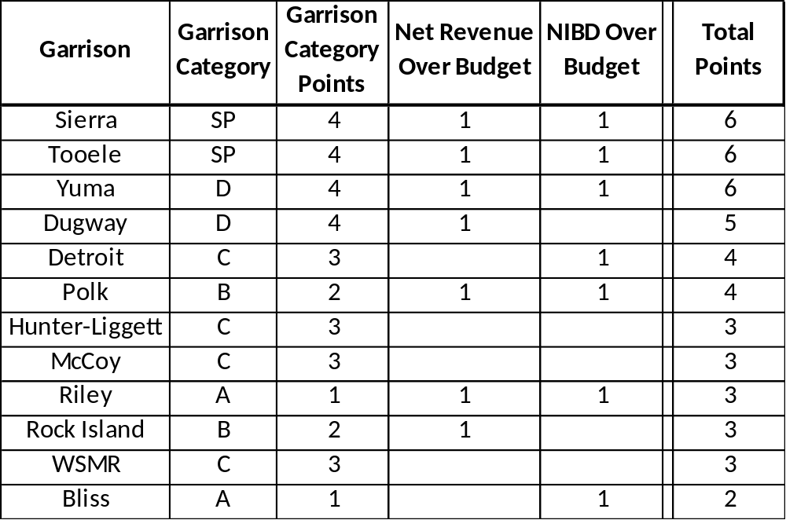
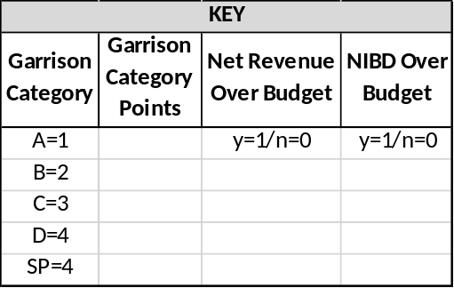
Sample Decision Matrix
Notes:
Five Steps to Preparing An AOB
1. Compile Historical Data
Calendars: Activity, FMWR, Garrison, Local Economy, etc.
Financial: Monthly Income Statements, DARs, Deposits, Variance Reports, etc.
Non-Financial: AARs, Marketing Plan, Participation #s, Customer Feedback, Command Changes, Competition, Lifestyle Trends, Regulation and regulation change
2. Apply Trend Analysis
5 Key Financial Trends
? How has my program performed over the last 3-5 yrs?
? Did I execute my program to budget last year?
? What months were better than others?
? What programs, activities, initiatives did better than others?
? Was participation up or down?
3. Determine Factors that will impact Future
Fluctuations in Income (UFM, funding targets, APF support)
Budget reductions and revisions
Funding cuts/efficiencies
Government/Politics – drawdown or up?
Policy changes
Command changes
Strategic Plans/Guidance
Operating guidance
World and US economies
Laws
Currency changes (OCONUS)
Weather
Environment/sustainability
Forecast Performance
By event or program
Participation
? Should I be making a profit?
? Should I be applying break-even analysis?
Review the “BIG PICTURE”
?Does my data make sense?
? Do my numbers and dollars appear reasonable?
? Am I providing my customers with the services they want?
? Am I providing my customers with the level of service(s) they want and deserve?
? Are my assumptions based on data and are they reasonable?
? Can I live up to my projections?

Slide 194

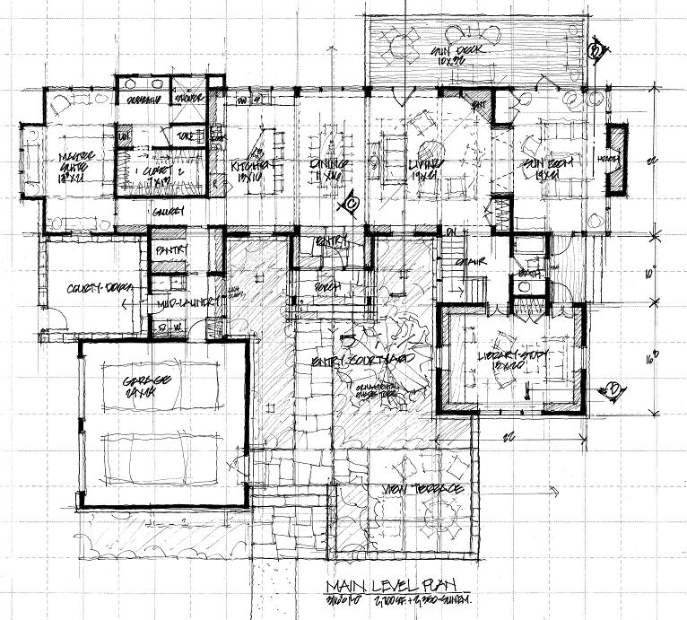
Reviewing the 5 Year Plan
Examining what remains to be executed
Changing priorities
Estimating cost changes
Determining which projects are in progress
Determining the validity of existing projects
Determining what needs to be added to the budget
Notes:
Five Steps to Preparing An AOB
1. Compile Historical Data
Calendars: Activity, FMWR, Garrison, Local Economy, etc.
Financial: Monthly Income Statements, DARs, Deposits, Variance Reports, etc.
Non-Financial: AARs, Marketing Plan, Participation #s, Customer Feedback, Command Changes, Competition, Lifestyle Trends, regulation and regulation change
2. Apply Trend Analysis
5 Key Financial Trends
How has my program performed over the last 3-5 yrs?
Did I execute my program to budget last year?
What months were better than others?
What programs, activities, initiatives did better than others?
Was participation up or down?
3. Determine Factors that will impact Future
Fluctuations in Income (UFM, funding targets, APF support)
Budget reductions and revisions
Funding cuts/efficiencies
Government/Politics – drawdown or up?
Policy changes
Command changes
Strategic Plans/Guidance
Operating guidance
World and US economies
Laws
Currency changes (OCONUS)
Weather
Environment/sustainability
Forecast Performance
By event or program
Participation
Should I be making a profit?
Should I be applying break-even analysis?
Review the “BIG PICTURE”
Does my data make sense?
Do my numbers and dollars appear reasonable?
Am I providing my customers with the services they want?
Am I providing my customers with the level of service(s) they want and deserve?
Are my assumptions based on data and are they reasonable?
Can I live up to my projections?

Slide 195

Capital Purchase and
Minor Construction (CPMC)
AR215-1, Ch. 15-7.
Is it a Capital Purchase? Or is it Construction? Or is it SRM?
NAF Construction from $250K-$1M is considered NAF Minor Construction
IMCOM Directorate approves
Congress tracks major construction $1M or more

Slide 196
Knowledge Check
Fixed assets are tangible properties purchased by or donated to a NAFI that have an expected life of _______ or more and cost _____ or more.
Could also be a group of _____ assets with a useful life of at least ______.
Assets which do not meet capitalization criteria are considered __________items and are not capitalized.
2 years
$2,500
like
2 years
expendable

Slide 197
Knowledge Check
Minor construction projects cost between ________ and ___________.
NAF dollars can be used for maintenance and repair projects over _______, but only after SRM is requested.
______________ approve CPMC projects up to $1,000,000 and __________ tracks projects larger than that amount.
$250,000
$1,000,000
$2,500
IMCOM Directorates
Congress

Slide 198
Capital Purchase and Minor Construction

Slide 199
Capital Purchase and Minor Construction
PROFIT
Examples:
NEW EQUIPMENT
MINOR CONSTRUCTION
What else?
PROFIT
CPMC
NIBD +8%
REINVESTMENT ZONE
NIBD +8%
BREAK EVEN
BREAK EVEN
REQUIREMENTS
REQUIREMENTS
FMWR
OPERATIONAL
EXPENSES
SUPPLIES
LABOR
PROGRAMMING
SUPPLIES
LABOR
PROGRAMMING
INCOME
UFM
SPECIAL FUNDING

Slide 200

Capitalization
Fixed asset
Cash payment
Balance Sheet
Recorded fixed asset
No impact to equity of fund
Notes:
Five Steps to Preparing An AOB
1. Compile Historical Data
Calendars: Activity, FMWR, Garrison, Local Economy, etc.
Financial: Monthly Income Statements, DARs, Deposits, Variance Reports, etc.
Non-Financial: AARs, Marketing Plan, Participation #s, Customer Feedback, Command Changes, Competition, Lifestyle Trends, Regulation and regulation change
2. Apply Trend Analysis
5 Key Financial Trends
? How has my program performed over the last 3-5 yrs?
? Did I execute my program to budget last year?
? What months were better than others?
? What programs, activities, initiatives did better than others?
? Was participation up or down?
3. Determine Factors that will impact Future
Fluctuations in Income (UFM, funding targets, APF support)
Budget reductions and revisions
Funding cuts/efficiencies
Government/Politics – drawdown or up?
Policy changes
Command changes
Strategic Plans/Guidance
Operating guidance
World and US economies
Laws
Currency changes (OCONUS)
Weather
Environment/sustainability
Forecast Performance
By event or program
Participation
? Should I be making a profit?
? Should I be applying break-even analysis?
Review the “BIG PICTURE”
?Does my data make sense?
? Do my numbers and dollars appear reasonable?
? Am I providing my customers with the services they want?
? Am I providing my customers with the level of service(s) they want and deserve?
? Are my assumptions based on data and are they reasonable?
? Can I live up to my projections?

Slide 201
Depreciation
Asset ÷ Life expectancy (in months)
Non-cash expense
Reduces the net income
Accrued cash for replacement
Notes:
Five Steps to Preparing An AOB
1. Compile Historical Data
Calendars: Activity, FMWR, Garrison, Local Economy, etc.
Financial: Monthly Income Statements, DARs, Deposits, Variance Reports, etc.
Non-Financial: AARs, Marketing Plan, Participation #s, Customer Feedback, Command Changes, Competition, Lifestyle Trends, Regulation and regulation change
2. Apply Trend Analysis
5 Key Financial Trends
? How has my program performed over the last 3-5 yrs?
? Did I execute my program to budget last year?
? What months were better than others?
? What programs, activities, initiatives did better than others?
? Was participation up or down?
3. Determine Factors that will impact Future
Fluctuations in Income (UFM, funding targets, APF support)
Budget reductions and revisions
Funding cuts/efficiencies
Government/Politics – drawdown or up?
Policy changes
Command changes
Strategic Plans/Guidance
Operating guidance
World and US economies
Laws
Currency changes (OCONUS)
Weather
Environment/sustainability
Forecast Performance
By event or program
Participation
? Should I be making a profit?
? Should I be applying break-even analysis?
Review the “BIG PICTURE”
?Does my data make sense?
? Do my numbers and dollars appear reasonable?
? Am I providing my customers with the services they want?
? Am I providing my customers with the level of service(s) they want and deserve?
? Are my assumptions based on data and are they reasonable?
? Can I live up to my projections?

Slide 202
Depreciation – Freezer Example
Asset ÷ Life expectancy (in months)
Purchased for $2500
Life expectancy = 2 years
Our monthly depreciation amount would be ___________?
$104.17
Notes:
Five Steps to Preparing An AOB
1. Compile Historical Data
Calendars: Activity, FMWR, Garrison, Local Economy, etc.
Financial: Monthly Income Statements, DARs, Deposits, Variance Reports, etc.
Non-Financial: AARs, Marketing Plan, Participation #s, Customer Feedback, Command Changes, Competition, Lifestyle Trends, Regulation and regulation change
2. Apply Trend Analysis
5 Key Financial Trends
? How has my program performed over the last 3-5 yrs?
? Did I execute my program to budget last year?
? What months were better than others?
? What programs, activities, initiatives did better than others?
? Was participation up or down?
3. Determine Factors that will impact Future
Fluctuations in Income (UFM, funding targets, APF support)
Budget reductions and revisions
Funding cuts/efficiencies
Government/Politics – drawdown or up?
Policy changes
Command changes
Strategic Plans/Guidance
Operating guidance
World and US economies
Laws
Currency changes (OCONUS)
Weather
Environment/sustainability
Forecast Performance
By event or program
Participation
? Should I be making a profit?
? Should I be applying break-even analysis?
Review the “BIG PICTURE”
?Does my data make sense?
? Do my numbers and dollars appear reasonable?
? Am I providing my customers with the services they want?
? Am I providing my customers with the level of service(s) they want and deserve?
? Are my assumptions based on data and are they reasonable?
? Can I live up to my projections?

Slide 203
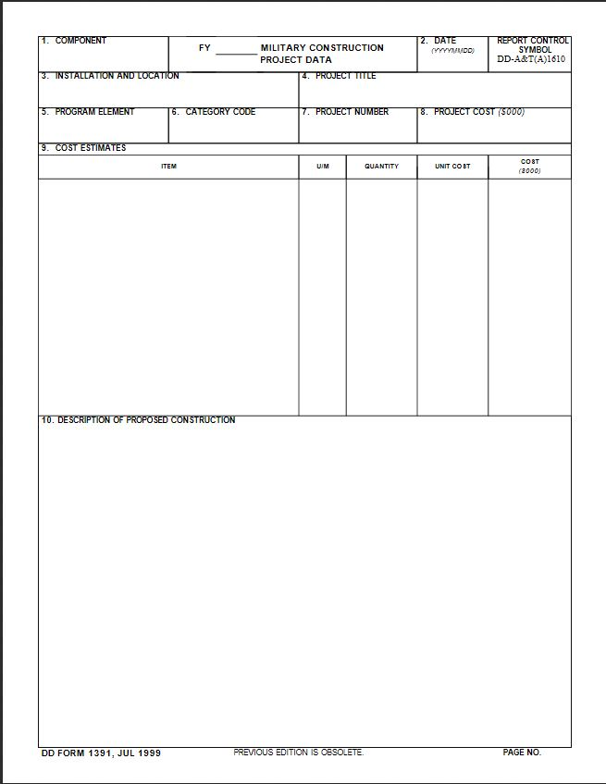
CPMC Proposal
AR215-1, Ch. 15-7.
DD Form 1391
  (Military Construction Project Data)
Consolidated list
Submitted in FMBS
Approved locally
NIBD consideration

Slide 204
CPMC Wrap-Up!
5-year plan
Fixed asset report
Program changes and enhancements
Alternatives
Priorities
FMBS
Get Involved!

Slide 205
Questions?

Slide 206
Module 7
Wrapping it Up!

Slide 207
Assignment:
AOB Variance Report Exercise
Review your Annual Operating Budget (AOB) report
  Complete the analysis section
  Tell us what the variance is saying
    Why the variance occurred
    How you are going to FIX unfavorable variances or DUPLICATE or CONTINUE favorable variances!
Each group will choose 1 person to brief their analysis to the large group
Turn in your completed/updated report to the instructors

Slide 209
GLAC | Actual | Budget | Variance $ | Variance %
AAA – Net Sales | $ | $ | $ | %
CAA – COGS | $ | $ | $ | %
Z6 – Gross Income Sales | $ | $ | $ | %
UFM INC – Payroll | $ | $ | $ | %
UFM INC – Non-Payroll | $ | $ | $ | %
EAA – Total Other Op Income | $ | $ | $ | %
Z10 – Gross Income from Operations | $ | $ | $ | %
UFM Labor | $ | $ | $ | %
GAA – Total Labor | $ | $ | $ | %
GAE – Total Other Operating Expense | $ | $ | $ | %
GGG – Total Operation Expense | $ | $ | $ | %
IAA – Total Other Income | $ | $ | $ | %
KAA – Total Other Expense | $ | $ | $ | %
KAE – NIBD | $ | $ | $ | %

Slide 210
Individual Action Plan
    Actions are clearly stated and based on application of knowledge gained during the course
    Actions are within the control of the individual and include an end date for completion
    Measurements of success are quantitative and measure the success of attaining the action

Slide 211
Expectations

Slide 212
End of Course Survey

Slide 213
NAF Financial Management for Program Managers
MG Robert M. Joyce School for Family and MWR
IMCOM G 3/5/7 Training Division

