Slide 1

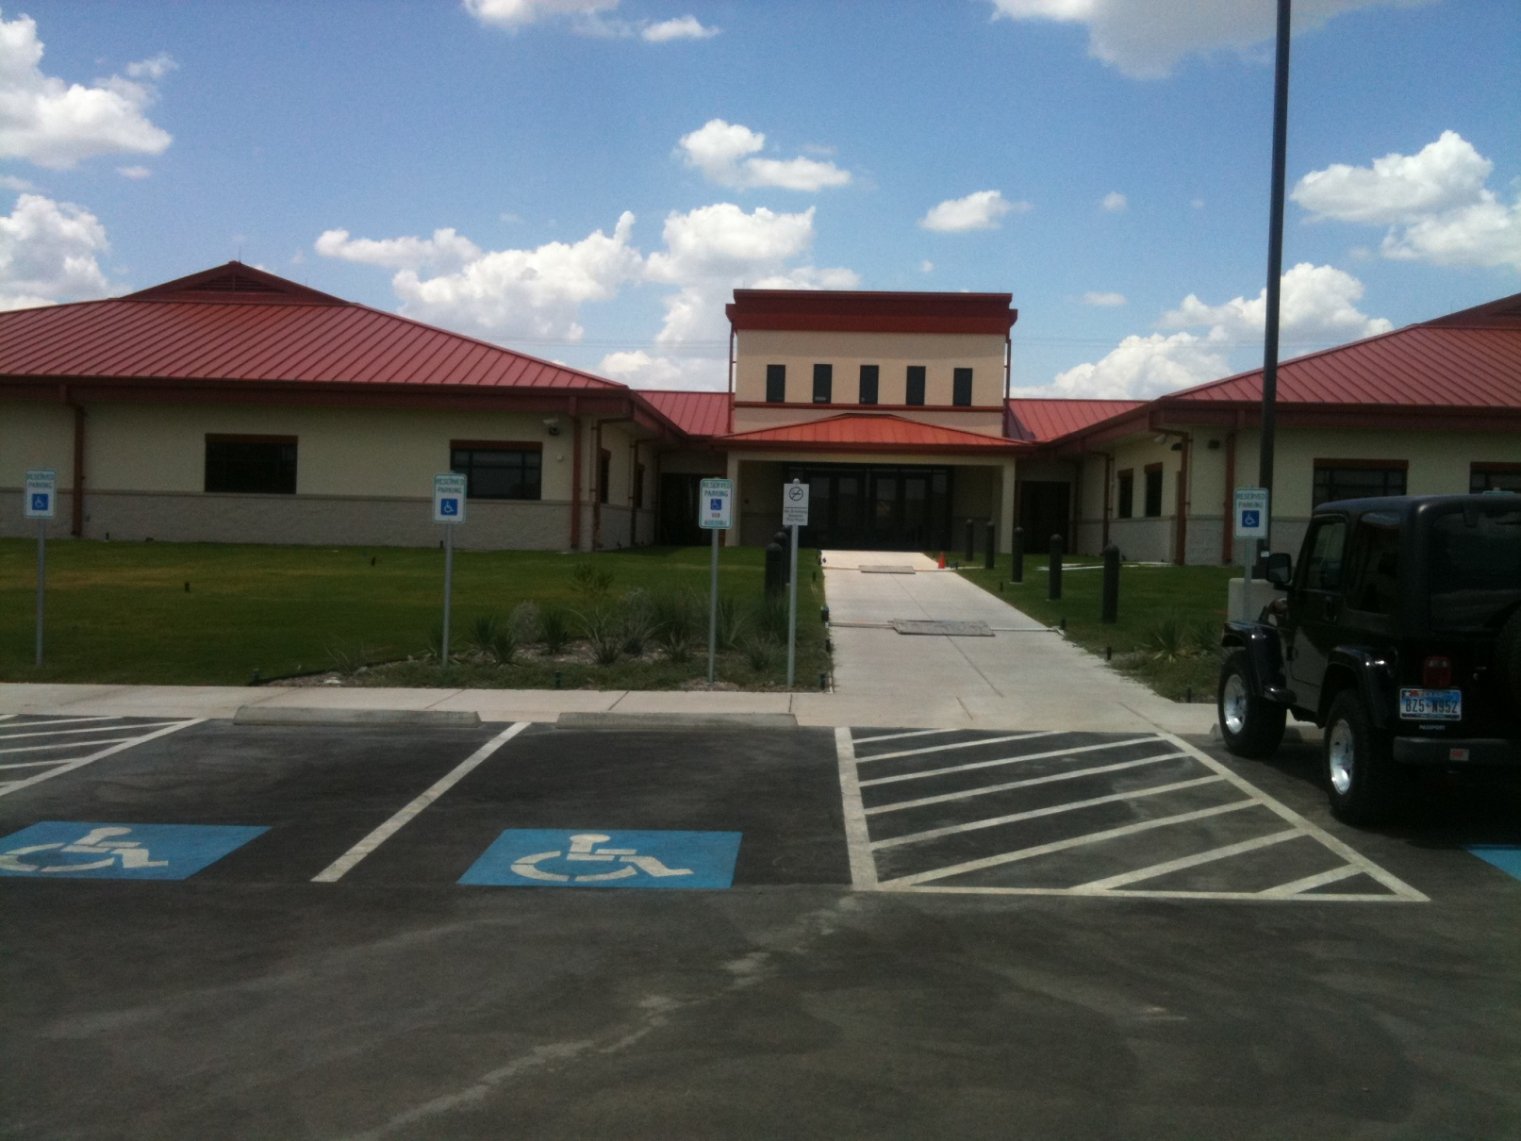
College of Installation Management
MG Robert M. Joyce
School for Family and MWR
2280 Signal Road, Bldg. 4022
San Antonio, TX 78234
Main Tel (210) 466-1050

Slide 2
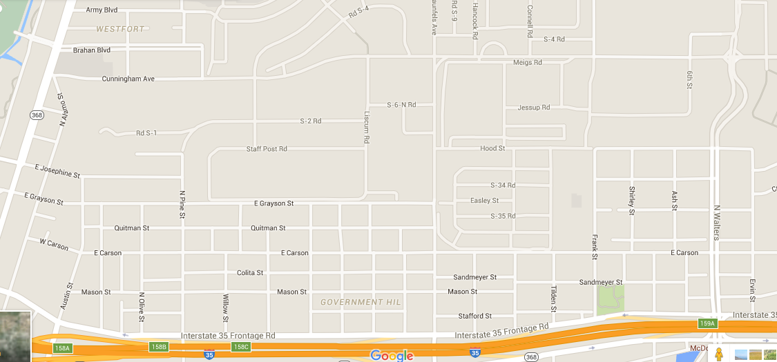
Accessing College of Installation Management
from Walters gate and Wilson gate
Wilson Way
Reynolds Road
Wilson Way
Broadway
Wilson Way
Signal Road
Wilson Gate (CAC only)
Coming from 281 > Josephine > Broadway
Walters Gate & Visitor Center
(24/7)
Coming from I35

Slide 3
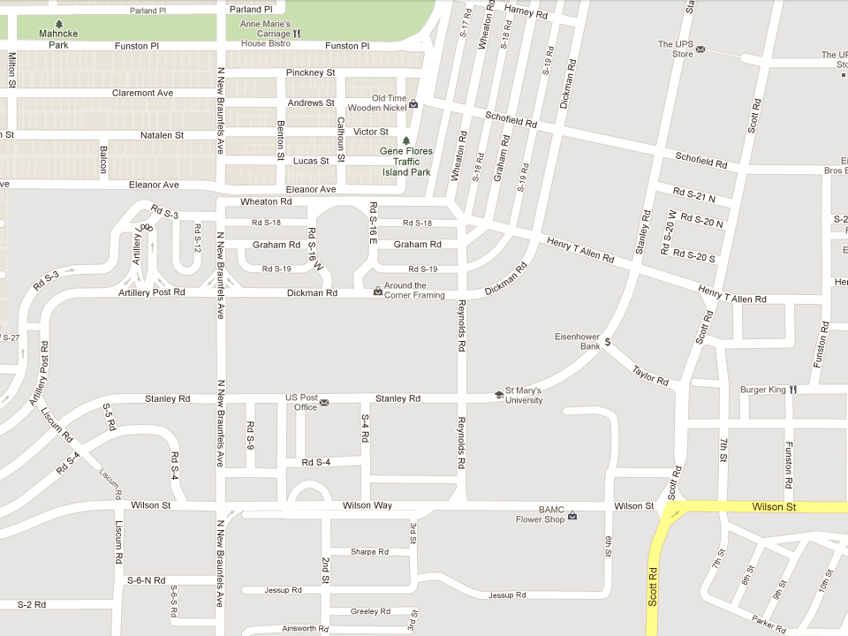
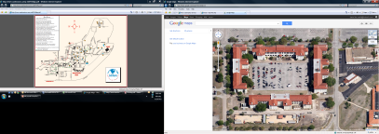

Hancock
Connell
Reynolds
N
Theater
Main Post Chapel
HQ, IMCOM
SIGNAL
College of Installation Management

Slide 4
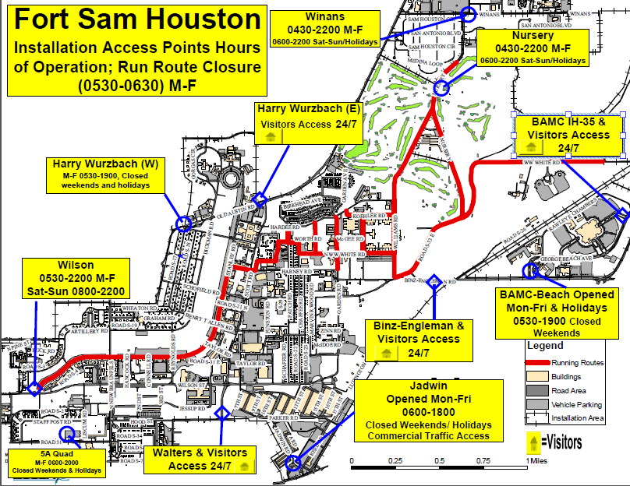
Academy

