Slide 1
Crucial Conversations

Slide 2
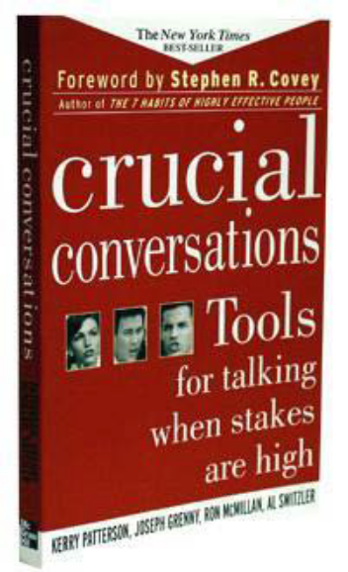
Crucial Conversations
“Tools for talking
when stakes are high”

Slide 3
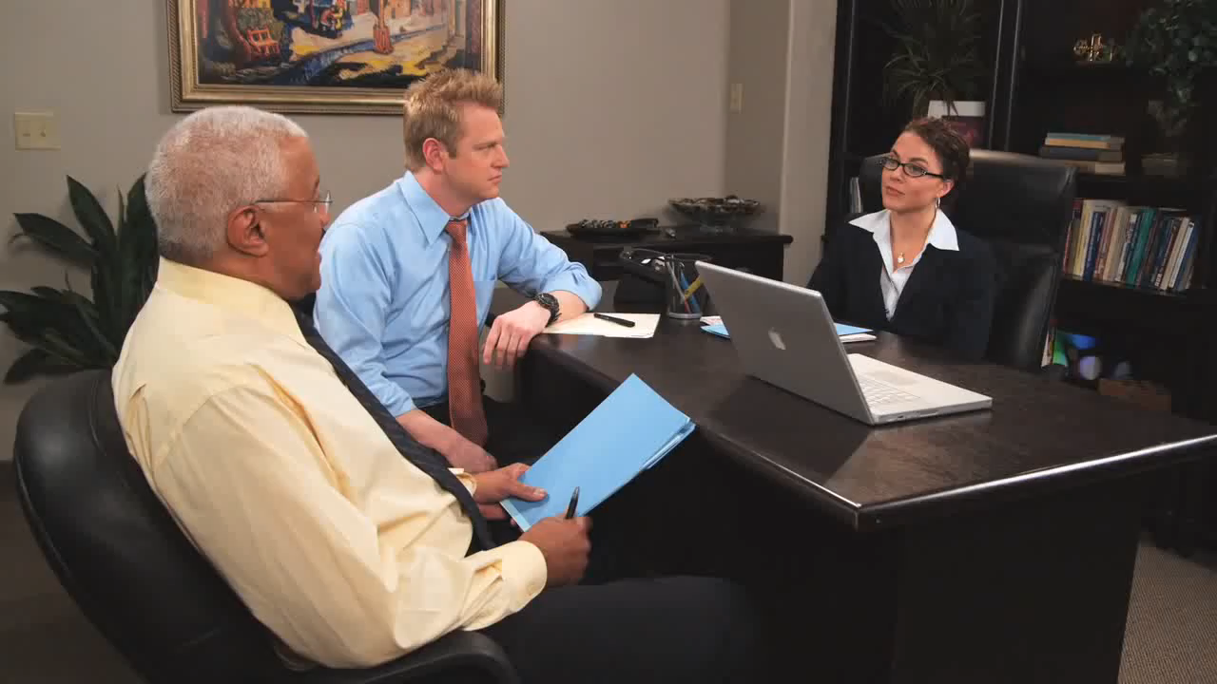
Jurassic Sales Call
12

Slide 4
Crucial Conversations
What makes a conversation “crucial” vs. typical?
  First, opinions vary
  Second, the stakes are high
  Third, emotions run strong

Slide 5
Crucial Conversations
How do we typically handle crucial conversations:
  We can avoid them
  We can face them and handle them poorly
  We can face them and handle them well

Slide 6
Crucial Conversations
Why don’t crucial conversations tend to go well?
  Emotions tend to rule
  Your body physically reacts
  We are under pressure
  We are stumped
  We act in self defeating ways

Slide 7
What are Common” Crucial Conversations?
Professional Personal
Giving the boss feedback
Informing a coworker about offensive behavior
Addressing a colleague’s work performance
Giving an unfavorable performance review
Dealing with the personal hygiene issue of a coworker
    Ending a relationship
    Asking a friend to repay a loan
    Resolving custody or visitation issues
    Dealing with a rebellious teen
    Confronting a loved one about substance abuse issues

Slide 8
Crucial Conversations
Why it is important to master crucial conversation skills:
  Kick Start Your Career
  Improve Your Organization
  Improve Your Relationships
  Revitalize Your Community
  Improve Your Personal Health

Slide 9
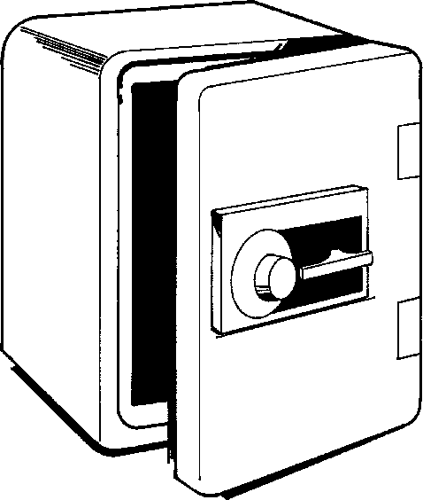
Crucial Conversations
Principals and Skills
Getting Unstuck
Start with heart
Learn to look
Make it safe
Master MY stories
STATE my path
Explore other’s paths
Move to action
  Review the Law of Crucial Conversations graphic

Slide 10
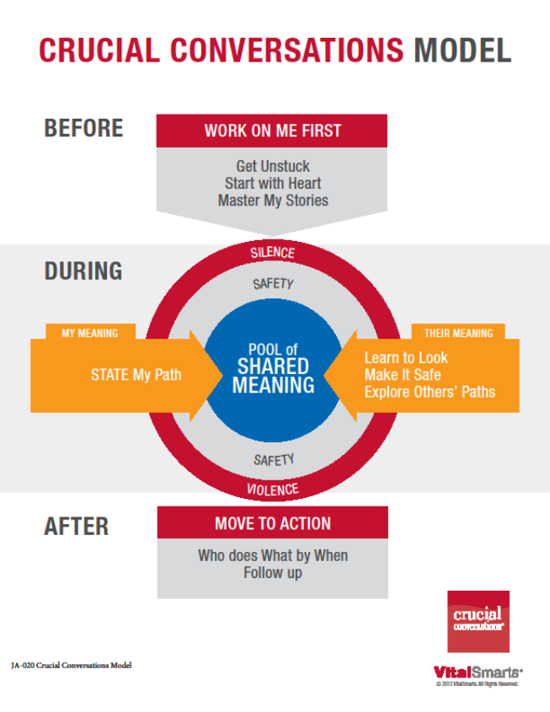
Law of Crucial Conversations

Slide 11
Before the Conversation
Work On Me First
  Get Unstuck
  Start with the Heart
  Master my Stories

Slide 12
Get Unstuck
Spot the conversations that are keeping you stuck
Critical Question:
  What conversations am I not holding or not holding well?

Slide 13
Get Unstuck
Table Discussion:
What conversations am I not holding or not holding well?
  Share an example of a conversation which is long overdue.
Am I holding the right crucial conversations?

Slide 14

Start with Heart
Work on me first
Focus on what you really want
Refuse the Sucker’s Choice

Slide 15
Start with the Heart Activity
Recall a tough conversation you’ve had that has left you frustrated and perhaps not getting the end results you had hoped for.
Complete T Chart in table groups.
10 Minutes
What was I thinking or
feeling and did not
actually say?
What was actually said

Slide 16
Start with Heart
Good communicators are aware of their own natural tendencies-particularly when they are under stress.
  How do you communicate when you are stressed?
  How do you communicate when you feel threatened?

Slide 17
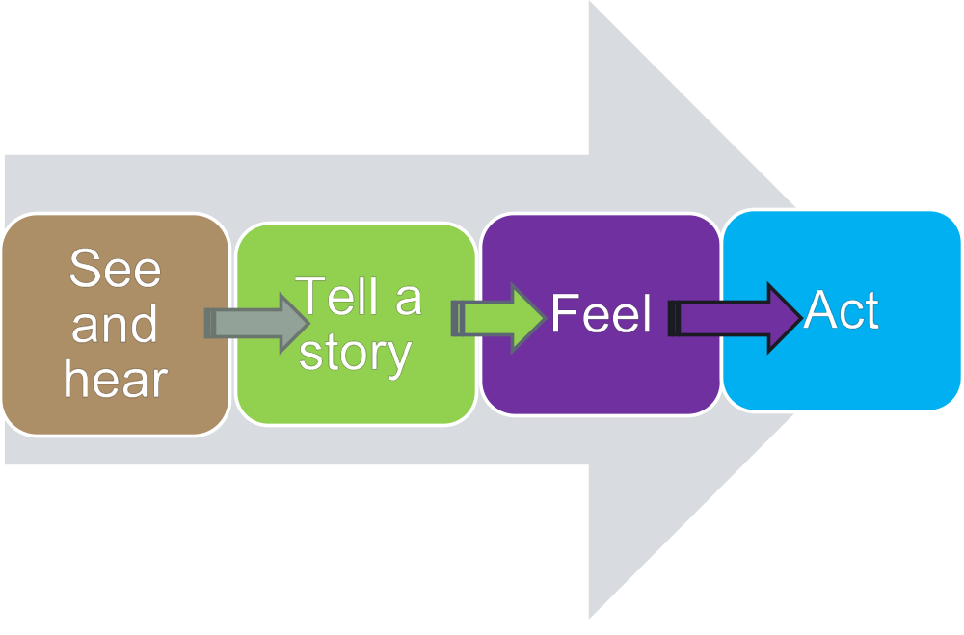
Master Your Story
12

Slide 18
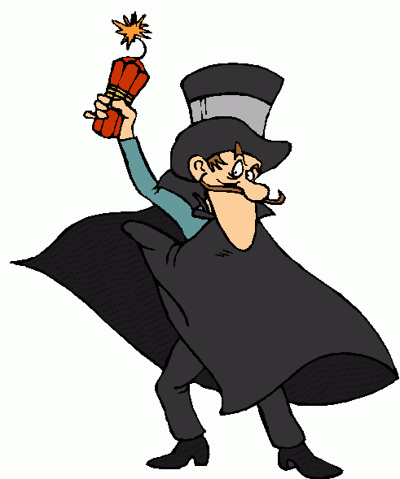
Master My Stories
Separate facts from stories
Watch for three clever stories
  Victim, Villain and Helpless
Tell the rest of the story

Slide 19
Master My Stories
Tell the rest of the story….
Am I pretending not to notice my role in the problem?
Why would a reasonable, rational, and decent person do this?
What should I do right now to move toward what I really want?
Activity: Watch video clip, how could this same example be applied workplace?

Slide 20
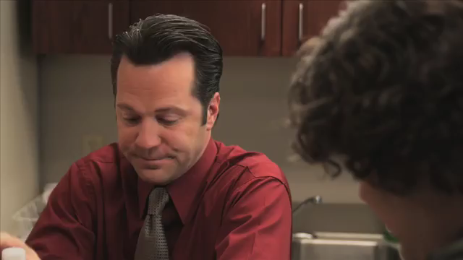
Performance Review
12

Slide 21
During the Conversation
My Meaning
  State My Path
Their Meaning
  Learn to Look
  Make It Safe
  Explore Other's Paths

Slide 22

Pool of Shared Meaning
Get information out in the open
Create a dialogue
Don’t debate, stay silent, or run away Contribute your information

Slide 23
STATE My Path
STATE:
  Share your facts
  Tell your story
  Ask for others’ paths (what)
  Talk tentatively
  Encourage testing (how)
Am I really open to others’ views?
Am I confidently expressing my own views?
My Meaning

Slide 24

Learn to Look
Look for when a conversation becomes crucial
Look for silence and violence
Learn to look for your own Style Under Stress
Their Meaning

Slide 25
Learn to Look
Am I noticing signs that safety is at risk?
Am I moving to my Style Under Pressure?
Activity: Take a few minutes to complete the survey independently.
-
Their Meaning

Slide 26
Learn to Look: Silence or Violence
Silence – Withholding information from the pool of meaning
Violence – Action taken to compel others to your way of thinking
The three most common forms of violence are:
  Controlling
  Labeling
  Attacking
Their Meaning

Slide 27
Make It Safe
Have I established Mutual Purpose?
Have I maintained respect?
Activity: Watch video clip. “Mutual Respect” Share an example of how we can “make it safe” for our staff members.
https://www.youtube.com/watch?v=_YnvaTnzV-0&index=4&list=PL114AB9079C66B3C9
Their Meaning

Slide 28
Make It Safe
Apologize when appropriate
Contrast to fix misunderstandings
Create Mutual Purpose
Their Meaning

Slide 29

Make it Safe – Mutual Purpose
USE CRIB to get to mutual purpose
Commit to seek mutual purpose
Recognize the purpose behind the strategy
Invent a mutual purpose
Brainstorm new strategies

Slide 30
Explore Others’ Paths
Explore with added AMPPs:
  Ask
  Mirror
  Paraphrase
  Prime
Am I actively exploring others’ views?
Their Meaning

Slide 31
After the Conversation
Move to Action
Turn crucial conversations in action and results
Decide how to decide
Document who does what by when and follow-up
How will we follow-up?
What is the plan from here?

Slide 32
Crucial Conversation
Planner Part 1
Individually, identify a needed Crucial Conversations
Complete the Crucial Conversation Planner
Be prepared to share in small groups
You have 20 minutes

Slide 33
Crucial Conversation
Planner Part 2
Divide into triads
Share a brief background about your needed Crucial Conversation to your triad
Deliver your conversation to your group
Provide supportive and corrective feedback to your team

Slide 34
Crucial Role Plays

Slide 35
Crucial Conversations Start with You!
https://www.youtube.com/watch?v=-TRB6YXU54A
“Tools for talking
when stakes are high”

