Slide 1
IMCOM
Communication Toolkit
December 2017

Slide 2
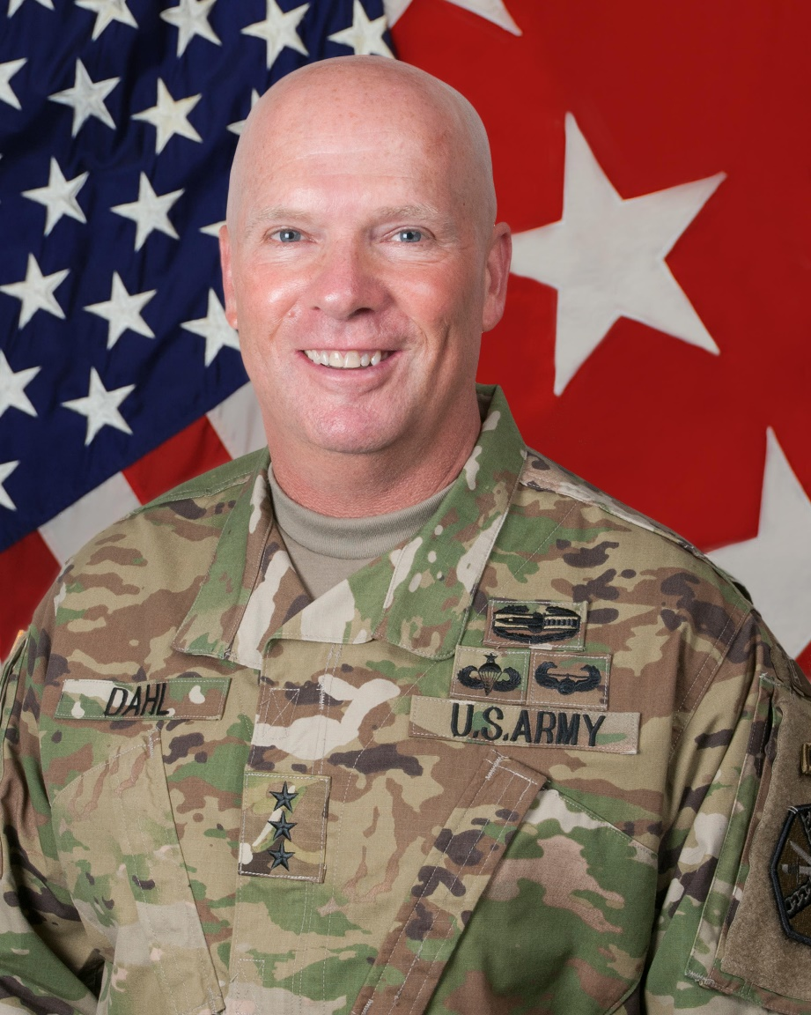
IMCOM Communication Toolkit
Foreword from the Commander
Introduction &
IMCOM professionals,
Defense Secretary Jim Mattis recently said, “Communications is the job of the Commander, not just the PAO.”
I need everyone’s help, and especially you, in communicating my intent. As the Army’s mission grows in complexity and scope, so does the IMCOM mission. The importance of maintaining understanding and trust with our workforce, our partners and tenant units, and the American public is more important than ever. It is imperative we stay consistent in our messaging, linking everything we do to our priorities, in order to unify our efforts and foster confidence in the things we do.
IMCOM’s service culture is built on a well-informed workforce. We must look for opportunities to engage IMCOM professionals about how they impact Army readiness. The service and relationships built by an informed workforce will benefit all tenant organizations on our installations.
Relationships with our communities outside the gate are equally important. An engaged public understands our mission and our challenges. Relationships we forge now increase our resilience and strengthen our capacity to answer our Nation’s call.
This toolkit provides my priorities in language you should use to facilitate a shared understanding across all of our audiences. Please use this resource as you achieve mission success.
LTG Kenneth R. Dahl,
IMCOM Commanding General

Slide 3
IMCOM Communication Toolkit
Table of Contents and Introduction
Introduction &
Who We are 4
What We Do 5
Where We Are 6
IMCOM Directorates 7
Writing/referring to
IMCOM Directorates 8
Divest, Reshape, Invest 9
Service Culture Initiative 10
Employee/Customer Pledges 11
Total Army Strong 12
IMCOM terminology 13-14
Guidance For Current Topics 15-24
Feedback address 25
The intent of this toolkit is to define and explain important IMCOM topics. It provides a macro level look at ongoing initiatives and the terms associated with them to facilitate a shared understanding of the commander’s intent across a complex and globally-dispersed workforce.
It clarifies terminology to set conditions for synchronized communications through FY 18.
Each section includes bullet comments that serve to educate as well as provide talking points. Use these to facilitate leader-to-led communications with IMCOM professionals and engage with community partners.

Slide 4

IMCOM Communication Toolkit
Who We Are
Our mission:
Our tagline:
Our role:
IMCOM integrates and delivers base support to enable readiness for a globally responsive Army.
“We are the Army’s Home.” This is about us and the work we do.
“Serving the Rugged Professional” describes our purpose and who we support.
Video: https://dvidshub.net/r/4rho2z
IMCOM is a supporting command. IMCOM’s energy and focus flow from the CG to the HQ staff and the IDs, then the IDs to the garrisons. It is at the garrison where it starts flowing back up, but in the direction of the senior commander.
Our vision:
Committed to Service – Enhancing Readiness – Foundation of the Army Culture
Our commitments :
Our Posture:
Our workforce :
We are committed to providing base operations support IAW established standards to accomplish the mission of all assigned installations.
We are committed to providing appropriate programs and services at the right time and place for our Soldiers and their Families.
IMCOM professionals are among the best in the world. We treat them as such by emphasizing engaged and caring leadership, fair and appropriate recognition, accountability, and empowerment. IMCOM professionals make a meaningful difference in the lives of those we support.
IMCOM is an agile organization that thrives in today’s dynamic environment. IAW Total Army Strong, IMCOM adjusts to manning and funding levels through normal, prudent, business decisions at echelon to balance competing resources.
As the world, nation and Army change, so will our command.

Slide 5
IMCOM Communication Toolkit
What We Do
Infrastructure
Addressing the urgent infrastructure challenges brought on by a decade of underinvestment. Provide facilities that enable speed of assembly and deployment.
Emergency Services
Meet DoD standards for emergency services such as law enforcement and firefighting.
Support to Training
Integrating and delivering services that enable demanding and realistic training to ensure our Soldiers and our formations are trained and ready to fight and win in combat.
Soldier Programs
Programs and services designed to support and assist Commanders to improve the readiness and resilience of individual Soldiers.
Family Programs
Programs and services designed to support and assist Commanders to enable Soldiers to build individual, collective and Family self-reliance, so Soldiers can solve their own problems and become/remain capable of meeting the unique demands of Army life.
READINESS
IMCOM Commanding General priorities were aggregated from CG visits to seventy-plus garrisons, balanced with our fiscal and operational environments and Army priorities.
Divest
Reshape
Invest
IMCOM will do a few things at the A or A-minus level rather than a lot of things at the C or C-minus level.

Slide 6
IMCOM Communication Toolkit
Divest, Reshape, Invest
POM 19-23 HQDA Approved Resourcing Strategy For Funding Installations = Divest, Reshape, Invest
The Army has directed IMCOM to divest of unsustainable programs and reshape those we are over-delivering. We will harvest those resources and apply them to unfunded, higher priority requirements.
IMCOM helps senior commanders make informed choices as they reshape service delivery to match customer demand.
As we help senior commanders balance resources, IMCOM remains accountable to performance standards that meet, but do not exceed, statutory requirements and DoD directives. Where no OSD/DoD standards exist, we will ensure our performance is commensurate with our sister services and remain responsive to patronage and usage data.
IMCOM is working to update constraining policies, streamline inefficient processes, and clarify priorities to collectively – and at echelon – determine where to focus available resources while providing commanders flexibility to tailor programs to meet local needs.
IMCOM continually assesses its options to provide fiscally-sustainable programs enabling Soldier and Family self-reliance.
IMCOM acknowledges that with fewer personnel and inconsistent funding, it must divest of non-essential tasks and operations to meet mission-essential requirements.
This process is part of what the Sergeant Major of the Army describes when he emphasizes that “it’s time to have a frank conversation about lowering expectations for future benefits” on Army installations.
Use this video to help explain to our workforce
https://dvidshub.net/r/ytez8r

Slide 7

IMCOM Communication Toolkit
IMCOM Directorates
IMCOM Garrison Alignment FY18-19
IMCOM HQ
IMCOM-
EUROPE
IMCOM-
TRAINING
IMCOM-READINESS
IMCOM-
SUSTAINMENT
IMCOM-
PACIFIC
AEC
Ansbach
Benelux
Brussels
Schinnen
Bavaria
Garmisch
Hohenfels
Rheinland-Pfalz
Baumholder
Stuttgart
Vicenza
Livorno
Wiesbaden
11 TRADOC Senior Commanders
  - Ft. Benning - Ft. Lee
  - Ft. Gordon - Ft. Lnd Wood
  - Ft. Huachuca - Ft. Rucker
  - Ft. Jackson - Ft. Sill
  - Ft Leavenworth
  - Ft. Knox
  - Presidio of Monterey
West Point (USMA)
Carlisle Barracks (AWC)
ASA Eustis (TRADOC)
Ft. Hamilton (USMA)
11 FORSCOM Senior Commanders
  - Ft. Bliss - Ft. Irwin
  - Ft. Bragg - Ft. Polk
  - Ft. Campbell - Ft. Riley
  - Ft. Carson
  - Ft. Stewart/HAAF
  - Ft. Drum
  - JBLM/Yakima
  - Ft. Hood
4 USAR Senior Commanders
  - Ft. Buchanan
  - Ft. McCoy
  - Hunter Liggett/Parks RFTA
  - ASA Dix/Devens RFTA
WSMR (ATEC)
7 AMC Senior Commanders
  - APG - Redstone
  - Natick - Rock Island
  - Picatinny - Detroit
  - Adelphi
MDW (4 Installations)
- Ft. Belvoir
- Ft. AP Hill
  - Ft. Meade
  - JB Myer-Henderson Hall
2 ATEC Senior Commanders
  Dugway
  Yuma
2 SOUTHCOM Installations
  Miami (SOUTHCOM)
  Soto Cano (ARSOUTH)
Ft. Detrick (MEDCOM)
ASA Ft. Sam Houston (ARNORTH)
Ft. Greely
JBER
Ft. Wainwright
Camp Casey
Daegu
Humphreys
Red Cloud
Yongsan
Hawaii
Kwajalein Atoll
PTA
Japan
Okinawa
7 Direct Reports
6 Indirect Reports
15 Direct Reports
16 Direct Reports
4 Indirect Reports
17 Direct Reports
9 Direct Reports
4 Indirect Reports

Slide 8
IMCOM Communication Toolkit
Service Culture Initiative
IMCOM’s Service Culture Initiative helps IMCOM mitigate the effects of reduced resources on both IMCOM professionals and our customers.
IMCOM’s service culture is built upon the fundamental premise that excellence in customer service is a byproduct of how we treat our IMCOM professionals. If they are happy, well-informed and cared for, they will convey this positive attitude toward our Soldiers and Families.
Promotes and fosters a return to the basics of leadership:
emphasizing engaged and caring leadership
fair and appropriate recognition
a comprehensive on-boarding program
accountability
empowering our people to make a difference in lives of those we support and invest in our Army professionals
Includes the branding of IMCOM:
internal branding (how we see ourselves) “We are the Army’s Home,”
external branding (how we see our customers) “Serving the Rugged Professional.”
Use this video to help explain to our workforce
https://dvidshub.net/r/fcpdyz

Slide 9
IMCOM Communication Toolkit
Service Culture Initiative
The IMCOM Leadership Pledge:
Taking care of our customers begins with taking care of our most valuable asset – our IMCOM Professionals.
IMCOM Leaders will provide our team members the same concern, respect and caring attitude that we expect them to share with our customers – Soldiers, Families, Civilians and Retirees.
We pledge to position you for success with:
An impactful on-boarding and orientation experience to welcome you to the IMCOM Team.
Clear performance standards, to include standards for service excellence.
An Individual Development Plan developed with your supervisor and reviewed during periodic counseling.
Opportunities for personal growth and professional development.
A recognition program to reward service and performance excellence.
Engaged leaders who seek and welcome your input and take action to continuously improve.
An organization that embraces the concepts of team, teamwork and empowerment.
A promise to hold ourselves and each other accountable.
The IMCOM Pledge to our Customers:
IMCOM acknowledges the special contribution and sacrifice of Soldiers and their Families to our Nation. As a service provider organization, we are committed to providing programs and services delivered with a sense of individual pride, professionalism, and in keeping with the spirit of Army and IMCOM values.
We create value for our customers through consistent and easily-accessible service.
We will:
Deliver products and services to established Army standards
Build relationships with our communities, our customers, and each other.
Be kind and respectful to those we serve.
Conduct ourselves professionally.
Welcome and encourage feedback; we will communicate and listen.
Provide neat, professional and aesthetically pleasing facilities.
Take ownership of our actions.

Slide 10
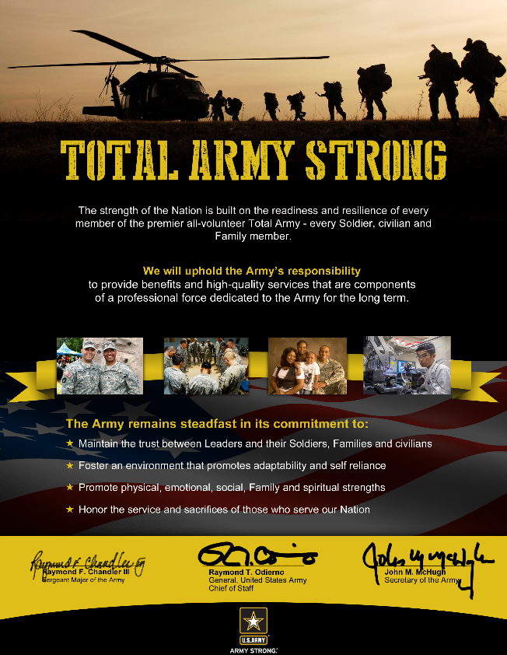
IMCOM Communication Toolkit
Total Army Strong
Total Army Strong:
  Is an Army-level program initiated in 2014.
  Is the successor to the Army Family Covenant.
  Ensures the most essential programs to promote a strong and ready Army.
  Gives commanders flexibility to tailor and prioritize based on local considerations.
  Allows decisions to be made strategically, but executed locally (Divest, Reshape, Invest).
The Army is striking a new balance to support the premier, all-volunteer Army through responsible stewardship, program assessment, and the promotion of self-reliance. This will ensure a sustainable balance of services to promote long-term Soldier and Family readiness. The Army will continue to refine programs to ensure they efficiently serve the most critical needs of the Soldiers, Family members and Civilians.

Slide 11
IMCOM Communication Toolkit
IMCOM Directorates
Writing or Referring to IMCOM Directorates
Director
The SES who leads one of five IMCOM Directorates. Refer to this individual as “Director,” or the full title such as “Director, IMCOM-Training.”
Deputy Director
The Colonel at each of the five IMCOM Directorates. Refer to this individual as “Deputy,” or the full title such as “Deputy Director, IMCOM-Sustainment.”
Staff Director
The military or civilian leader at IMCOM HQ who leads a staff directorate.
ID
IMCOM Directorate, the organization that is the intermediate echelon between IMCOM HQ and the garrison. Plural is IDs. Refer to individual Directorates by their full name, with a hyphen between IMCOM and the name (i.e. IMCOM-Europe).
IDs
IMCOM Directorates. Do not use as an abbreviation for IMCOM Directors. The “s" should always be lowercase. No apostrophe.
The IMCOM Directorate Naming Convention
Spelling out IMCOM reminds everyone, particularly supported units, that our Directorates remain a part of IMCOM even though located with the supported unit. The hyphen connotes strength of this connection, and the directorate’s full name identifies their Supported ACOM’s area of focus.
IMCOM-Europe
The IMCOM Directorate located in Germany that supports US Army Europe. Written and referred to as IMCOM-Europe. Do not abbreviate.
IMCOM-Pacific
The IMCOM Directorate located in Hawaii that supports US Army Pacific Command. Written and referred to as IMCOM-Pacific. Do not abbreviate.
IMCOM-Readiness
The IMCOM Directorate located at Fort Bragg which directly supports Forces Command, Army Test and Evaluation Command (White Sands Missile Range) and Army Reserve Command. Written and referred to as IMCOM-Readiness. Do not abbreviate.
IMCOM-Sustainment
The IMCOM Directorate located at Redstone Arsenal which directly supports the Army Materiel Command, Military District of Washington, Army Test and Evaluation Command, MEDCOM, and SOUTHCOM. Written and referred to as IMCOM-Sustainment. Do not abbreviate.
IMCOM-Training
The IMCOM Directorate located at Joint Base Langley-Eustis which directly supports Army Training and Doctrine Command, the United States Military Academy, Fort Hamilton, and the Army War College. Written and referred to as IMCOM-Training. Do not abbreviate.

Slide 12
IMCOM Communication Toolkit
The IMCOM Glossary
Complex and Globally-Dispersed Workforce
Refers to the IMCOM workforce, made from a diverse cross section of the world population. It includes members of virtually all races and age groups, both sexes, uniformed and civilian personnel, and foreign nationals dispersed throughout the globe.
Continuing Resolution
An appropriations bill that provides funding for operations, personnel, equipment and certain activities while a Federal Budget is being developed or approved.
Defense Performance Management and Appraisal (DPMAP)
The new DoD / IMCOM rating system for appropriated fund professionals.
Garrison
An Army organization using tables of distribution and allowance designed to integrate and deliver base operations support activities on an installation.
Incremental Funding
Paying for or providing funds for services or purchases over time. Usually impacts the ability to save through economy of scale and requires increased administrative support.
Installation
An aggregation of contiguous or near continuous, real property holdings under the jurisdiction of the DoD.
Installation Funding Strategy
Divest, reshape, invest.
Installation Reinforcing Support
Formerly called “Hub and spoke.” The mutual sharing of existing base operations services among installations.
Less with less
The realistic understanding that acknowledges with fewer personnel and less funding, IMCOM – in support of senior commanders - must make difficult decisions to determine what to divest and reshape, in order to invest.
On-boarding
The systematic and consistent approach to integrating new professionals into the organization. An important element of the IMCOM service culture initiative.
POM – Program Objective Memorandum
A recommendation from the Services and Defense Agencies to the Office of the Secretary of Defense outlining how they plan to allocate resources to meet the Service Program Guidance and Defense Planning Guidance. It shows programmed needs for the next five years.
Rugged Professional
The Soldiers we support. Soldiers expect tough conditions and difficult missions; they must thrive in austere environments. A ready Army is made up of warriors experienced, trained, and prepared to win in a complex world.

Slide 13
IMCOM Communication Toolkit
The IMCOM Glossary
Senior Commander (SC)
Normally the senior general officer at the installation. The SC’s mission is the care of Soldiers, Families, and Civilians, and to enable unit readiness. While the delegation of senior command authority is direct from HQDA, the SC will routinely resolve installation issues with the IMCOM Directorate and, as needed, the associated ACOM, ASCC, or DRU.
Service Provider’s Forum
A recurring meeting where Commanding Generals of ASC, IMCOM, MEDCOM, MICC, NETCOM, USACE and others meet to integrate efforts at an enterprise level. Beginning in December 2017, the Vice Chief of Staff of the Army (VCSA) will chair the meeting occasionally.
Spartan Plus WiFi
Refers to the conditions Soldiers can expect to find while deployed or in austere enduring locations like Rodriguez Range in South Korea, or Novo Selo in Bulgaria. The phrase recalls Greek warriors who lived a life of strict self-discipline marked by simplicity, frugality, and the avoidance of luxury and comfort. While deployed, Soldiers can expect a fitness facility with limited cardio and free weights, a place to sleep and conduct personal hygiene, baseline WiFi that may need to be rationed by unit leadership due to bandwidth, dining facility and laundry support, a common area that will include limited library, AFN TV, some sort of recreation equipment (billiards, darts, foosball), etc.
Staff Director
The military or civilian leader at IMCOM HQ who leads a staff directorate.
Support Relationships
Describes the interaction between various organizations in the Army. e.g., the interaction between IMCOM-Readiness and FORSCOM. ACOMs and their SCs at installations are supported commanders.
Supported Command
ACOM or ASCC the IMCOM Directorate supports.
Supporting Command
IMCOM (IMCOM Directorates)
Year of Execution
The fiscal year in which funds must be used. While IMCOM maintains a 3-5 year planning horizon to minimize things like contract interruptions, the primary focus is executing programs in the current fiscal year. This focus allows IMCOM to assess and clarify program requirements. This quality data on execution informs the formulation of the POM.

Slide 14
IMCOM Communication Toolkit
Current Topics
Communication Guidance
For Current Topics
The IMCOM communication Toolkit is a living document and will be updated as circumstances warrant.

Slide 15

UNCLASSIFIED/FOUO
IMCOM PAG on a Page: Service-For-Life
IMCOM Organizational Goal(s): Integrate and deliver base support to enable readiness for a globally-responsive Army.
Primary Audience: Retirement Services Offices, Retired Soldier Councils, Veteran Service Organizations (VSOs). This audience is tied to our installations by function, and have direct contact with potential volunteers.
Communications Goal: Garrison Commanders, Retirement Services Offices (RSO) and garrison Public Affairs Offices will engage Retiree Councils, veteran and retired Soldiers and their spouses, and Veteran Service Organizations to increase understanding of current manpower and money shortfalls that are driving changes in the manner and amount of services on Army installations, and how volunteers can mitigate this impact.
Secondary Audiences: ACS Volunteer Coordinators, IMCOM Professionals, and Veterans and Retired Soldiers and their Spouses (a group tied to us through their legacy of service).
Key Message: Retirement Services Offices are uniquely positioned to connect Soldiers for Life with opportunities to volunteer locally.
End state: Garrisons increase use of retired Soldiers, their spouses and veterans as volunteers to mitigate the impact of resourcing shortfalls on garrisons.
Strategy Statement: Veteran and retired Soldiers and their spouses have both a capacity and propensity to serve. IMCOM is uniquely positioned and empowered to connect these Soldiers for Life with opportunities to volunteer on the installation. Garrison leaders should use this guidance in community engagements to encourage the volunteer spirit at the local level. Garrison Public Affairs supports this through the community relations and command information programs, and social media. RSOs and garrison leaders have daily contact with local veteran and retired Soldier communities and can engage them to explore ways to serve. Soldiers for Life still wear the uniform in their hearts, and as IMCOM works to implement changes to program and service delivery at the local level, providing volunteer opportunities allows them to give back at a time when we really need their help.
Talking Points:
We, as a Nation, are committed to taking care of our veteran and retired Soldiers. IMCOM is just part of the national team.
IMCOM is not funded to provide installation services to veteran and retired Soldiers, but rather does so on a space available basis.
We need help. IMCOM now receives about a billion dollars less per year and is providing programs and services with about 4,000 fewer people than in FY15.
Volunteers have served proudly since the early years of our country, mending uniforms, caring for the sick and wounded, and comforting Families of fallen Soldiers.
Volunteering is a great way to continue serving and to stay in touch with America’s Army.
Through their dedicated service, volunteers transform military installations into communities.
We welcome veteran and retired Soldiers and value their feedback.
Volunteering means working with others to make a meaningful contribution to a better community.
Veteran and retired Soldier volunteers have a unique opportunity to match their talents and interests with needs on the installation, to make a positive impact,, and to feel the satisfaction of contributing to the Army Team.
Bill Costlow, IMPA, (210) 466-0708/William.r.costlow.civ@mail.mil
UNCLASSIFIED/FOUO
20171001

Slide 16
UNCLASSIFIED/FOUO
IMCOM PAG on a Page: Community Ready and Resilient Integrator (CR2I)
IMCOM Organizational Goal(s): Integrate and deliver base support to enable readiness for a globally-responsive Army.
Primary Audience: Senior Commanders/Senior Responsible Officers, ID Directors, Garrison Commanders.
Communications Goal: Key stakeholders, understand the role of Community Readiness and Resiliency Integrators (CR2Is) with Ready and Resilient (R2) initiatives at installations.
Secondary Audience: Garrison PAOs play a vital role in communicating Commander’s intent. CR2Is will rely heavily on PAOs to inform audiences of R2 initiatives at installations. Effective communication of R2 initiatives will require a solid relationship between CR2Is and PAOs and a shared understanding of Commander’s intent.
Key Message: CR2Is will integrate and synchronize R2 initiatives at installations for SC/SROs.
End state: Stakeholders and PAOs understand and enable CR2Is in health promotion efforts to integrate and synchronize R2 initiatives at installations.
Strategy Statement: The U.S. Army Manpower Analysis Agency’s (USAMAA) 2015 review of health promotion tasks found redundancies between HPO-supported activities in the CHPC process and other Army prevention activities. The integration of installation services is an IMCOM task. In order to reduce redundancies, IMCOM CR2Is will support SC/SROs with a holistic functional approach towards health promotion and R2 integration. SC/SROs will provide direction to CR2Is for integration of R2 initiatives at their installation. CR2Is will merge CHPC tasks with prevention efforts, resulting in seamless integration of services with minimal disruption. IMCOM integrates installation services best when it communicates support at the garrison level. Conversations between IMCOM Directors, SCs, GCs and PAOs will help facilitate a shared understanding of Commander’s intent to make this effort successful.
Talking Points:
The health of Soldiers, Families and Civilians is key to readiness and remains a priority for the Army.
CR2Is will provide more efficient delivery of R2 services by synchronizing communications, resources and processes.
CR2Is will integrate and synchronize multiple initiatives to improve the readiness and resilience of the Total Army – Soldiers, Families and Army Civilians.
CR2Is will implement health/readiness initiatives which support the vision, mission, priorities and requirements of the SC/SRO.
CR2Is will analyze and tailor R2 initiatives to fit the requirements of the installation in accordance with the tenants of Total Army Strong.
CR2Is will streamline CHPC efforts with existing prevention initiatives and adjust resources to improve readiness.
CR2Is will set the conditions to successfully transform R2 support for the next phase of the operation.
Nate Allen, IMPA, (210) 466-0687/nathaniel.d.allen.civ@mail.mil
UNCLASSIFIED/FOUO
20171001

Slide 17
UNCLASSIFIED/FOUO
IMCOM PAG on a Page: Service Culture Campaign
IMCOM Organizational Goal(s): Integrate and deliver base support to enable readiness for a globally-responsive Army.
Primary Audience: IMCOM Civilian professionals at every level and at every installation across the IMCOM enterprise.
Communications Goal: Show IMCOM Civilian professionals that IMCOM leaders at all levels of the organization are committed to valuing, respecting and empowering the IMCOM workforce. Tell IMCOM customers about IMCOM’s commitment to a culture of superior customer service.
Secondary Audiences: IMCOM supported units, organizations, Soldiers and Families at 70+ installations across the IMCOM enterprise
End state: IMCOM Civilian professionals understand that IMCOM leaders at all levels of the organization are committed to valuing, respecting and empowering the IMCOM workforce. IMCOM supported organizations and customers understand IMCOM’s commitment to a culture of superior customer service.
Key Message: IMCOM has a long-term commitment to providing the best possible customer service to Soldiers, Families, and communities. Excellence in customer service is a result of how an organization treats its employees.
Strategy Statement: IMCOM Communicates best with its workforce and its customers at the local installation level. IMCOM will leverage its network of information outlets managed by 300+ public affairs professionals at more than 70 installations to tell the IMCOM Service Culture story in the most effective ways, using the most effective means on an installation-by-installation basis. The HQ IMCOM PAO will provide big-picture talking points and an SCI launch story. Public affairs leaders at each installation will develop local communication products to tailor the IMCOM SCI story to their workforce and key audiences. The HQ IMCOM PAO will provide support, communication products and information to IMCOM garrison PAOs as needed. HQ IMCOM PAO will work to help find a broader, Army-level audience for installation-level SCI success stories.
Talking Points:
IMCOM has a long-term commitment to providing the best possible customer service to Soldiers, Families, and communities.
Excellence in customer service is a result of how an organization treats its employees.
If employees have engaged and caring leaders, feel valued and respected for the work they do, are properly trained, and live the Army values, they will in turn pass forward this positive attitude to their customers and to their co-workers.
All employees deserve respect and the basic tools needed to be successful, including proper on-boarding, performance standards, training opportunities, recognition programs, empowerment, and a commitment to hold one another accountable.
We want to establish a culture where members of the IMCOM team take pride in the organization, fully understand and live by our organizational values, feel valued and respected, and are led by engaged and caring leaders.
Creating a culture of excellence in customer service will take the combined effort and commitment of every IMCOM professional to be successful.
Scott Malcom, IMPA, (210) 466-0716/scott.f.malcom.civ@mail.mil
UNCLASSIFIED/FOUO
20160309

Slide 18
UNCLASSIFIED/FOUO
IMCOM PAG on a Page: Intergovernmental Support Agreements
IMCOM Organizational Goal(s): Integrate and deliver base support to enable readiness for a globally-responsive Army.
Primary Audience: Garrison staff: contract, agreement, and resource managers; DPW, SJA, PAO, and Army Commanders. Public partners: any agency or instrumentality of a local or State government.
Communications Goal: Garrison Commanders, senior members of their staffs, and municipal and elected leaders will understand the value and potential savings of public-public partnerships.
Secondary Audiences: Community leaders, reporters, bloggers.
Key Message: Garrison installation support service contracts that are converted to Intergovernmental Support Agreements (IGSAs) average a 25% savings to IMCOM. IMCOM Commanding General encourages garrisons efforts to look for IGSA opportunities.
End state: An institutionalized mindset that incorporates public-public partnerships to enhance mission readiness in an era of reduced resources.
Strategy Statement: Garrison staff members will engage with their local and state counterparts and open a dialog to explore IGSA opportunities.
Talking Points:
IGSAs are a vital component of reshaping to identify and harvest resources. On average, the Army realizes a 25% cost reduction for installation support services provided through IGSAs with local or state government partners.
IGSAs represent a way of partnering to provide, receive, or share installation support services. IGSAs are not contracts, they are public-public partnerships.
Army leaders acknowledge the important roles played by contracting partners. IGSA’s are not meant to replace contracts or contractors, but are cooperative way to strengthen our communities while enabling readiness in a cost-effective manner.
IGSAs serve the interest of the Army if they enhance mission readiness or create efficiencies and economies of scale.
HQ IMCOM is currently running a multi-million dollar IGSA program, resulting in significant cost savings and avoidance.
The goal of the IGSA program is to enhance mission viability and improve quality of service for Soldiers while implementing collaborative projects that reduce redundancies, costs, and risks through relationships that provide mutual value to the government and local communities.
IGSAs may be entered into on a sole source basis between the U.S. Army and the public partner. IGSAs are not required to use Davis-Bacon or Service Contract rates and may employ the wage rates paid by the State or local government.
IGSAs provide relief from the rigor and complexity of the Federal Acquisition Regulations that govern traditional procurement contracts.
IGSAs cannot be used for security guard or fire fighting functions.
Not all partnership concepts will result in an IGSA. We must explore the entire partnership spectrum to maximize partnership benefits.
Bill Costlow, IMPA, (210) 466.0708/william.r.costlow.civ@mail.mil
UNCLASSIFIED/FOUO
20171001

Slide 19
UNCLASSIFIED/FOUO
IMCOM PAG on a Page: EFMP Respite Care
IMCOM Organizational Goal(s): Integrate and deliver base support to enable readiness for a globally-responsive Army.
Primary Audience: Soldiers and Families.
Communications Goal: Increase understanding of changes to the Respite Care component of the Army’s Exceptional Family Member Program (EFMP), and provide information on the Army installation funding strategy of divest, reshape, and invest, and its impact to service delivery on Army installations.
Secondary Audiences: American Public, Congress, State and local officials, media.
End state: Rugged professionals and their Families are aware of why IMCOM services on Army installations are being adjusted, particularly the reshaping of EFMP respite care. The secondary audience has a better understanding of IMCOM’s stewardship of limited resources and what it costs to sustain our all-volunteer Army.
Key Message: IMCOM is reshaping EFMP Respite Care to a level consistent with established standards in order to sustain the program’s viability for the long-term, and invest resources in the Army’s critical readiness needs today.
Strategy Statement: The Reshaping of EFMP Respite Care is in progress. Last year, IMCOM notified Army families enrolled in EFMP Respite Care of the intent to reshape services to levels 3 and 4 only. Over the past 16 months, garrison EFMP Managers and System Navigators have helped levels 1 and 2 recipients understand the change and seek alternative care solutions. HQ IMCOM PA provides overarching guidance to directorate / garrison PAOs and responds to queries. Garrisons actively engage audiences to explain the reshaping details of EFMP Respite Care in their communities.
Talking Points:
In 2007, during a period of high operational tempo in the Army, EFMP added a respite care component to provide a temporary rest period for Family members with a deployed Soldier who provide regular care for dependents with special needs. Over time, the program grew beyond the standard required by DoD directive; it is not sustainable.
EFMP respite care provided four levels of in-home temporary care – as validated by a physician: 1 & 2 services included supervision with experience in safety and managing difficult behavior; 3 & 4 services provides for one-on-one special assistance and for life threatening or chronic conditions.
Last year, garrisons notified Army EFMP respite care families they would reshape delivery to levels 3 and 4 recipients only. Over the past 16 months, EFMP managers and System Navigators at garrisons assisted levels 1 and 2 recipients in finding alternative solutions, and will continue to do so.
EFMP Respite Care is not defined or limited by the budget at a garrison, but by the number who qualify for a level of care, based on established guidelines.
As we balance limited resources, IMCOM remains accountable to performance standards that meet, but do not exceed, statutory requirements and DoD directives. Where no OSD/DoD standards exist, we will ensure we perform on par with our sister services and remain responsible to patronage and usage data. Preserving the world’s premiere Army requires a fine balance of resources and requirements to meet the expectations of an all-volunteer force.
Robert Dozier, IMPA, (210) 466-1002/robert.s.dozier.naf@mail.mil
UNCLASSIFIED/FOUO
20171001

Slide 20
UNCLASSIFIED/FOUO
IMCOM PAG on a Page: Emergency Services
IMCOM Organizational Goal(s): Integrate and deliver base support to enable readiness for a globally-responsive Army.
Primary Audience: Garrison leaders and IMCOM civilians involved in protection and emergency management and response efforts.
Communications Goal: Increase understanding and support of IMCOM’s investment in emergency services and the Prevent, Protect, Mitigate, Respond and Recover (P2MR2) capabilities.
Secondary Audiences: Soldiers, Families and Civilians living and working on IMCOM installations. Local, state and federal emergency response partners and local officials. American public, Congress, media.
Key Message: Safety, security and preparedness are community responsibilities, and are essential to the readiness and resiliency of our installations.
End state: Garrison leaders understand and support IMCOM’s investment in emergency services and exercise P2MR2 capabilities at installations in compliance with the National Incident Management Standards (NIMS).
Strategy Statement: IMCOM is investing in P2MR2 capabilities in order to maintain readiness, protect its people and assets, and sustain the mission. IMCOM emergency service professionals communicate with local stakeholders to increase understanding, build relationships, and increase interoperability. IMCOM Provost Marshall/Force Protection (PMP) has two forthcoming operations orders which will provide guidance for execution and training of emergency services and NIMS compliance: Force Protection OPORD and the IMCOM Protection Training and Full Scale Exercise (FSE) Implementation Guidance.
Talking Points:
Everyone on an installation has a role in security and preparedness. Increasing communication about IMCOM emergency services will help our communities understand their roles and responsibilities.
IMCOM’s Full Scale Exercise (FSE) Program assists with exercise planning, design and execution, and provides comprehensive FSE observations on demonstrated P2MR2 capabilities.
IMCOM PMP will hold 30 courses per year, designed to build P2MR2 capabilities at installations through 5 areas of study: Emergency Operations Center Course, Exercise Evaluator Course, Response and Recovery Course, Basic Emergency Manager Course and Advanced Emergency Manager Course.
FSE evaluation responsibilities are shared by subject matter experts (SMEs) from installations across the Command, providing for objective evaluations and greater sharing of expertise across the enterprise.
IMCOM HQ PMP will assist installations with the development of exercise plans.
Installation exercises will grow in scope and complexity over time, to include participation from outside agencies, in order to develop and rehearse plans for emergencies which are beyond Garrison capabilities.
Nate Allen, IMPA, (210) 466-0687/nathaniel.d.allen.civ@mail.mil
UNCLASSIFIED/FOUO
20171001

Slide 21
IMCOM Communication Toolkit
Point of Contact
Scott Malcom
Scott.f.Malcom.civ@mail.mil
210-466-0716
DSN: 450-0716
The IMCOM communication Toolkit is a living document and will be updated as circumstances warrant.

